Slide 1

Timoney, Roscrea,
Co. Tipperary.

Slide 2
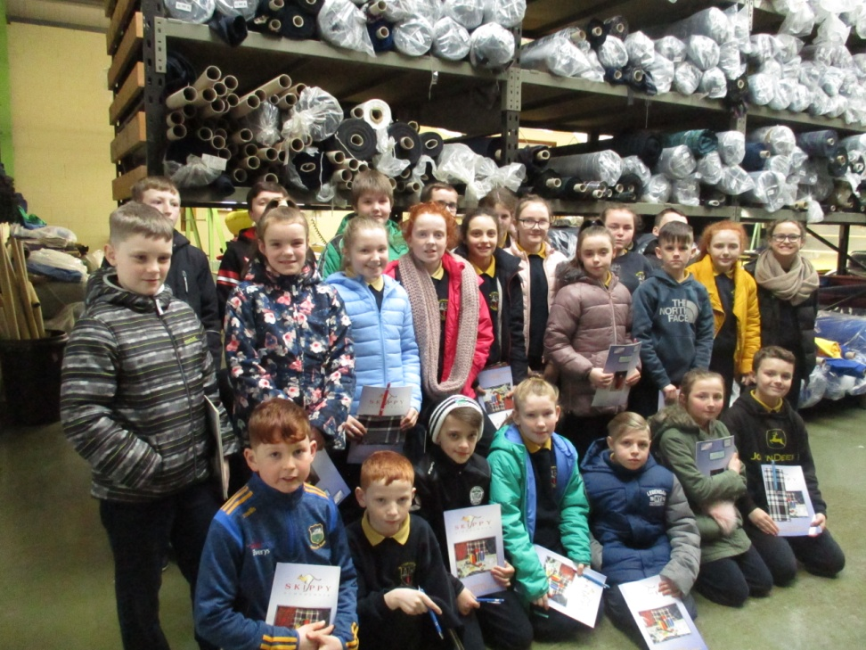
On the 5th of February 2019, Ms. Madden’s 5th class visited Skippy International Ltd. Skippy’s is one of Ireland’s leading school wear manufactures and distributors. It is a 100% Irish owned family business who have been producing garments for over 30 years.

Slide 3
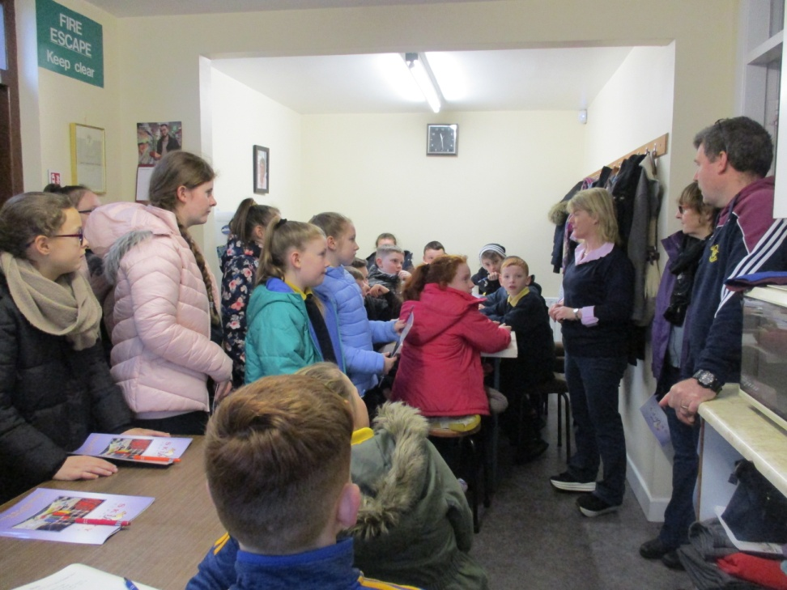
Keith and Kathleen gave us a tour of the factory and guided us through the all the stages of production. We even got to see how our own school uniform is made!

Slide 4
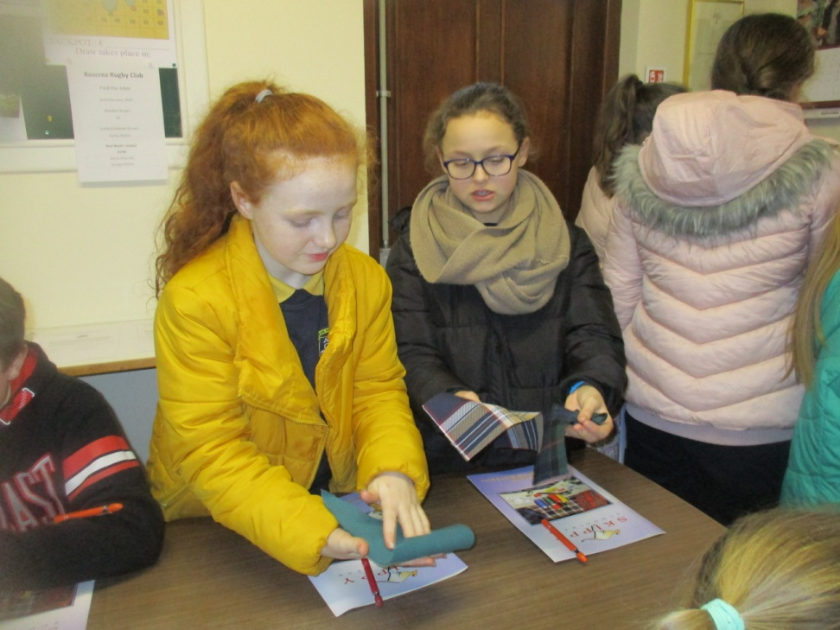
We learned about the different types of fabric and materials and how they are used in the production of school wear.

Slide 5
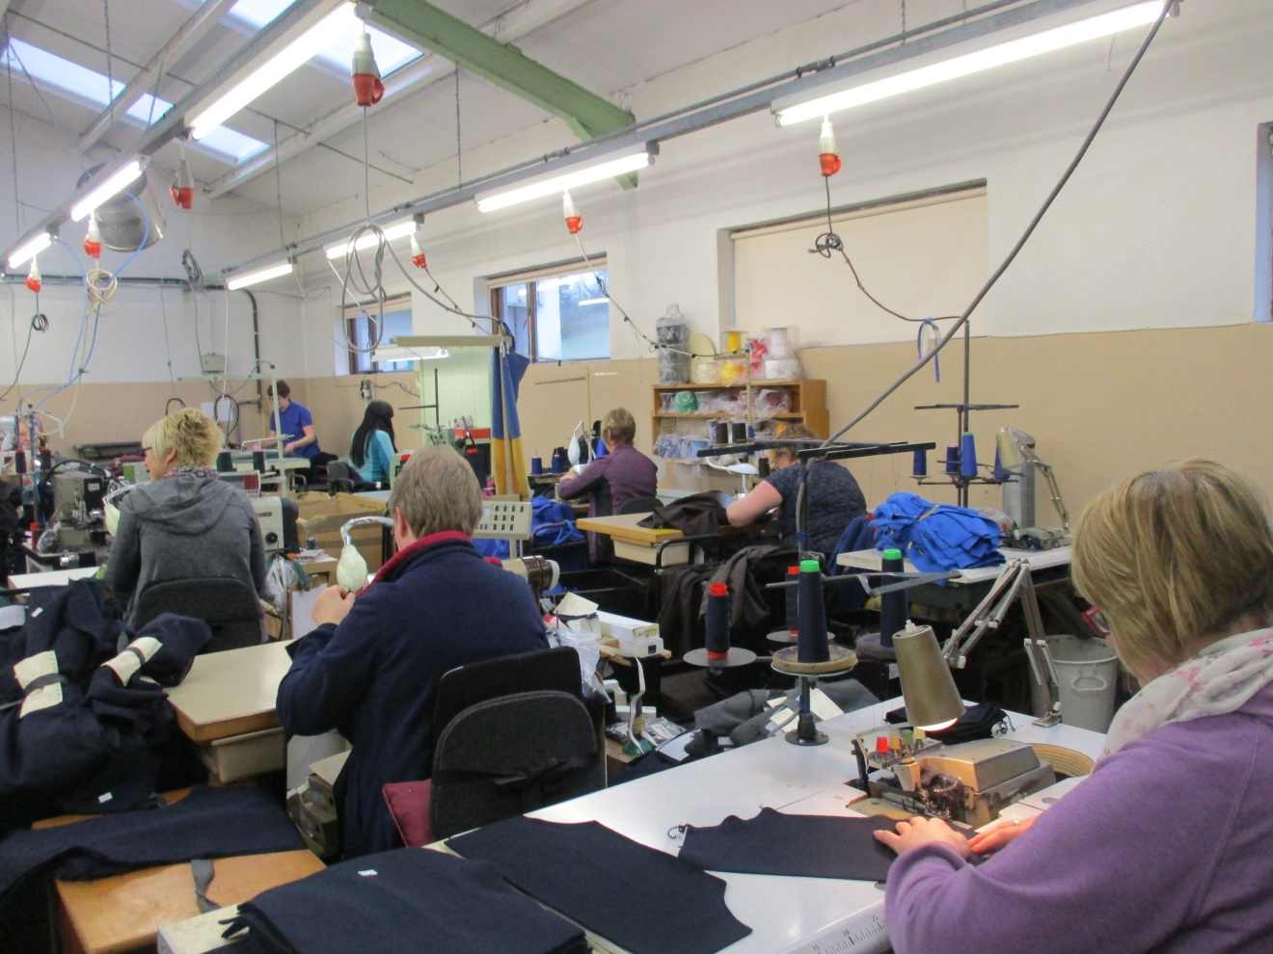
Different stages of production
Have a look at some pictures of workers doing a variety of jobs; cutting, sewing, pressing and much more!

Slide 6
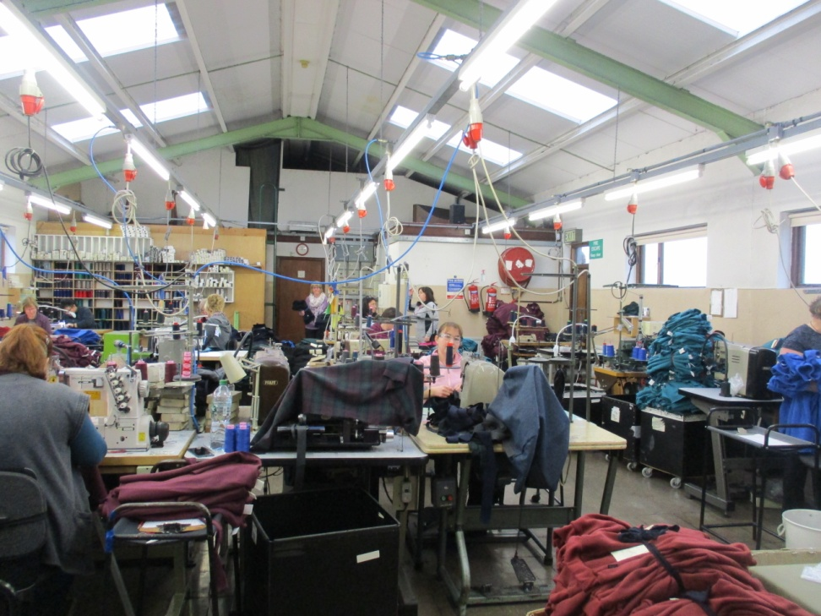
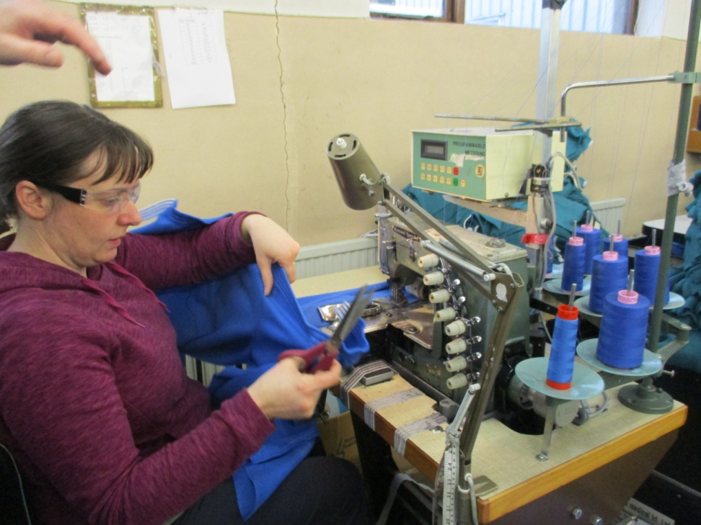

Slide 7
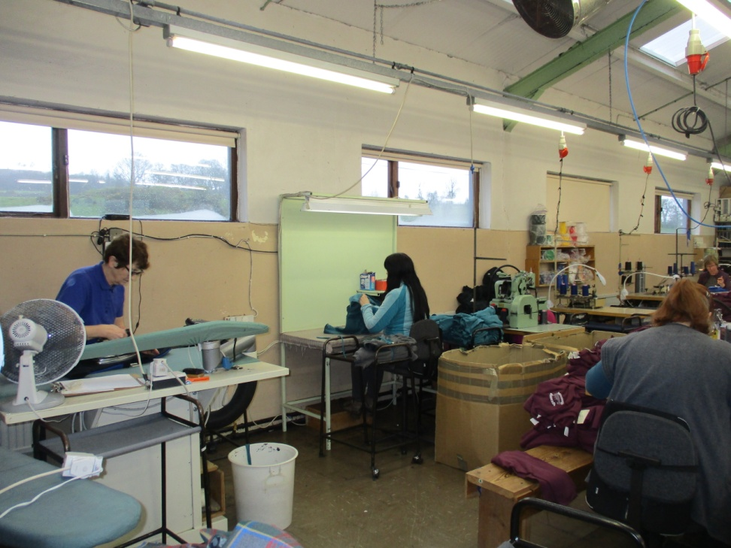
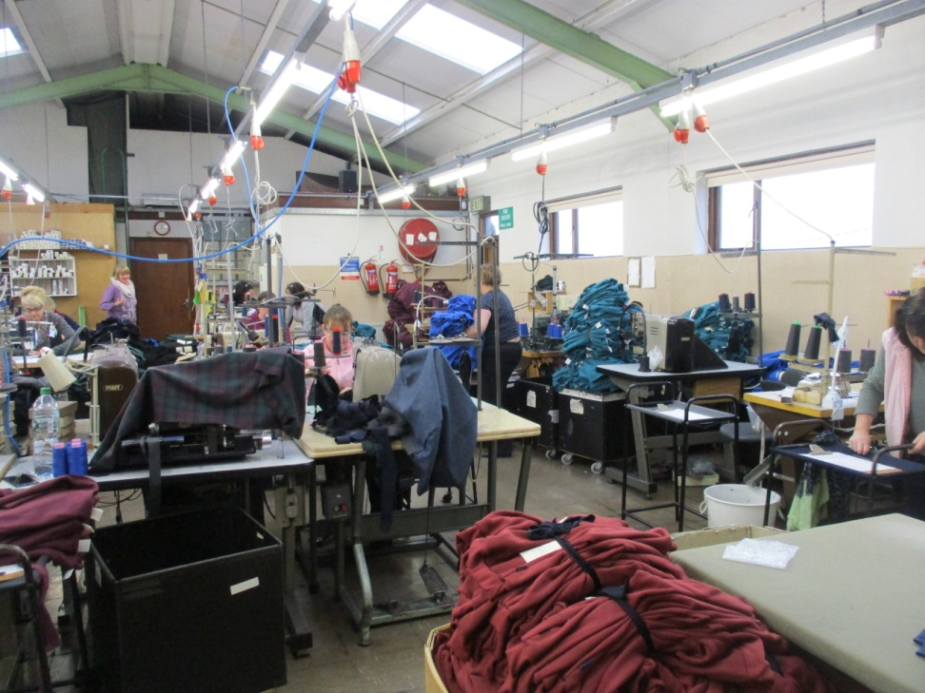

Slide 8
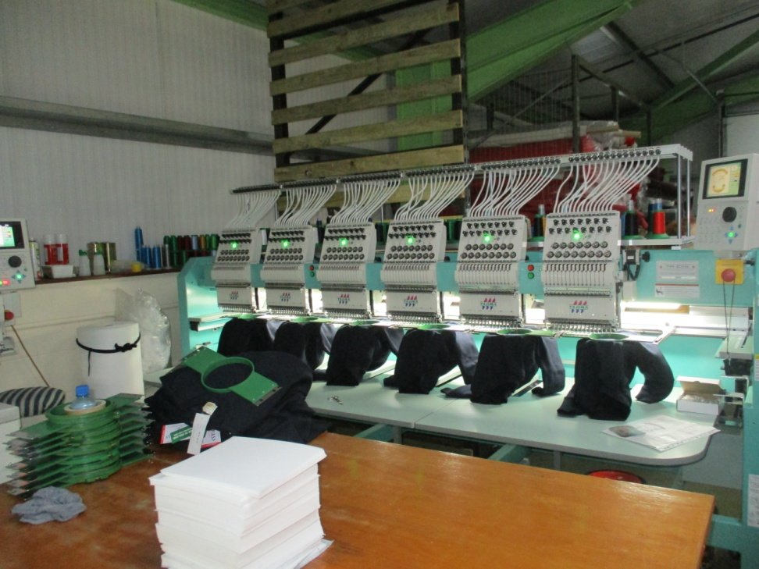
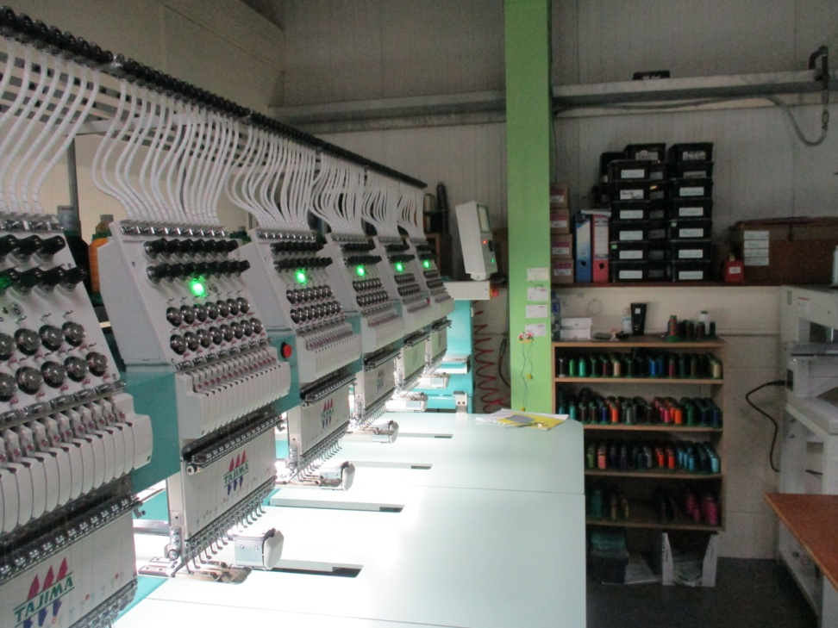
Here we saw our school jumpers being embroidered with our school crest!

Slide 9
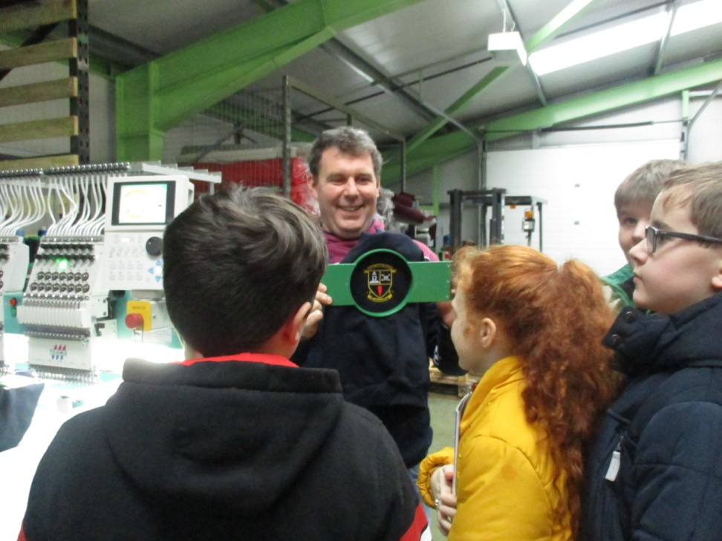
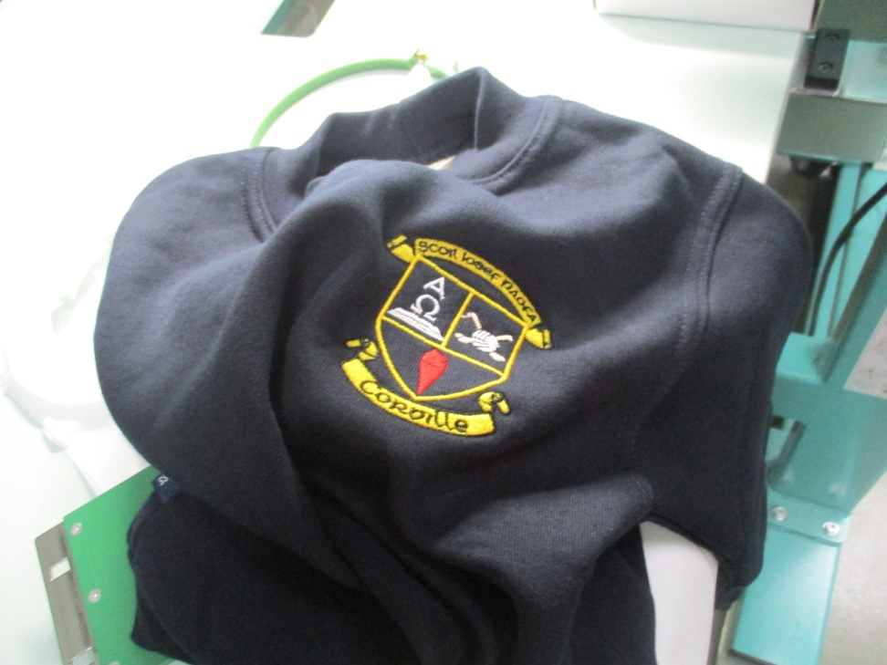
The result!!

Slide 10
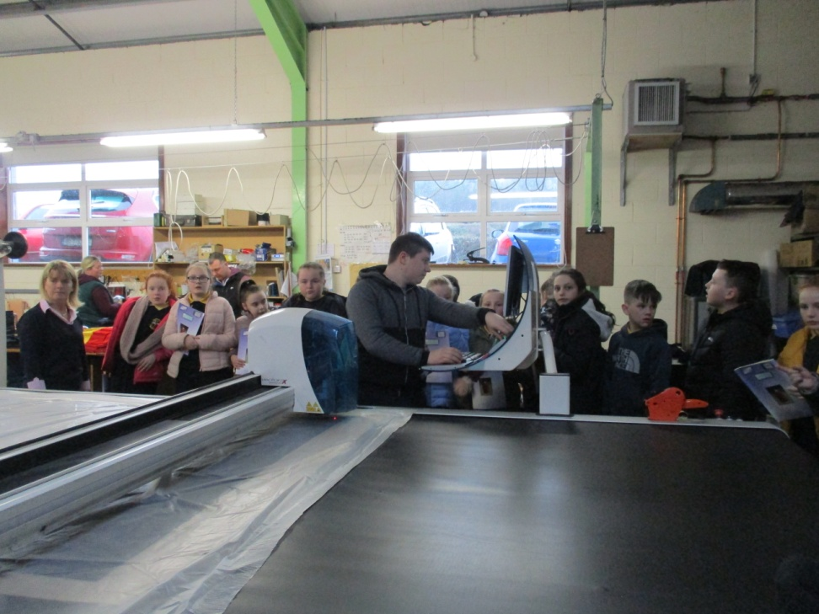
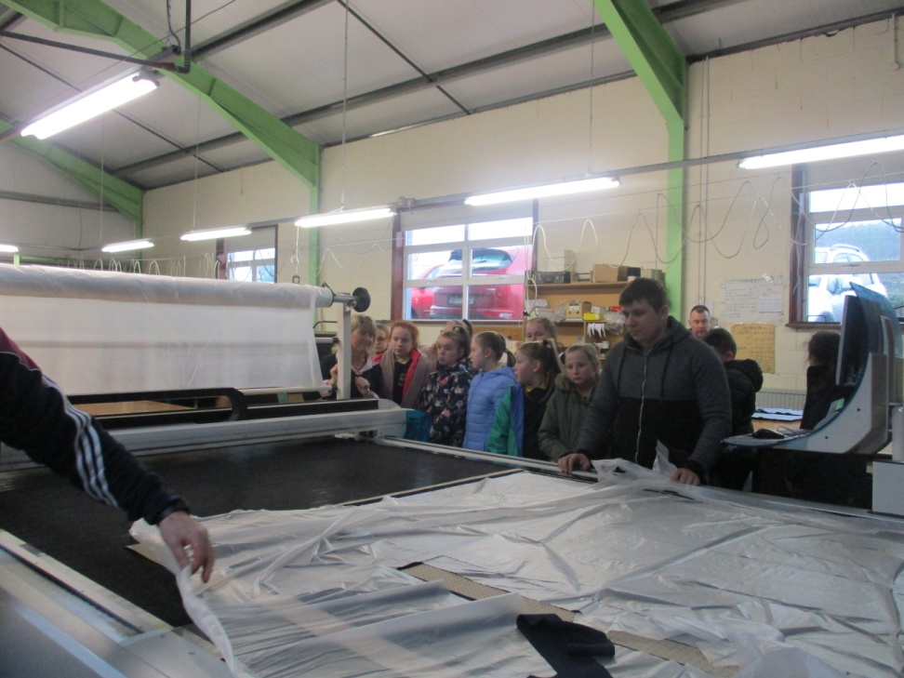
Here we saw a skirt being made

Slide 11
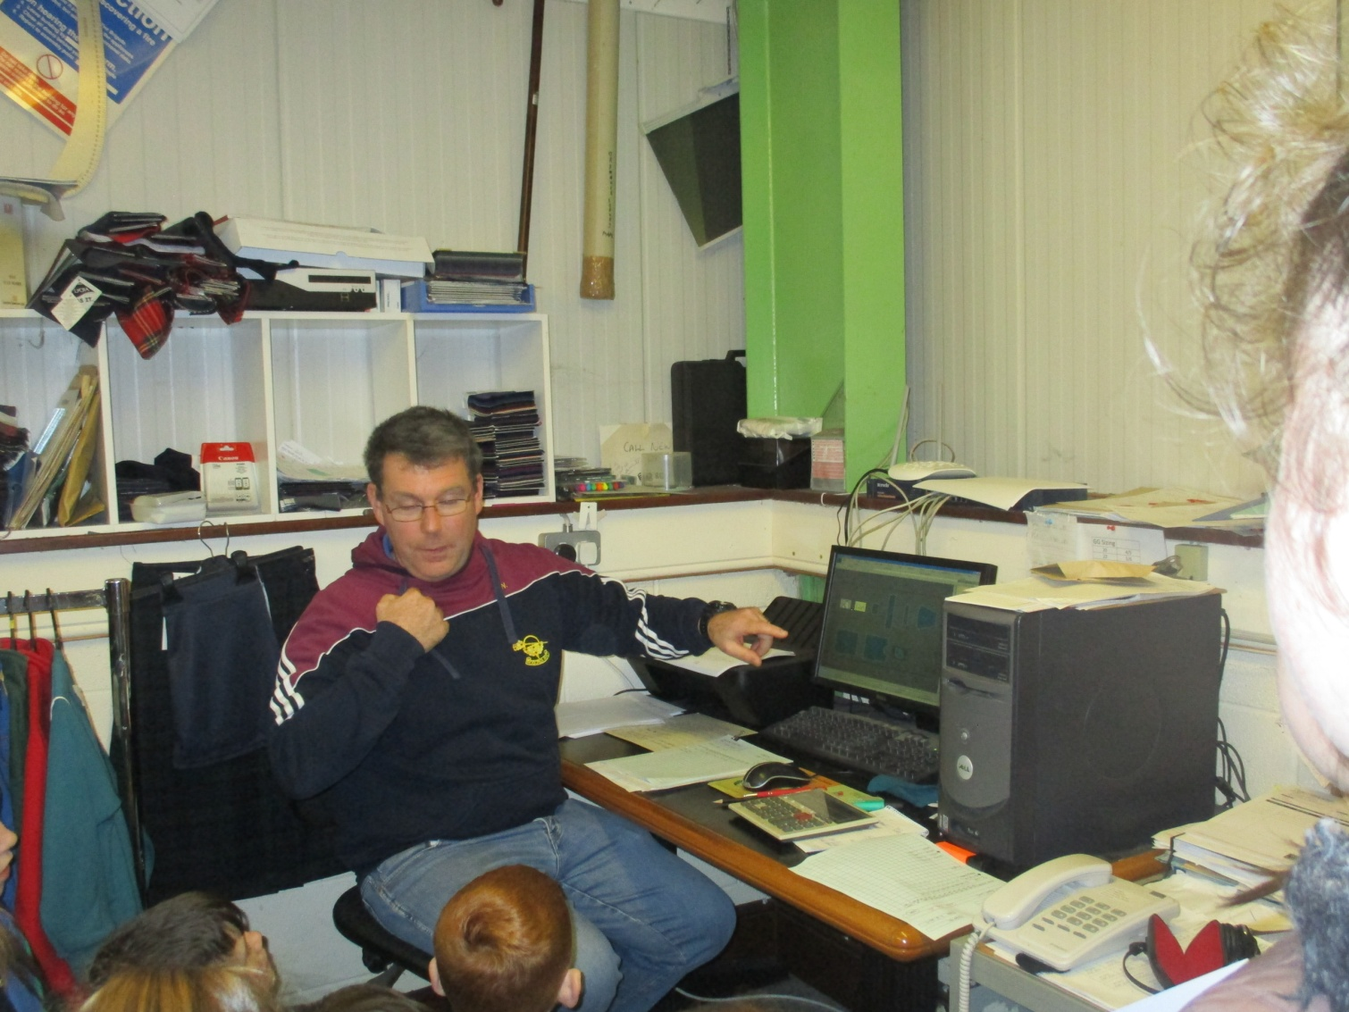
The design room

Slide 12
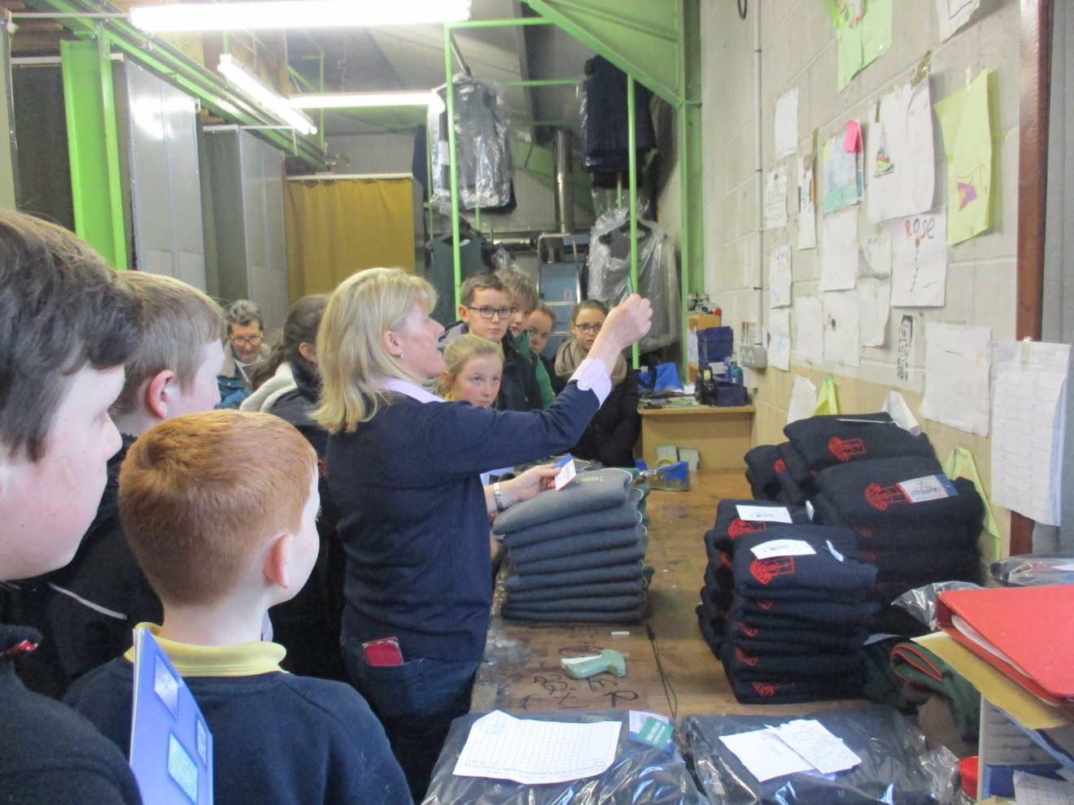
Packaging Area

Slide 13
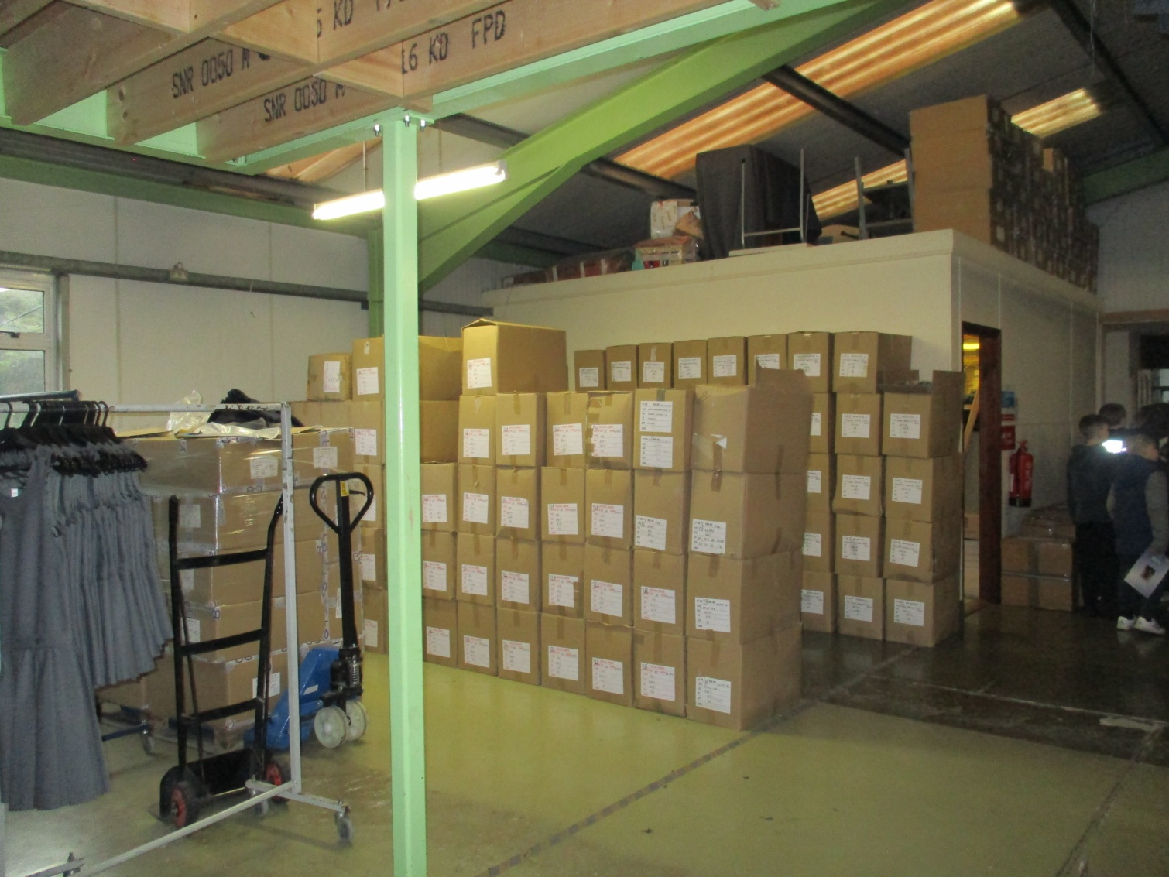
Ready for the shops!

Slide 14
We really enjoyed our trip to Skippy International Ltd. and learning all about how our school uniforms are made!
5th Class

