Slide 1


INDUSTRY PROJECT
ERASMUS+
2016-2019

Slide 2
COAL DEPOSIT IN BULGARIA

Slide 3
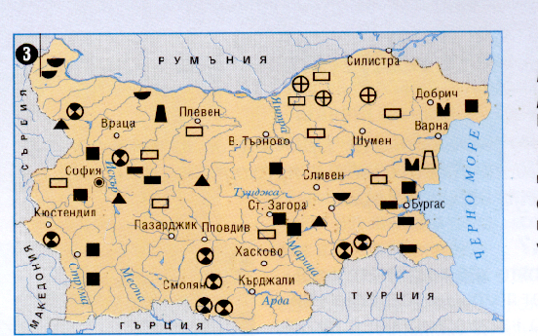

Slide 4
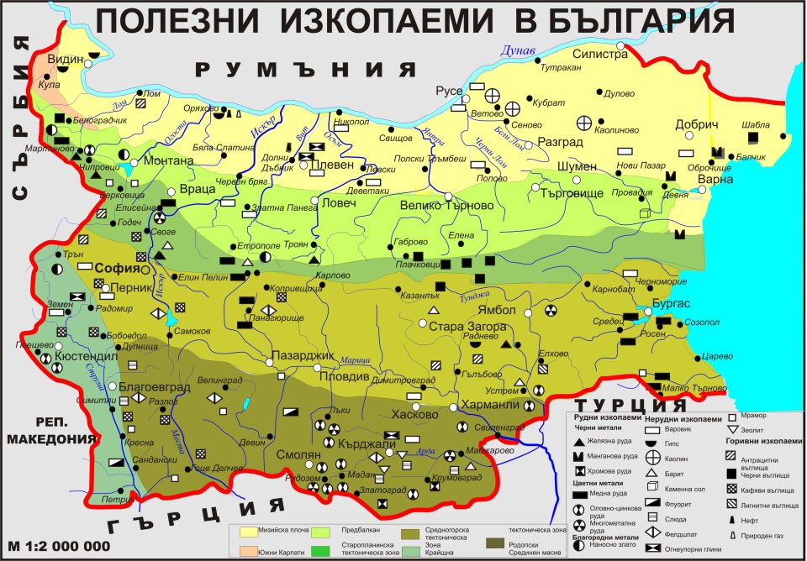

Slide 5
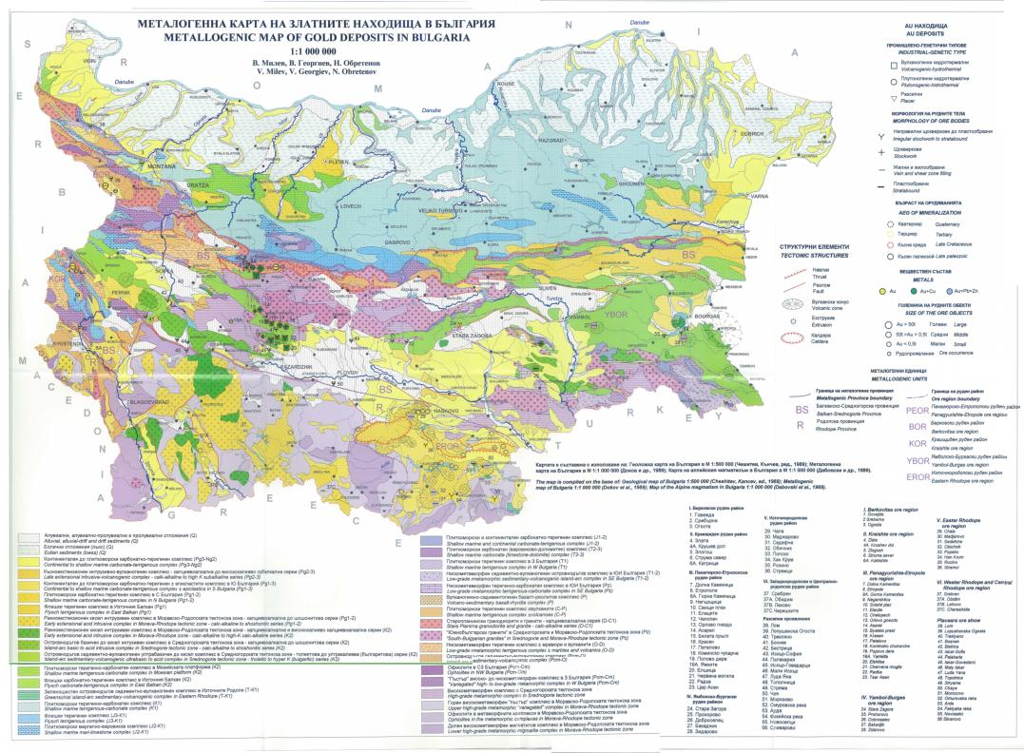

Slide 6
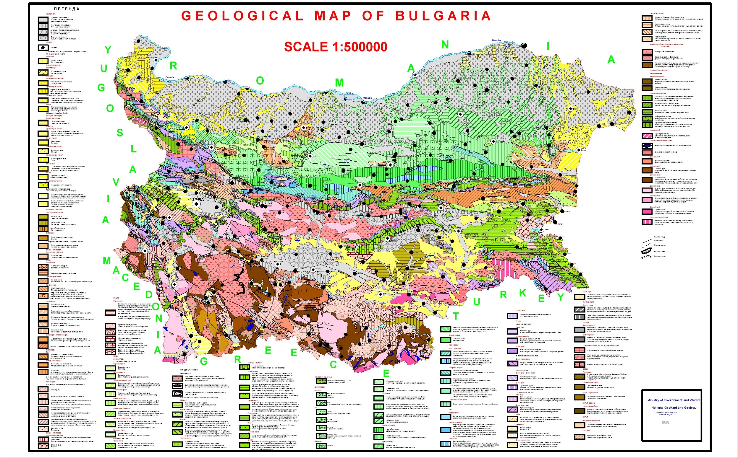

Slide 7
