Slide 1
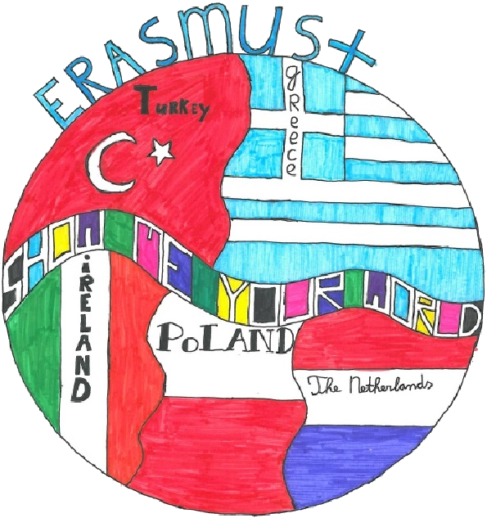

Presentation of 11th Primary School, Ptolemaida Greece
Music by Manos Chatzidakis

Slide 2
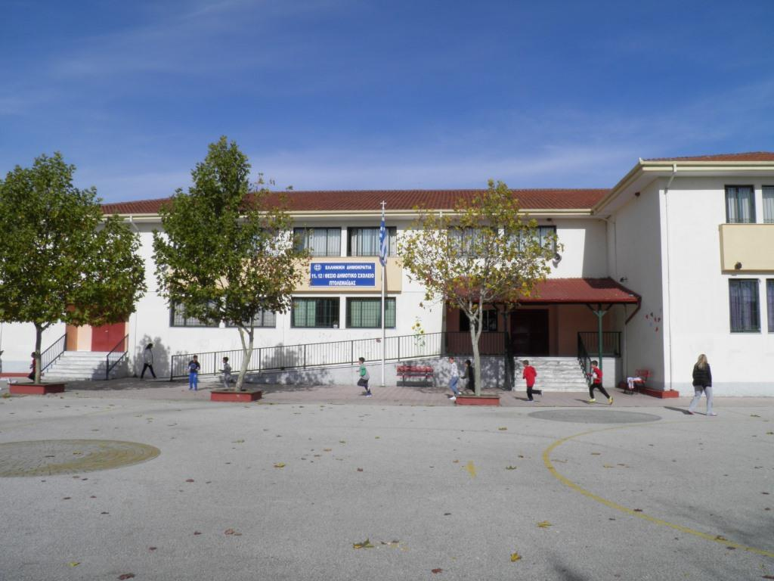
11th Primary School of Ptolemaida - Greeceι
This is our school. It’s big and new. It was built in 2001. There are two floors and 14 classrooms. There is also a lab, a computer room, a library, a drama room, an English room, a canteen, a gym, a teachers’ room and the headmaster’s office. There are about 250 pupils aged 6-12. There are about 20 teachers who teach us Language, Maths, English, French, History, Geography, Physics, Music, PE, Religion, Art and Drama. We are having a really good time in our school. GROUP A’.

Slide 3
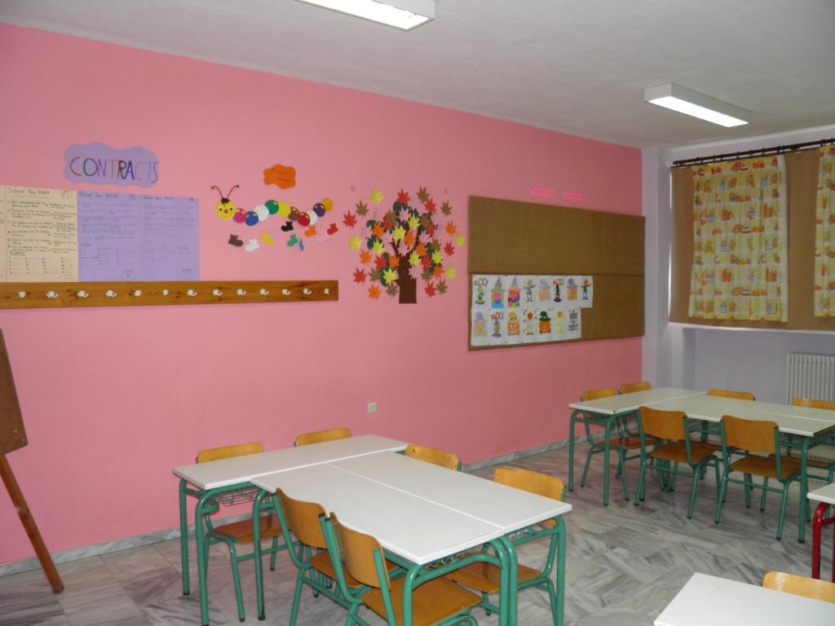
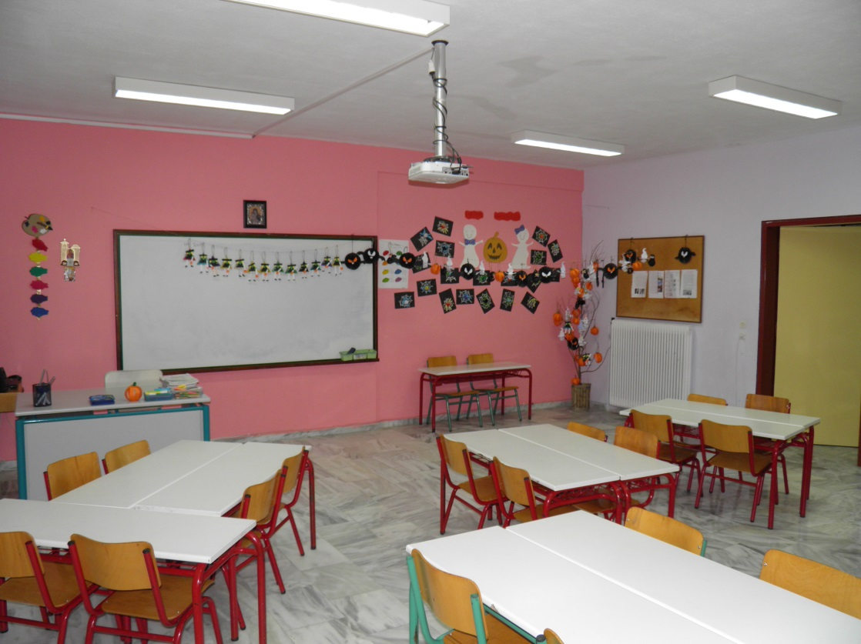
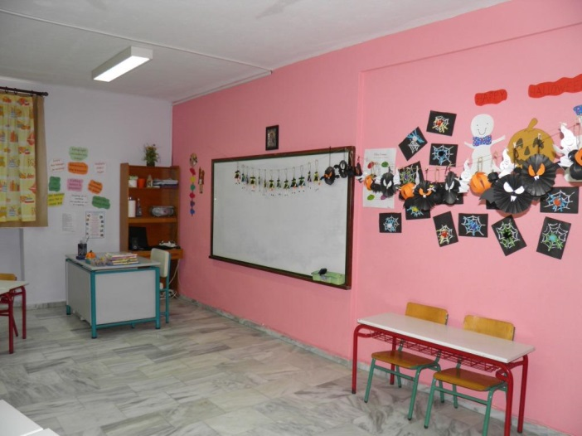
This is our English classroom. It’s quite big and colourful. There is a whiteboard, a laptop and a projector. We are working on an Erasmus+ project here with our teacher. It’s really interesting.
GROUP D’

Slide 4
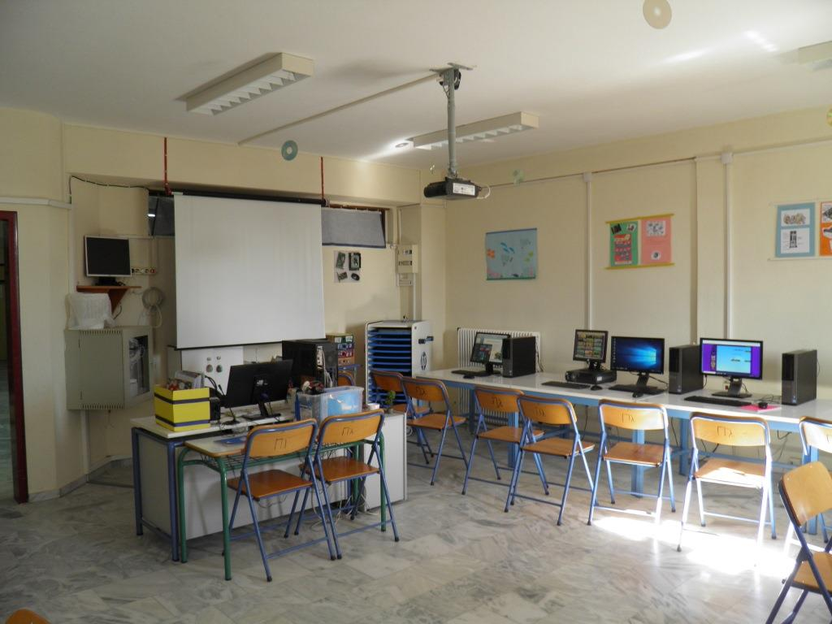
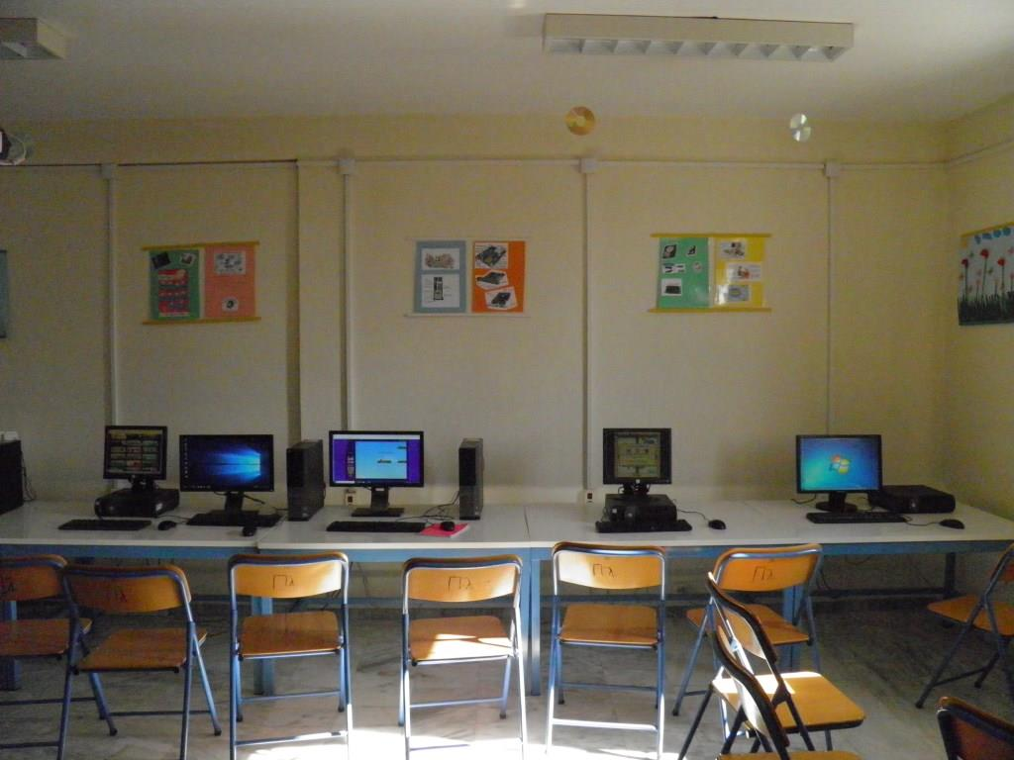
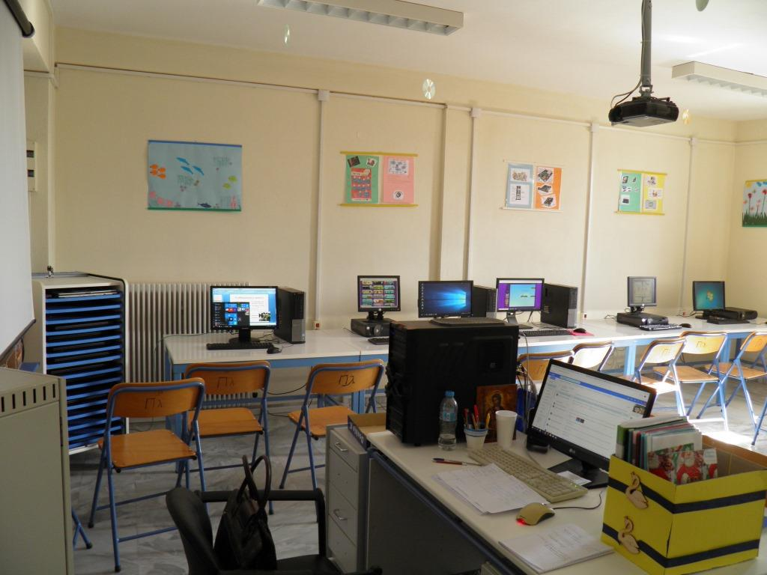
This is the computer lab. There are 15 desktop computers and 10 laptops. Our ICT teacher helps us with our project activities. There is also a projector. This room is big and clean and we always have fun here. Our teacher sometimes let us play computer games too. GROUP B’.

Slide 5
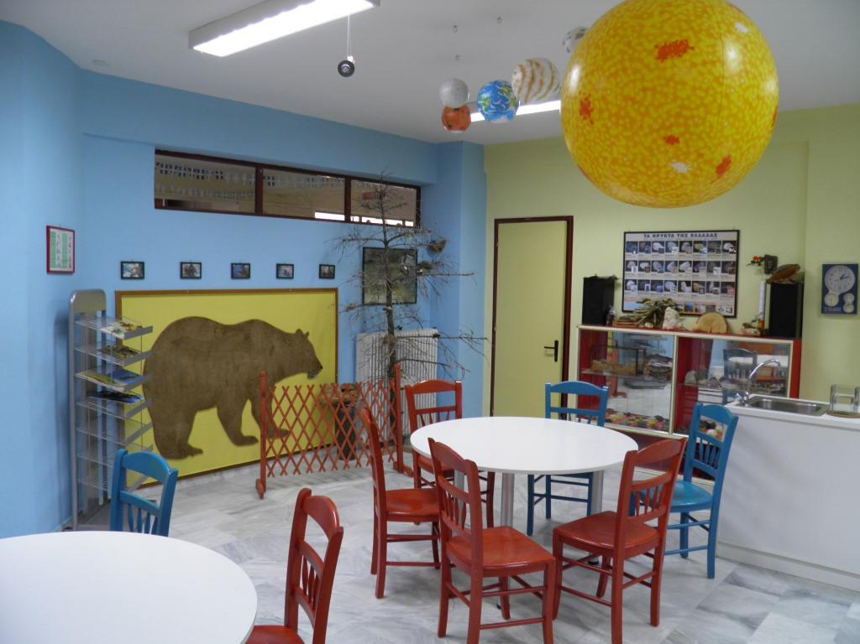
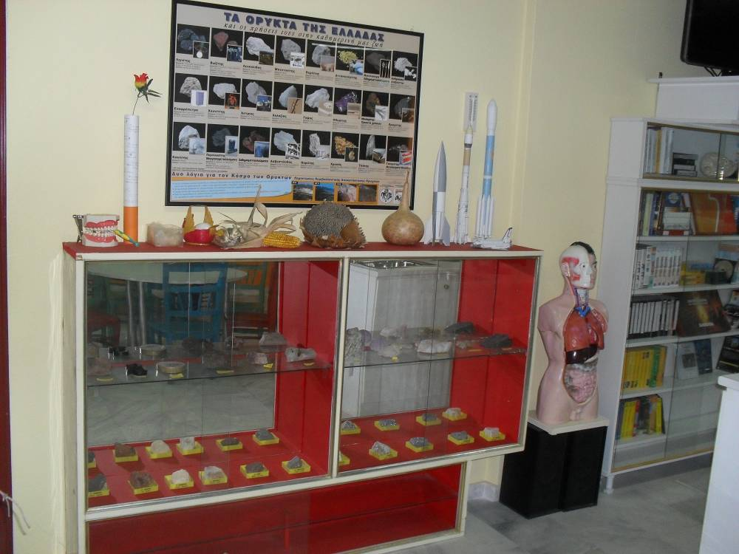
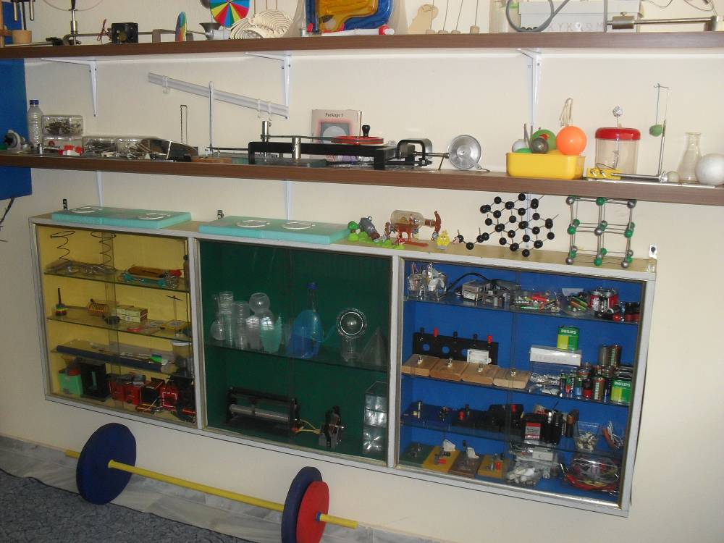
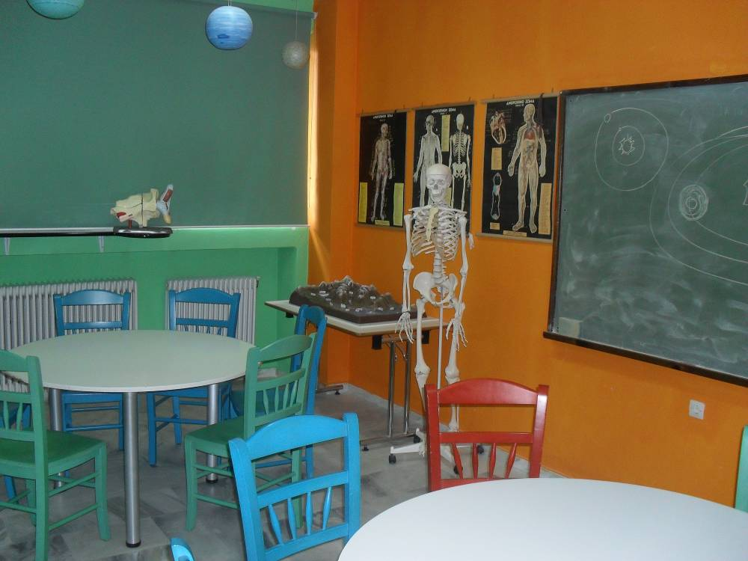
Physics place
This is the Lab. It’s a colourful class and we do experiments here. There are round tables and colourful chairs. GROUP D’.

Slide 6
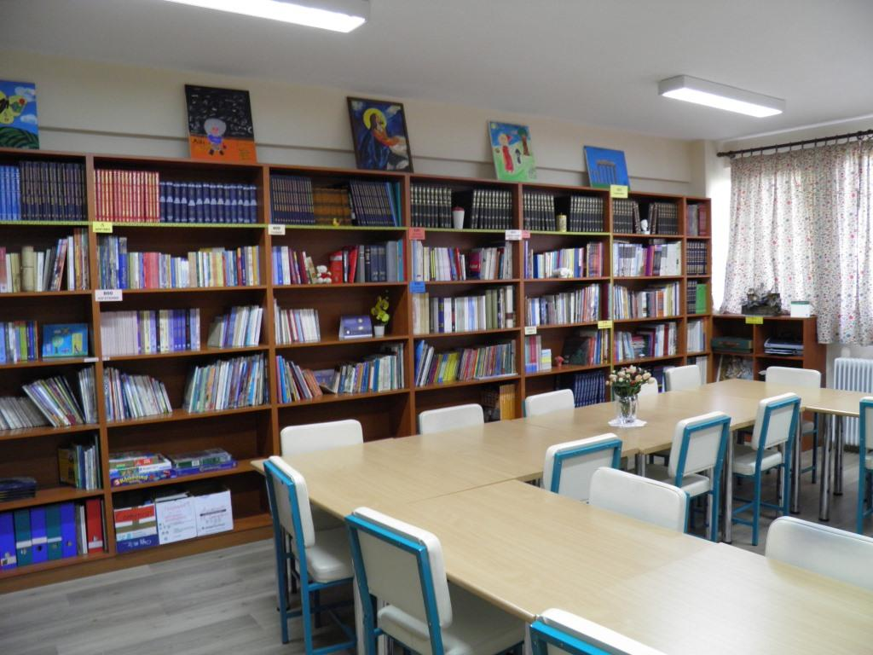
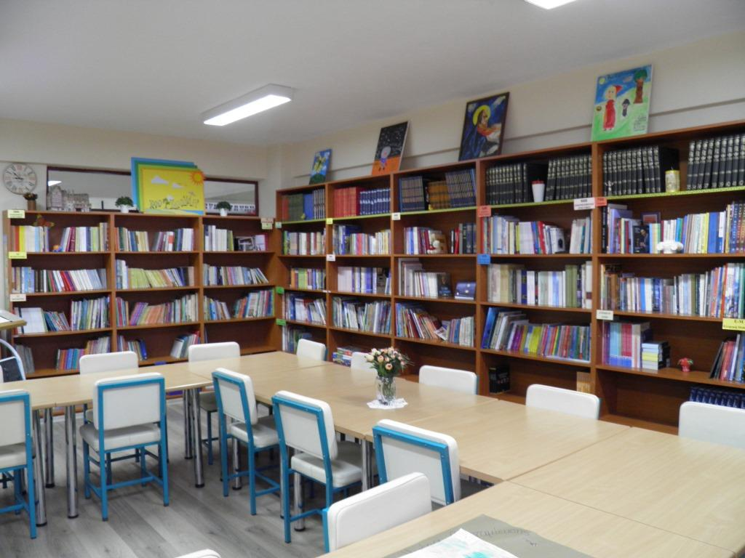
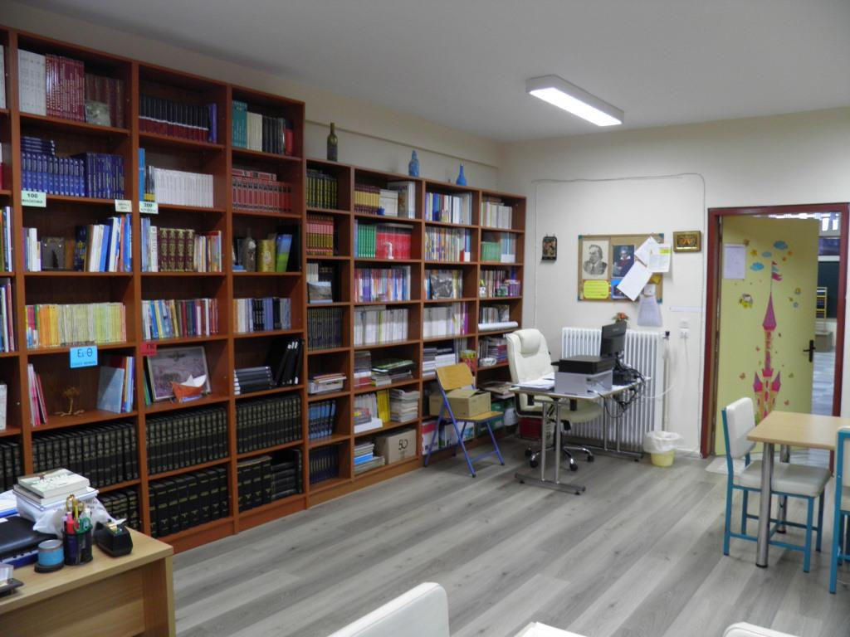
This is the Library. It’s our favourite place. There are big tables and a huge bookcase. There are a lot of books on the shelves. We can borrow them and read them. GROUP A’.

Slide 7
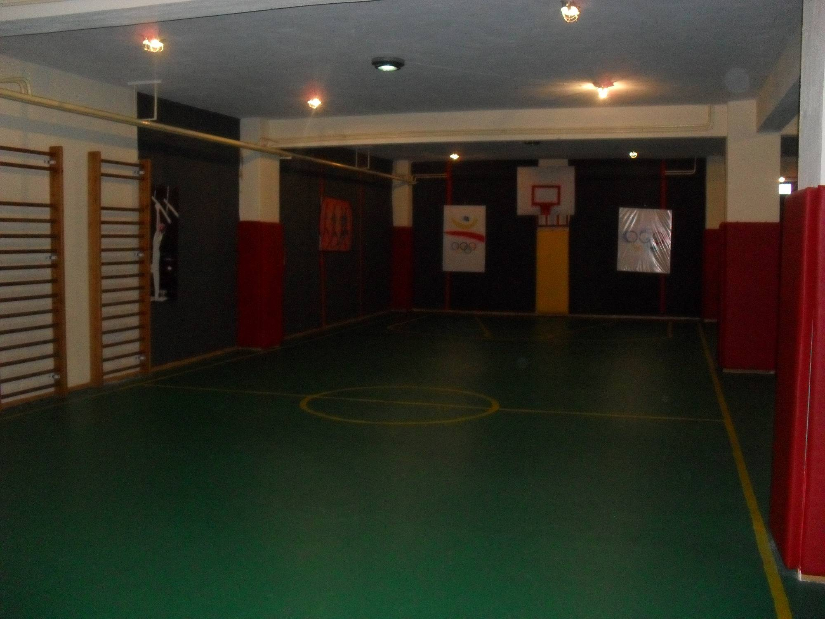
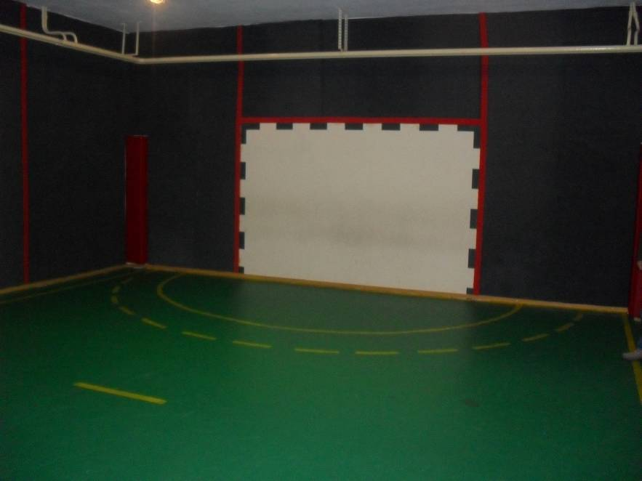
This is the gym. It’s very big and beautiful. It’s is in the basement of our school and when it rains and it’s cold we do gymnastics here. There is a football pitch, a basketball and a handball court. GROUP C’.

Slide 8
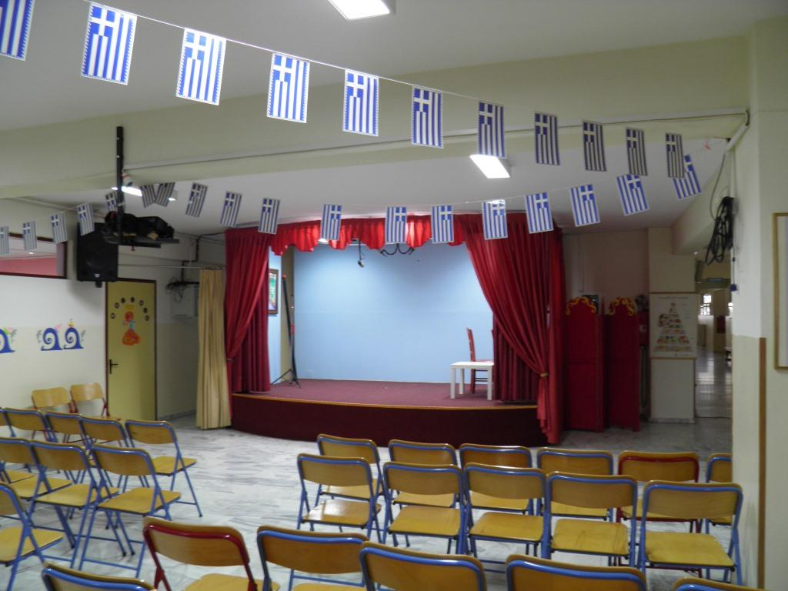
This is our stage. We sing and act in our celebrations and festivals here. GROUP A’.

Slide 9
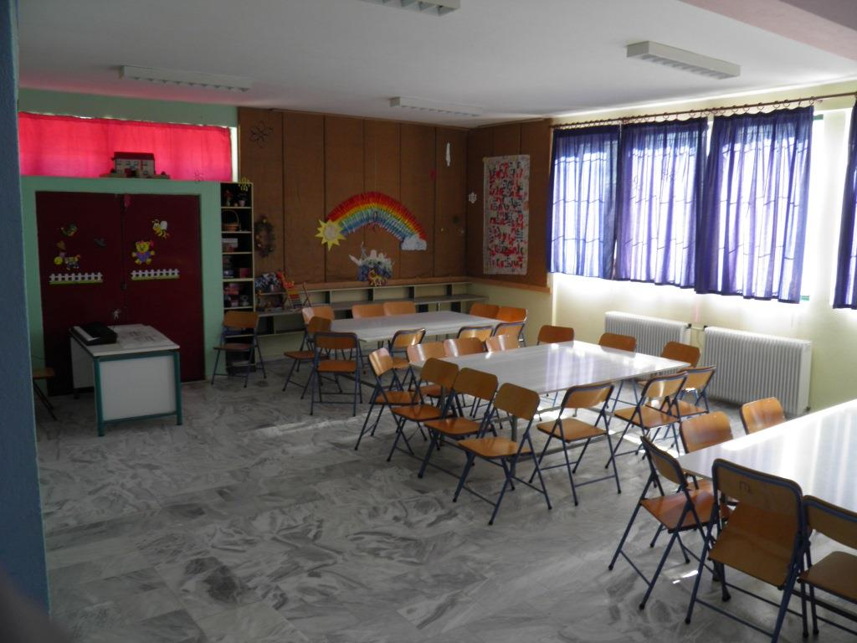
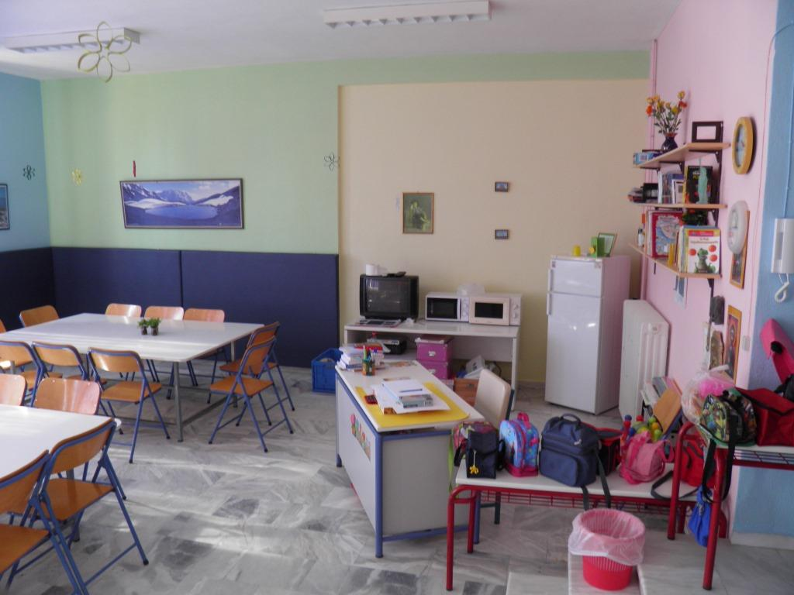
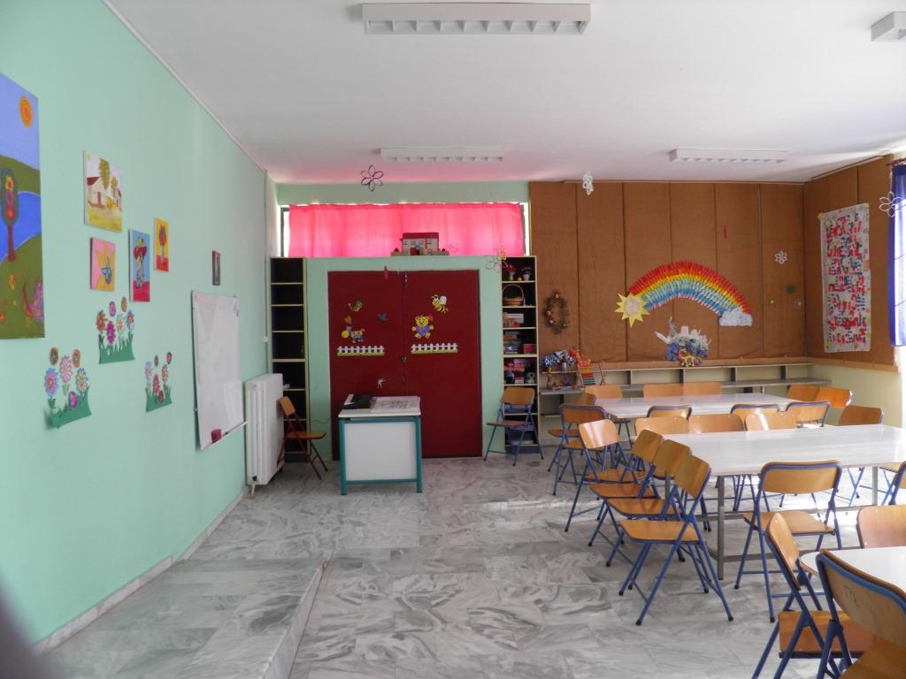
This is the Day Care room. It’s a very big room. There are big tables and it is used by pupils who stay at school until four o’clock. All the other pupils leave school at quarter past one.
GROUP B’.

Slide 10
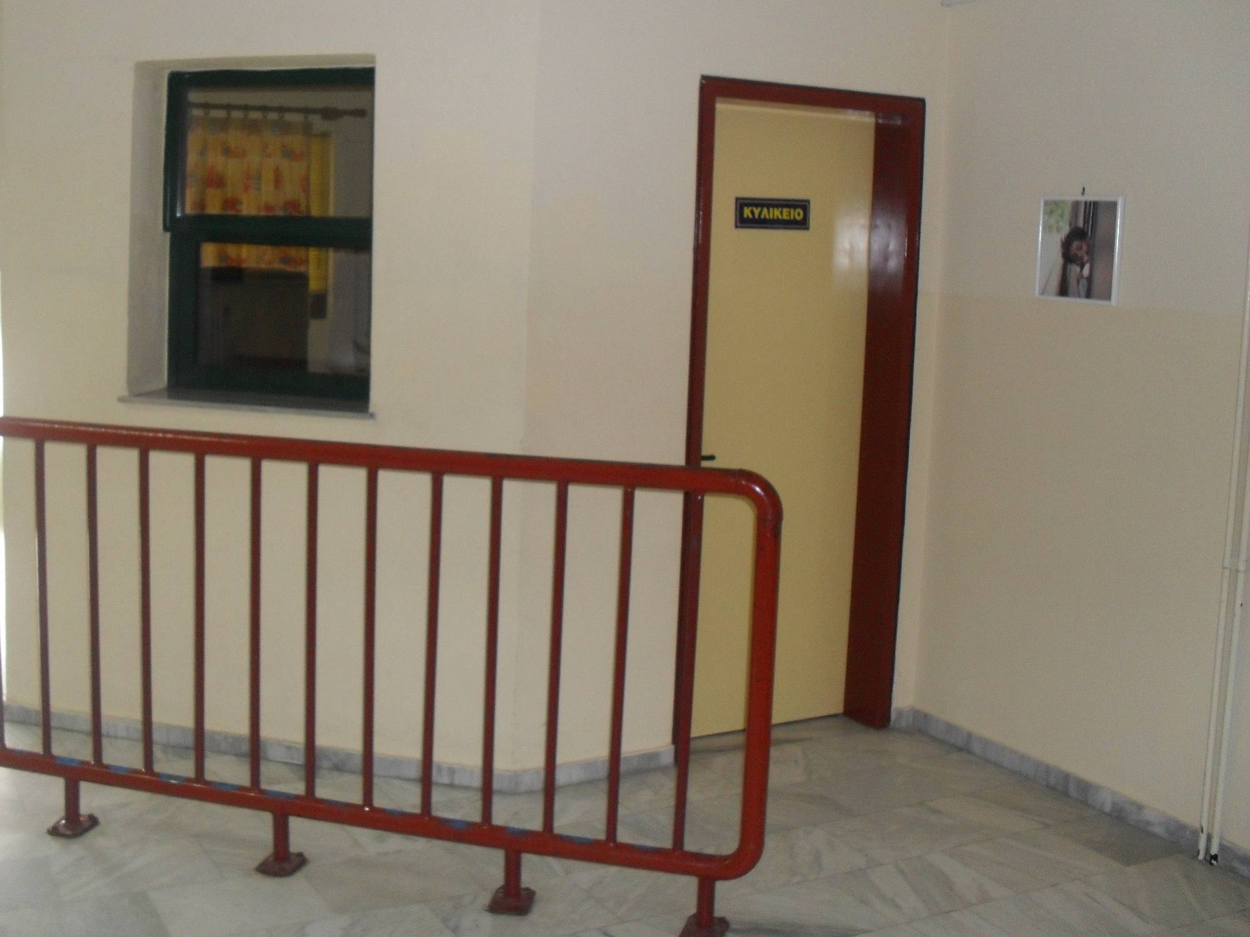
This is the Canteen. Miss Anna works here. She’s friendly and hardworking. She makes sandwiches, toasts and croissants. They are delicious. In our breaks we wait in a queue and we have our snacks. GROUP B’.

Slide 11
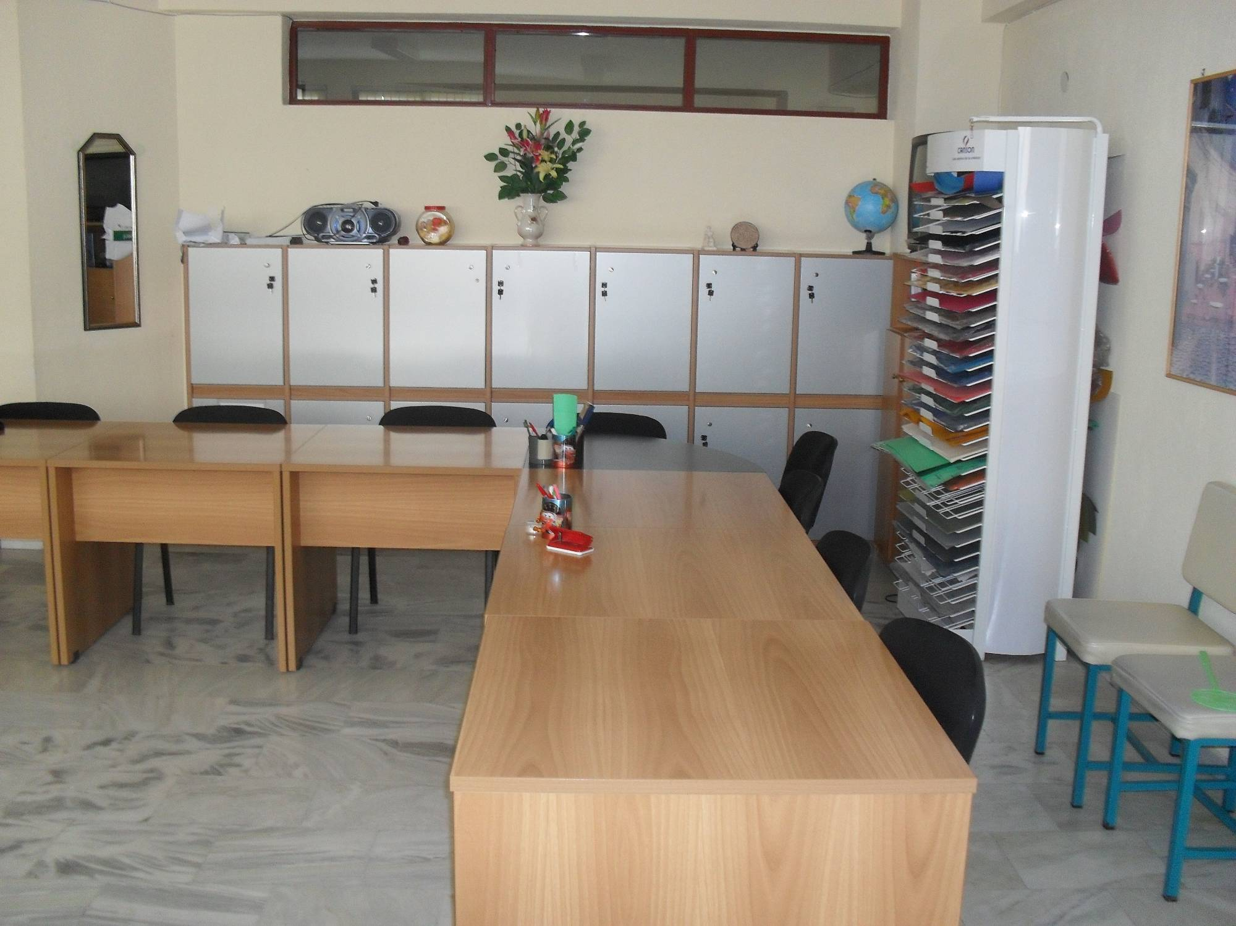
This is the teachers’ room. During the breaks the teachers have a cup of coffee here and they talk about schools subjects.
GROUP C’.

Slide 12
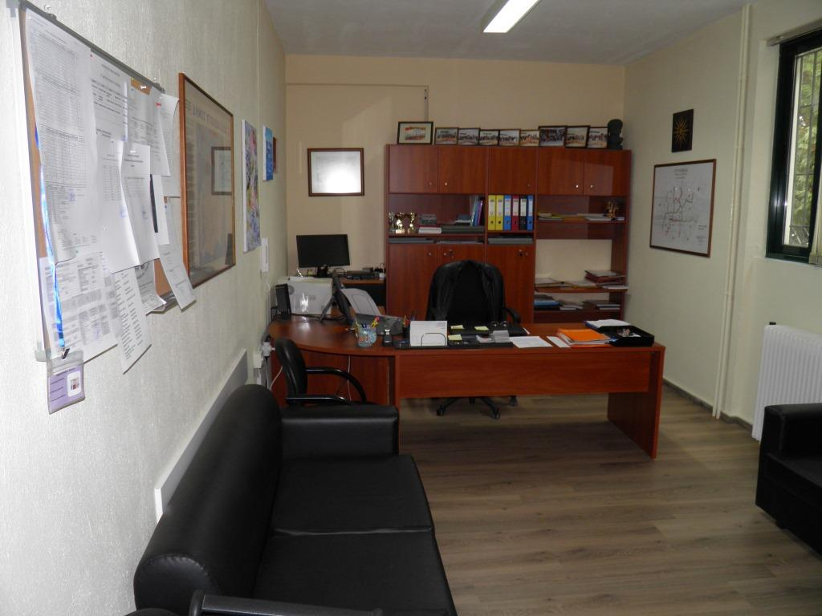
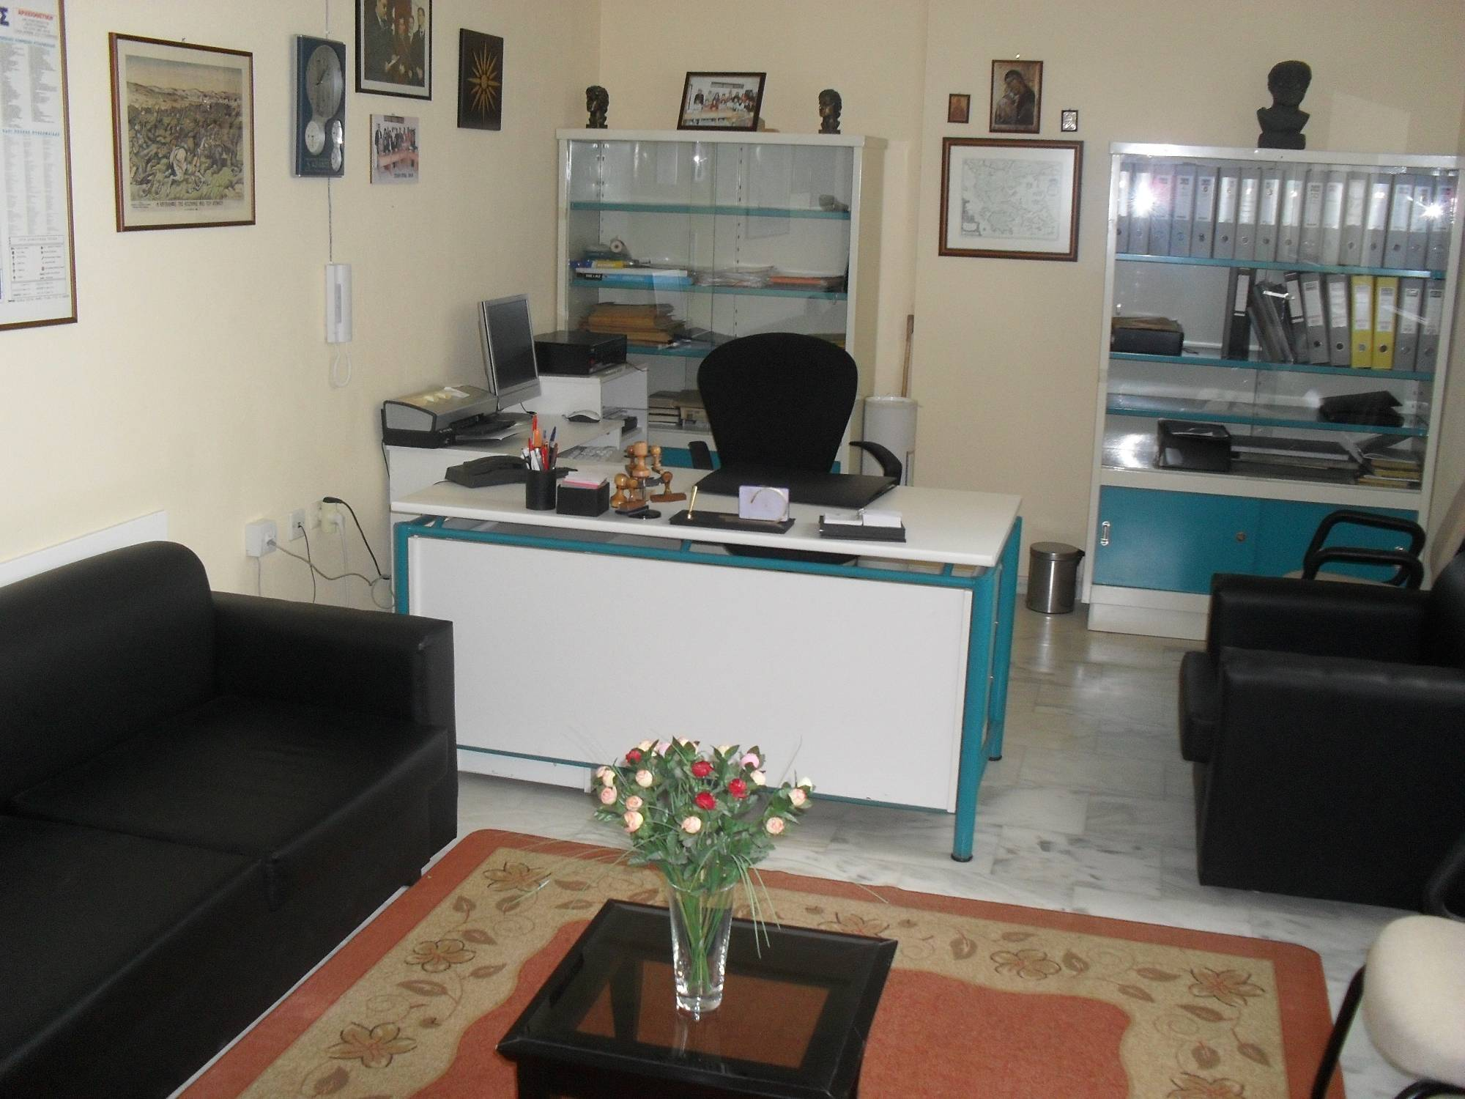
This is the headmaster’s office. Our headmaster is Mr Apostolis Mitroulis. He is nice and helps us when we are in trouble.
GROUP D’.

Slide 13
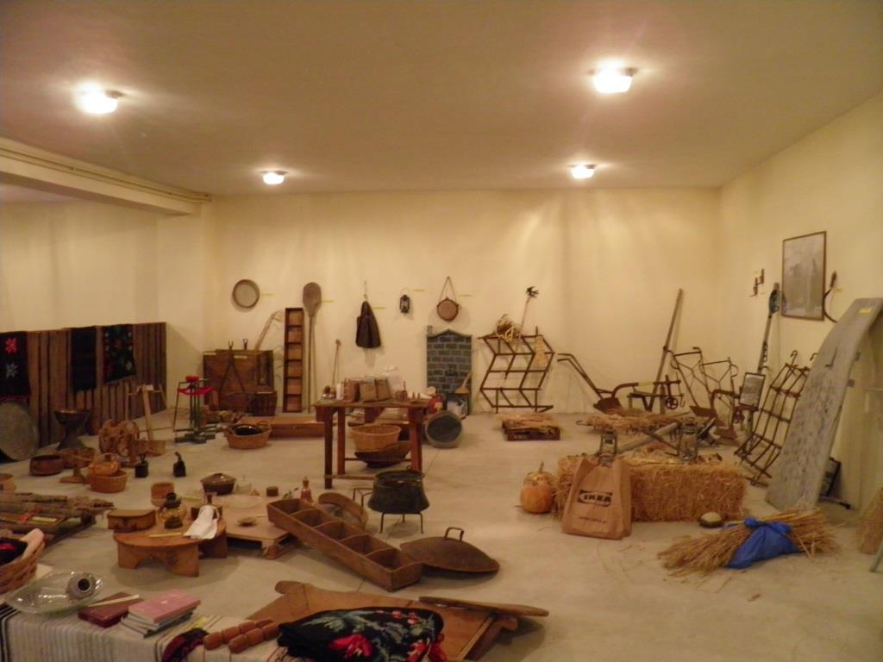
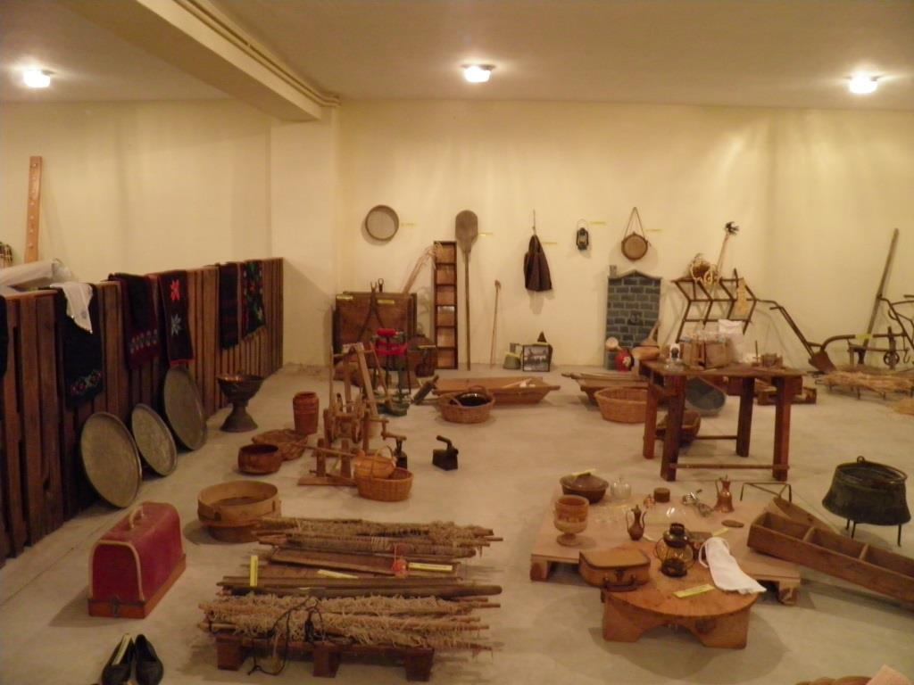
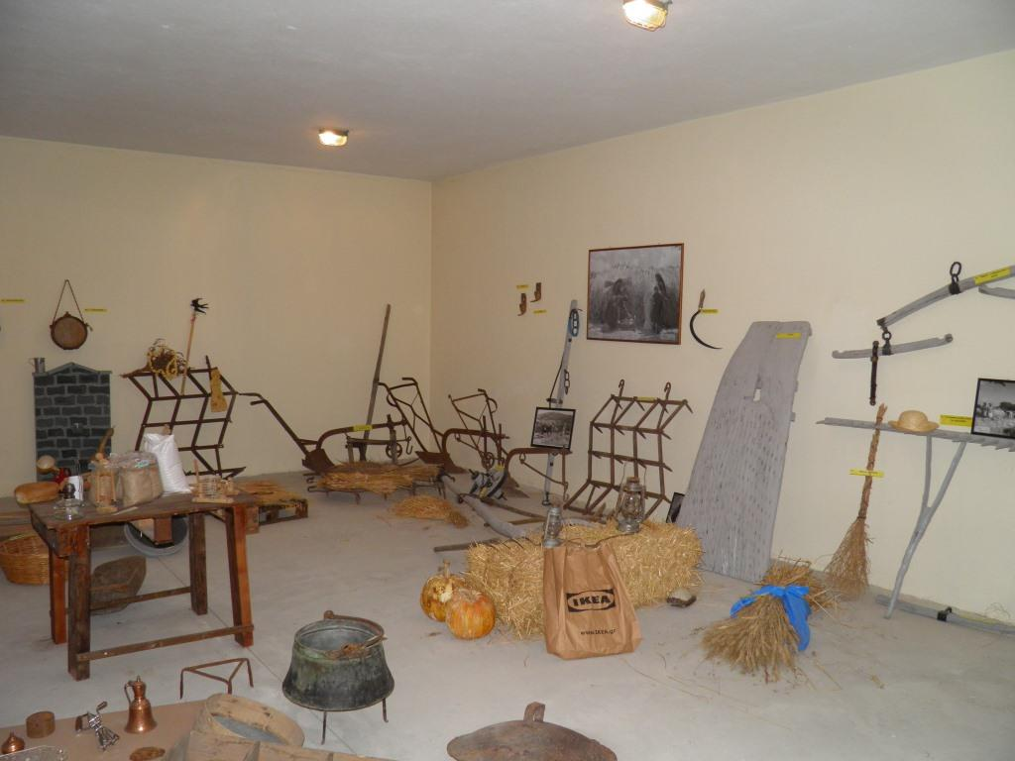
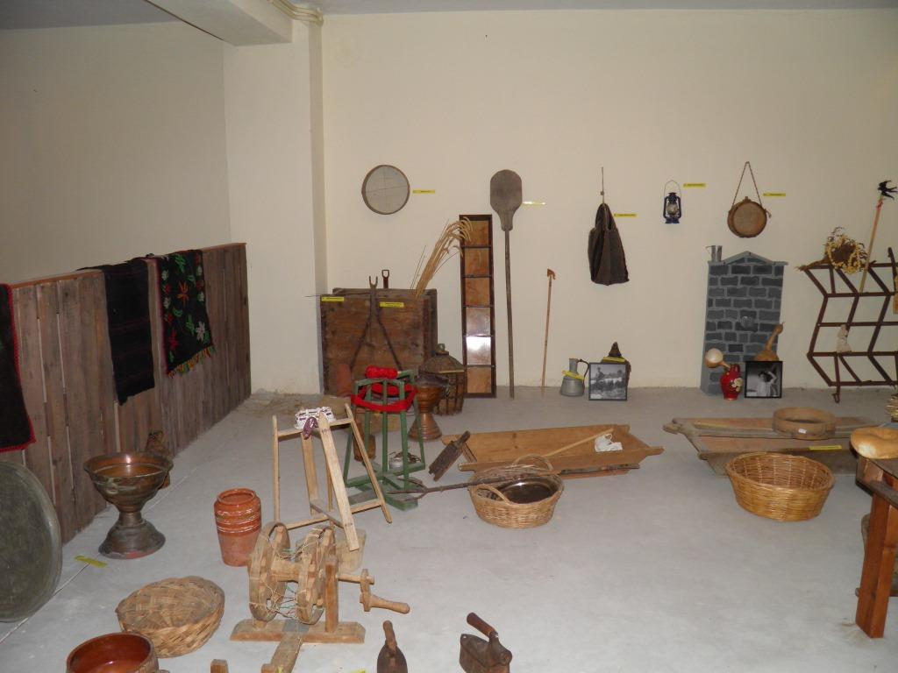
At the basement, next to the gym, there is a small folklore museum. Here you can see household utensils and agricultural tools of the old times. GROUP A

Slide 14
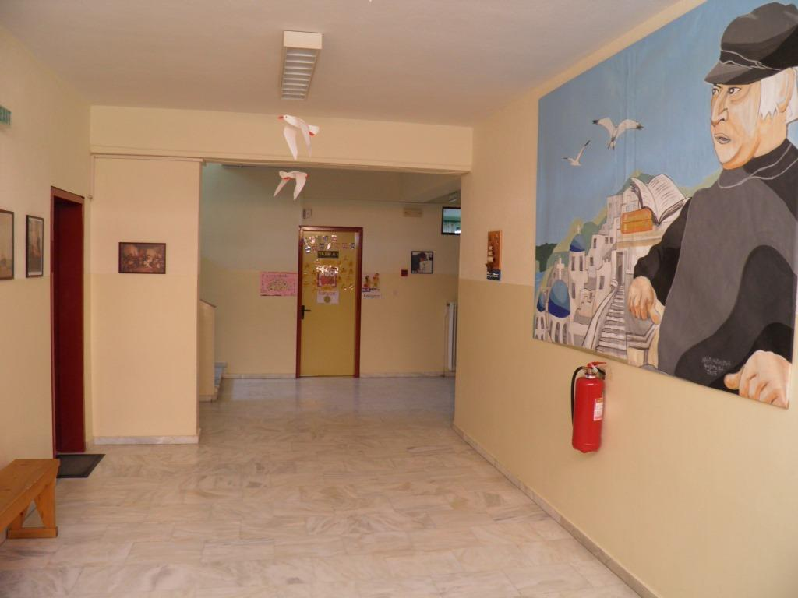
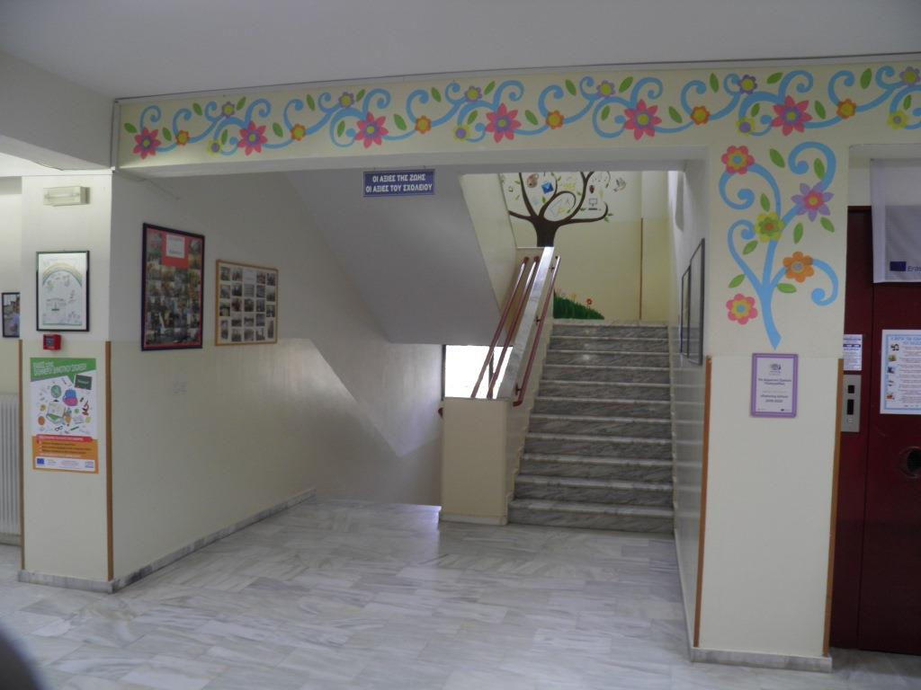
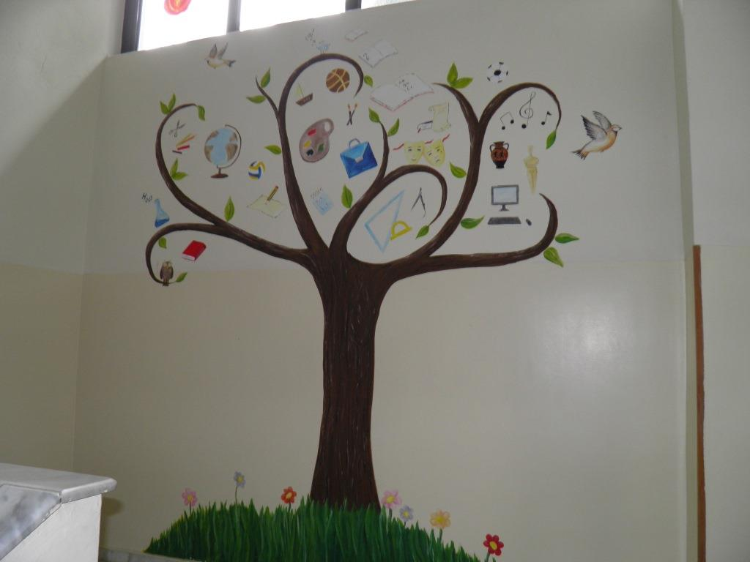
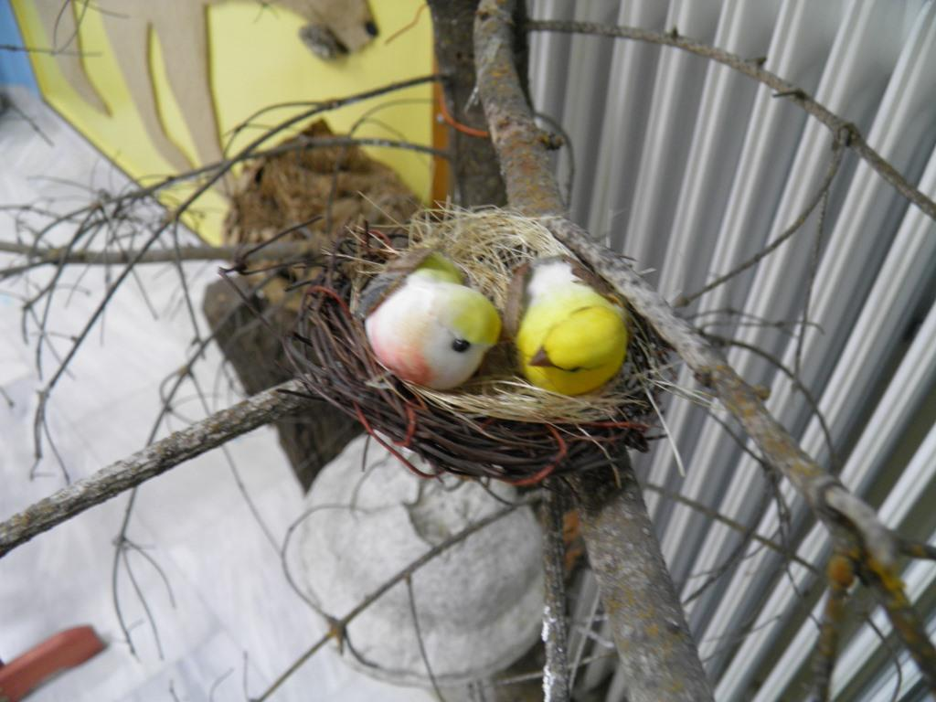
Beautiful corners

