Slide 1


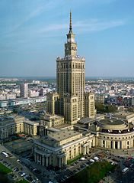
Polish traditions…
…and more
Polish flag
Coat of arms of Poland
About Poland
By Artur Iskra

Slide 2
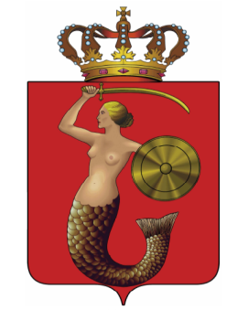
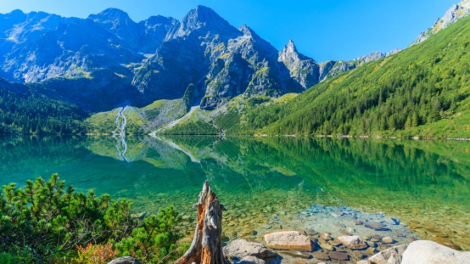
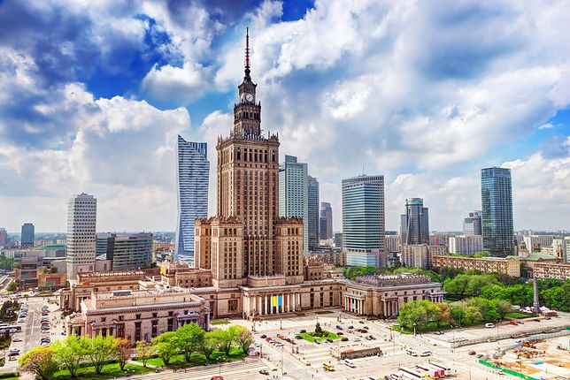
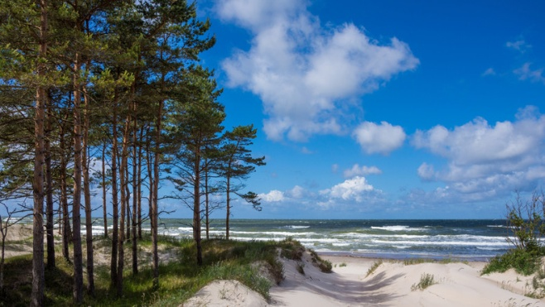
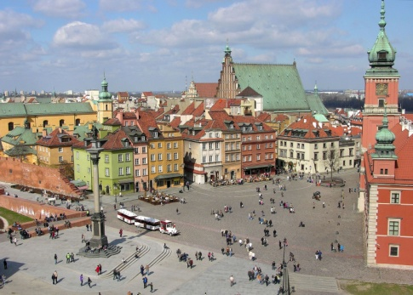
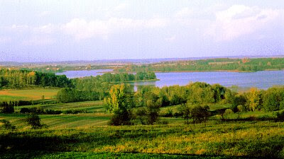
Geography of Poland
Poland in most of part is lowland country with hills and mountains on the south and sea on the north. The capital of Poland is Warsaw with about 1,7 milion inhabitants. In my opinion this is the most beautiful and the biggest city in our country.
Morskie Oko is the most beautiful lake in Poland.
Palace of Culture and Science
Baltic Sea
Old town in Warsaw

Slide 3
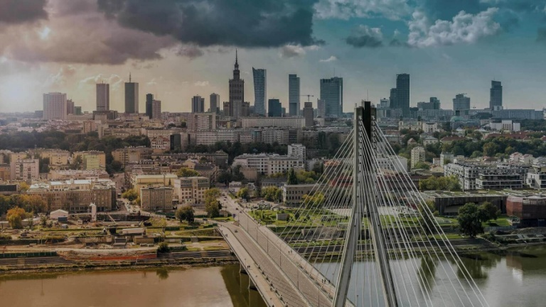

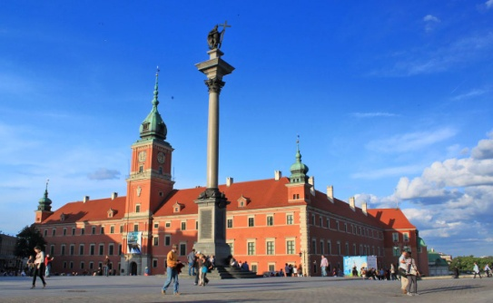
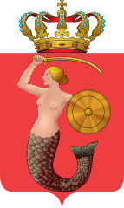
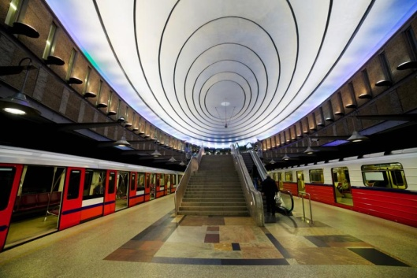
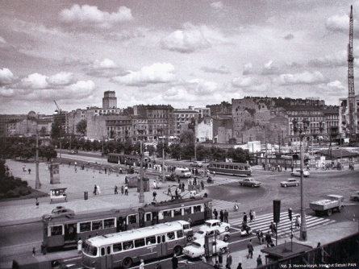
A little more about Warsaw
Warsaw is a capital of Poland. It is situated along the Vistula River. It was permanently inhabited by Zygmunt III Waza. Warsaw was destroyed by the Germans during the World War II and the reconstruction took over 30 years! Warsaw is not the first capital of Poland. The first one was Gniezno and then Cracow.
Kolumn of Zygmunt III Waza
Warsaw metro
Warsaw before the war
Coat of arms of Warsaw

Slide 4
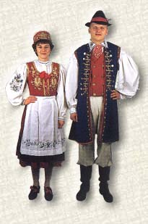
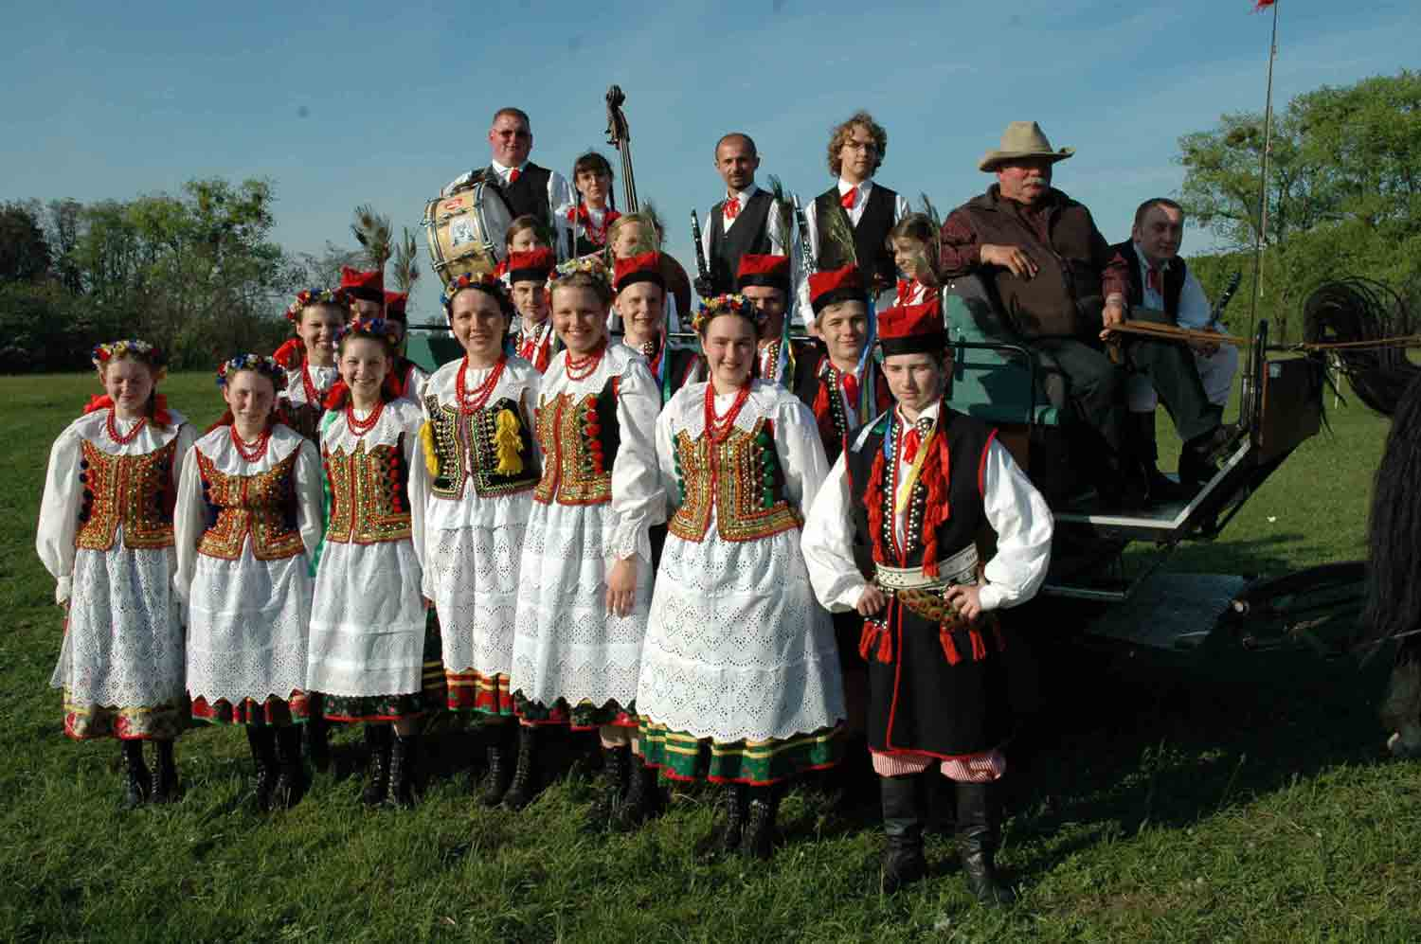
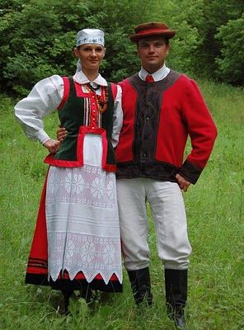
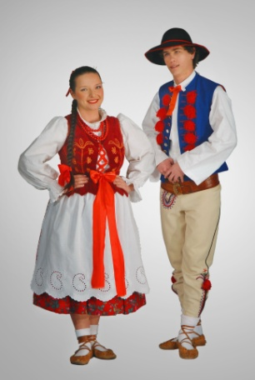
Culture and traditons
Polish culture is very diverse and has many different varieties. The culture in Pomerania is different from the culture in the mountains. Traditional holidays are also different from those in other parts of Europe.
One of the traditional Polish is Fat Thursday, which is known for eating donuts. Andrei is also know for his fortune-telling. The most important holiday for Polish people is the Independence Day celebrated on November 11th.
Polish folk costumes:
Cracovian costume
Kashubian costume
Highlander outfit
Kurpie costume

Slide 5
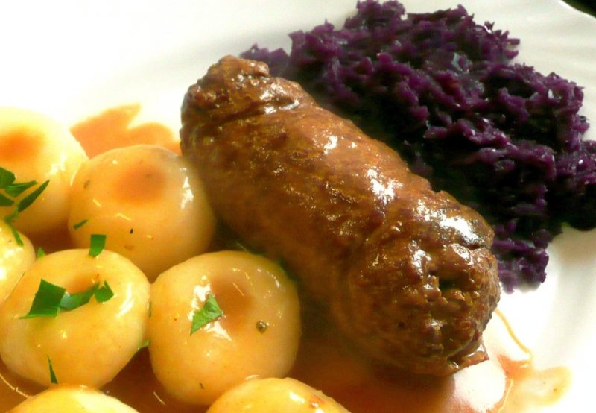
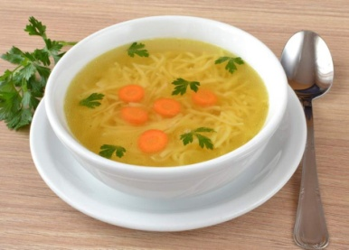
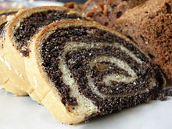
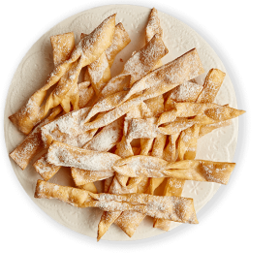
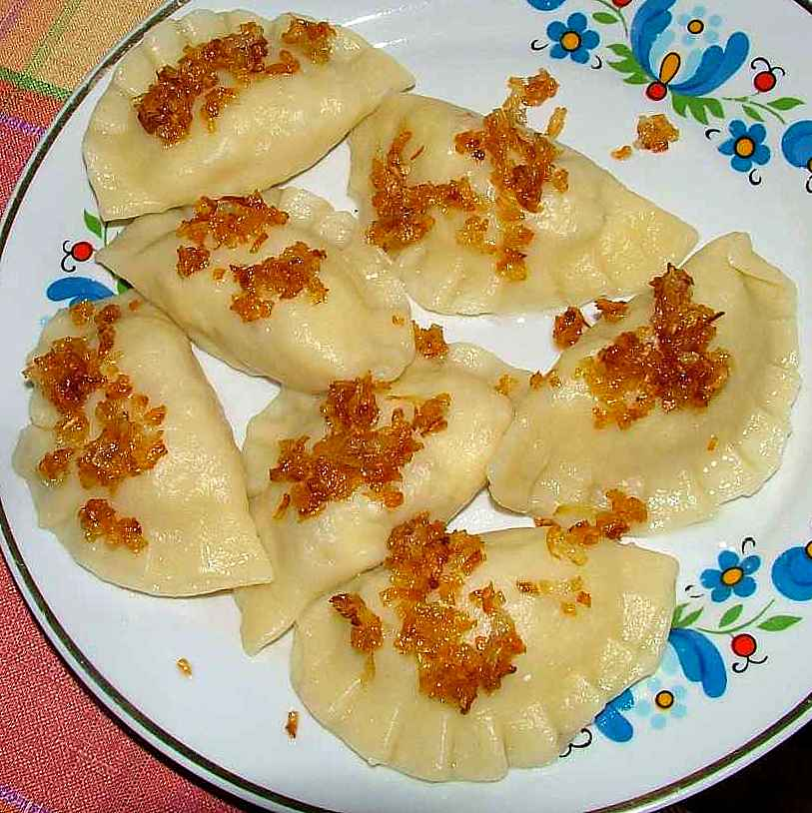
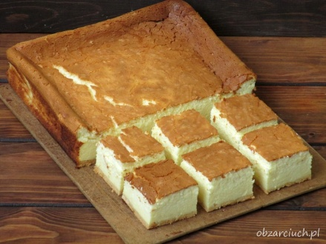
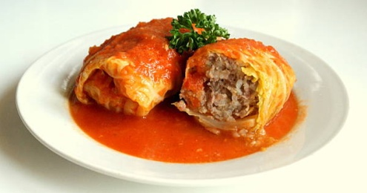
Try the traditional food
Traditional Polish dishes are very good but not everyone likes them.
Dishes:
Desserts:
Chicken soup
Noddles with roulade and red cabbage.
Poppy-seed cake
Deep-fried sweet pastry
Pierogi can be with meat, cabbage and mushrooms or cheese
Golabki with rice and meat wrapped in cabage.
Cheese cake

Slide 6
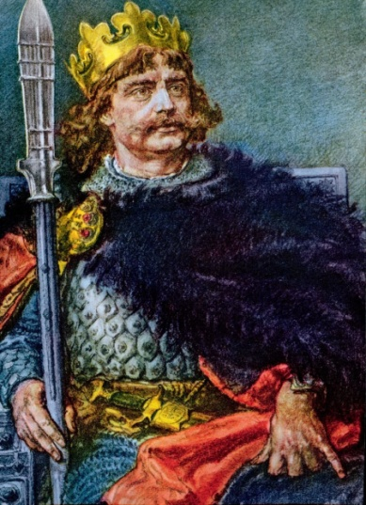
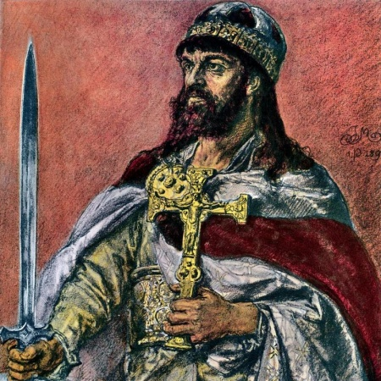
History
The first historical ruler of Poland was Mieszko I. But the first king of Poland was Bolesław Chrobry. It was crowned in 1025. The Polish uprising is said to be around 960. 6 years later Mieszko I was baptized and since then Poland has been a Christian country. Poland was a large country in Eastern Europe until the partitions of Poland in 1795.
Since then, Poland has been without maps for 123 years. It was so until November 11,1918, when the World War I ended and Poland returned to the maps again.
Mieszko I
Bolesław Chrobry

Slide 7
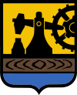
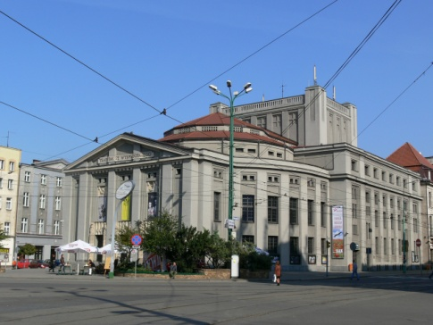

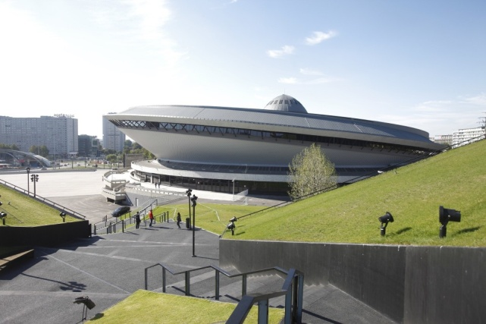
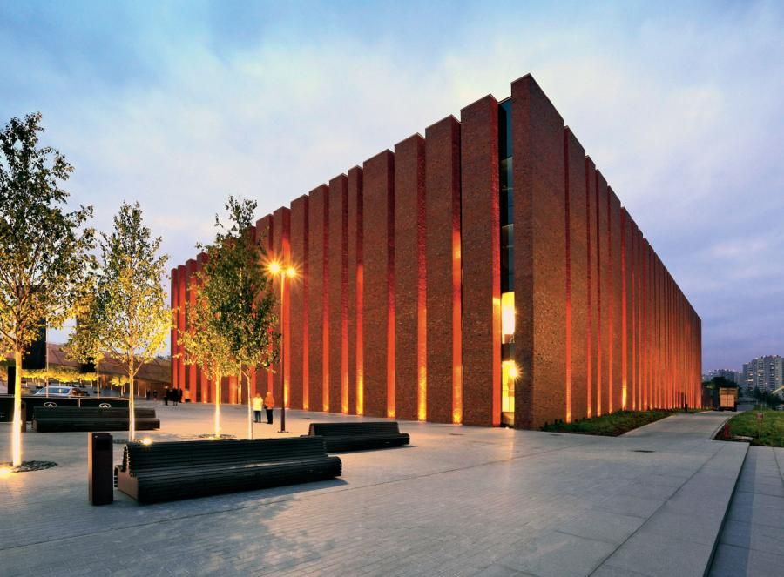
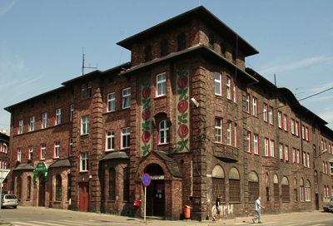
My city - Katowice
Katowice district Nikiszowiec known for its brick buildings
Sponsorowane przez
Katowice district Nikiszowiec known for its brick buildings
Sponsorowane przez
Katowice district Nikiszowiec known for its brick buildings
Sponsorowane przez
Katowice the most important city in Silesia and one of the most important industrial cities in Poland. It is located in the Silesian Agglomeration (Metropolis) together with some other cities located close to each other.
Silesian Theatre
Spodek is a hall where various events take place. It’s a most famous place and symbol of Katowice.
Katowice district Nikiszowiec known for its brick buildings.
The Silesian Philharmonic is also a very well-known. There are performances on a very high level.

Slide 8
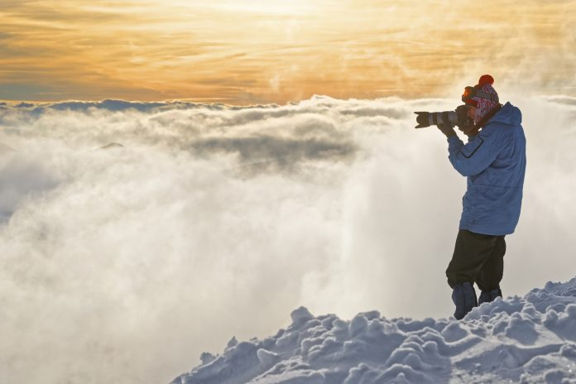
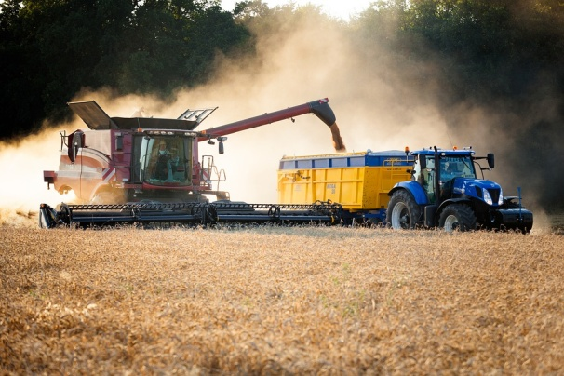
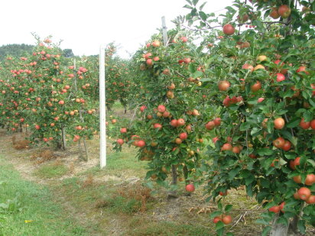
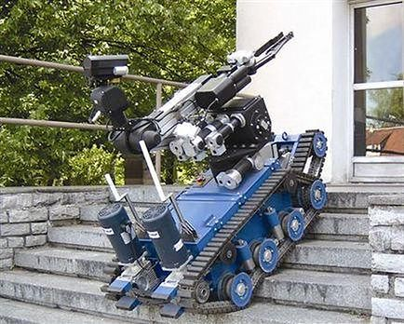
What is good about Poland
Polish people is good in many life areas. Polish inventors are good in robotics and technical science and take a part in international projects.lAgriculture and horticulture are also very developed. As a result, Poland is the first country to export apples in the world!
Photos of Polish photografers are valued over the world
This Polish robot went to Afganistan

Slide 9

Summary
Poland is a country of newer and newer innovations. And despite its difficult history, it is able to rise to a high level together with other countries.
We told you about:
Geography Warsaw Culture and Food History Katowice Innovations
traditions - my city

Slide 10
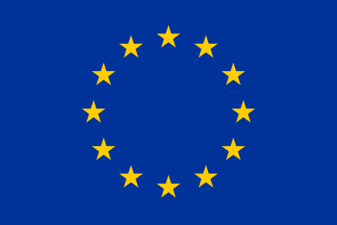
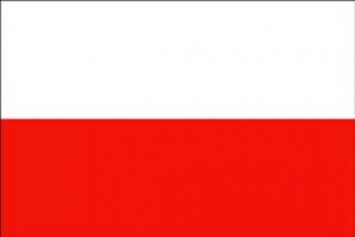

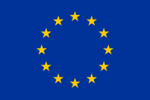
Thank you for your attention!
Created by: Artur Iskra

