Slide 1
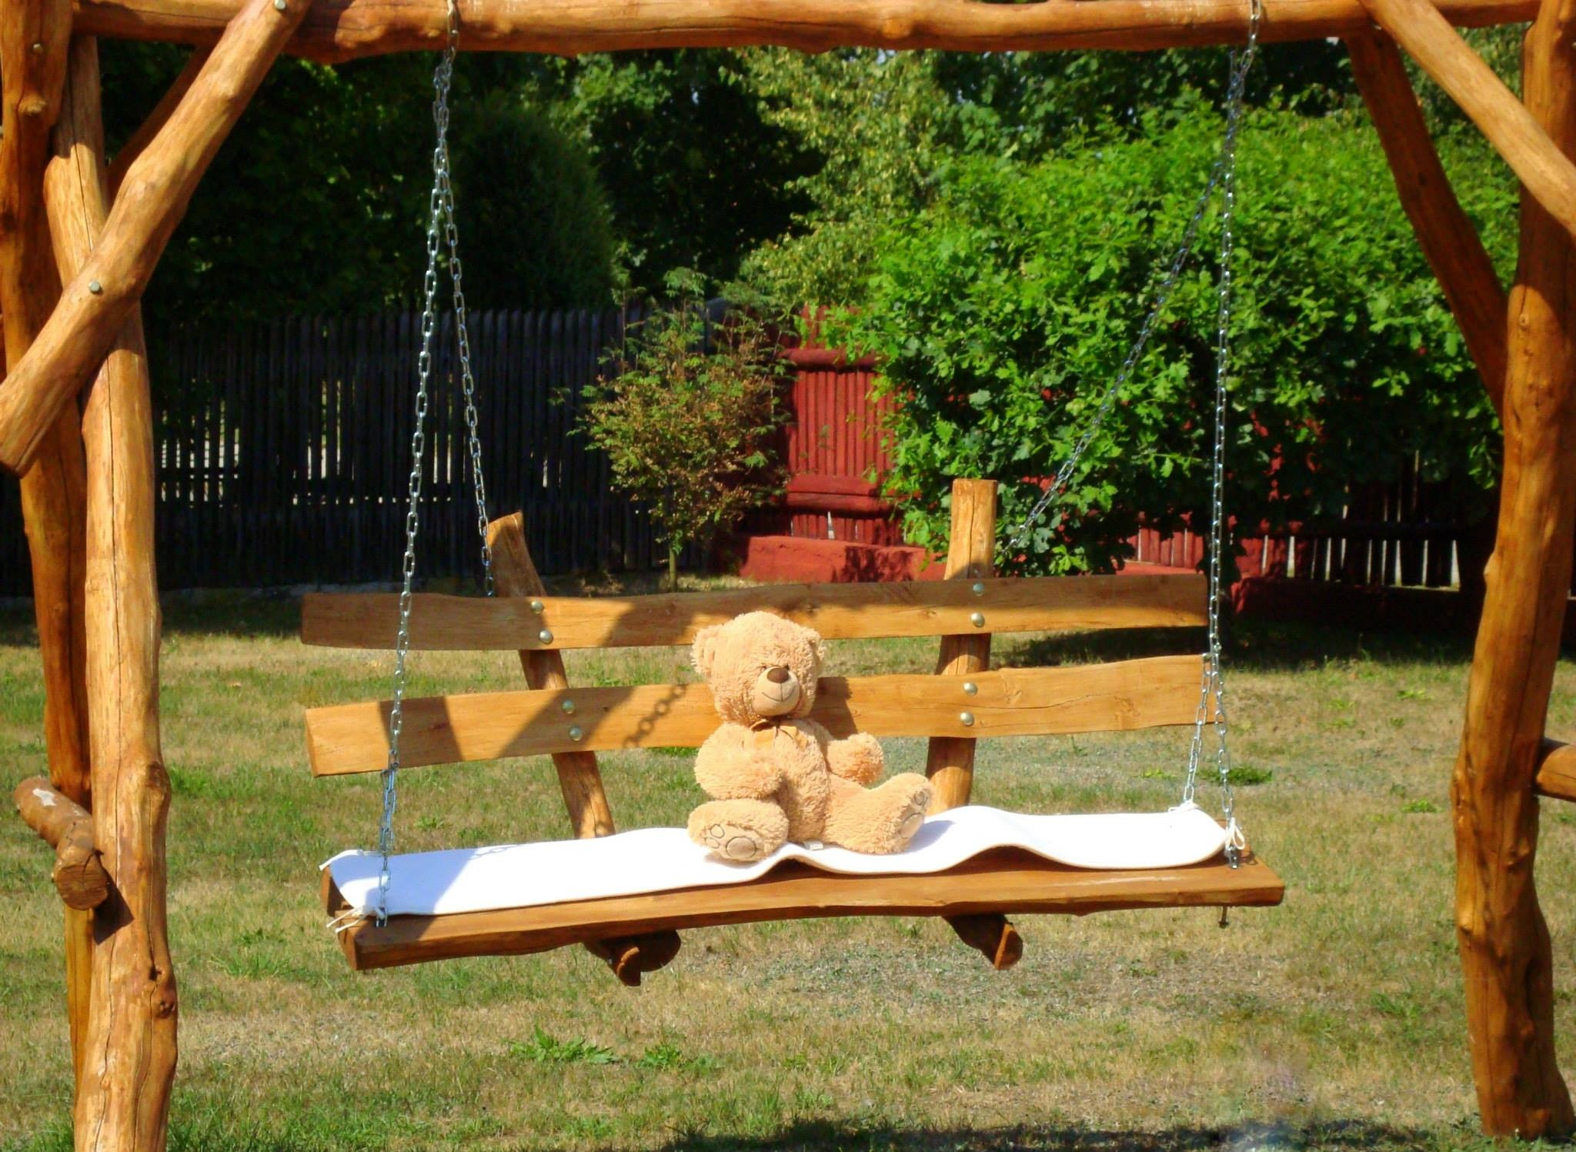
playing outside
LIEKE,LUC , LIEKE

Slide 2
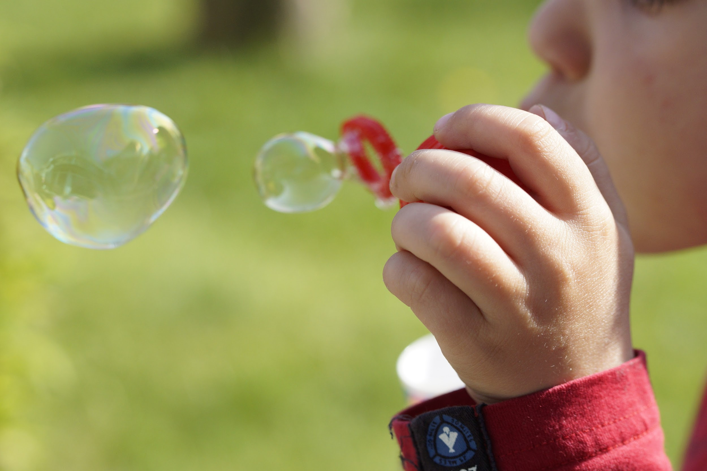
inhoud
to build huts?
wath clothes?
where do you play?
at which moment?
how long do you do that?

Slide 3
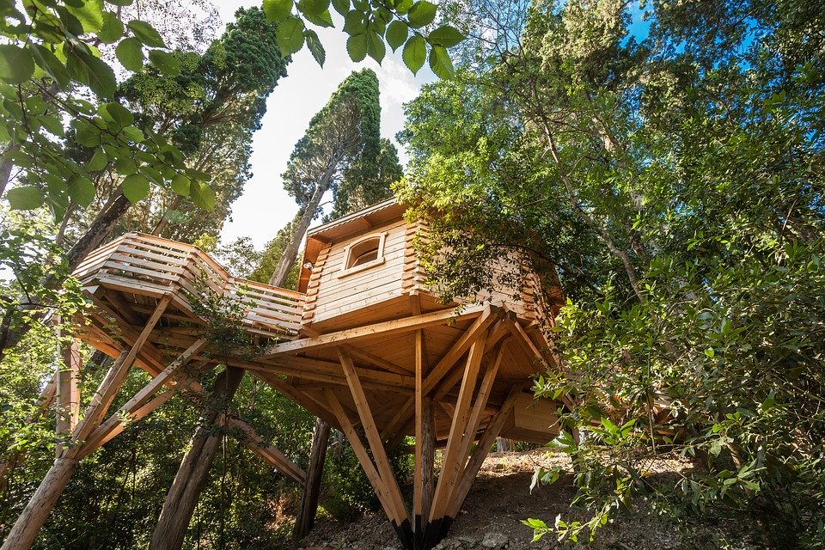
to build huts
which place
what stuff
determinis again

Slide 4
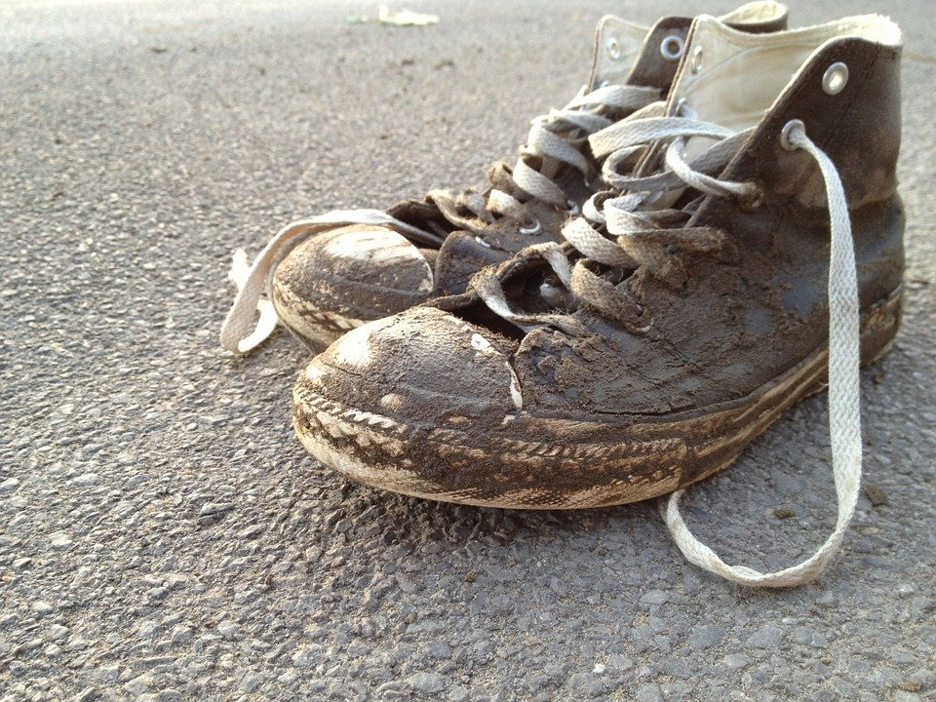
wich clothes?
olth clothes
why old clothes
how can they get dirty
what old clothes

Slide 5
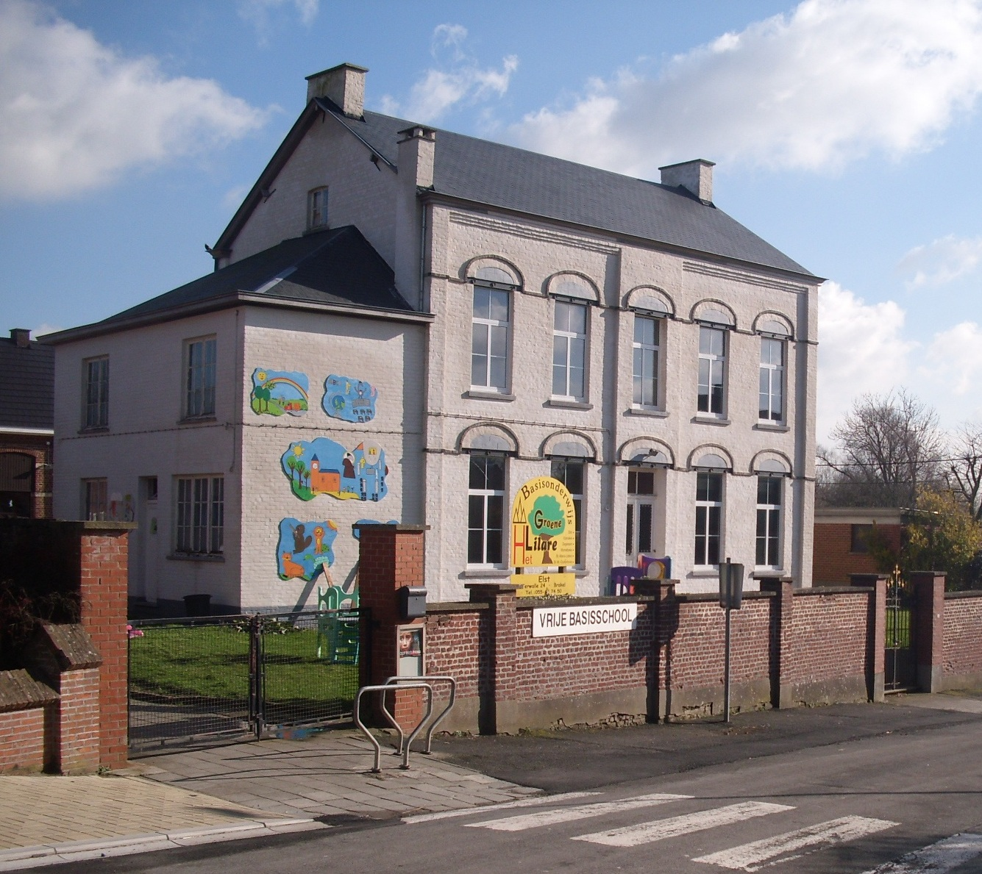
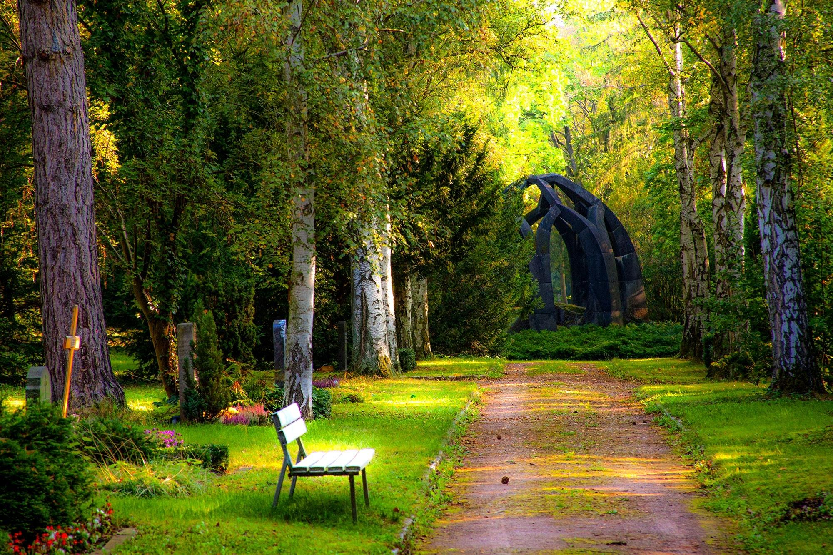
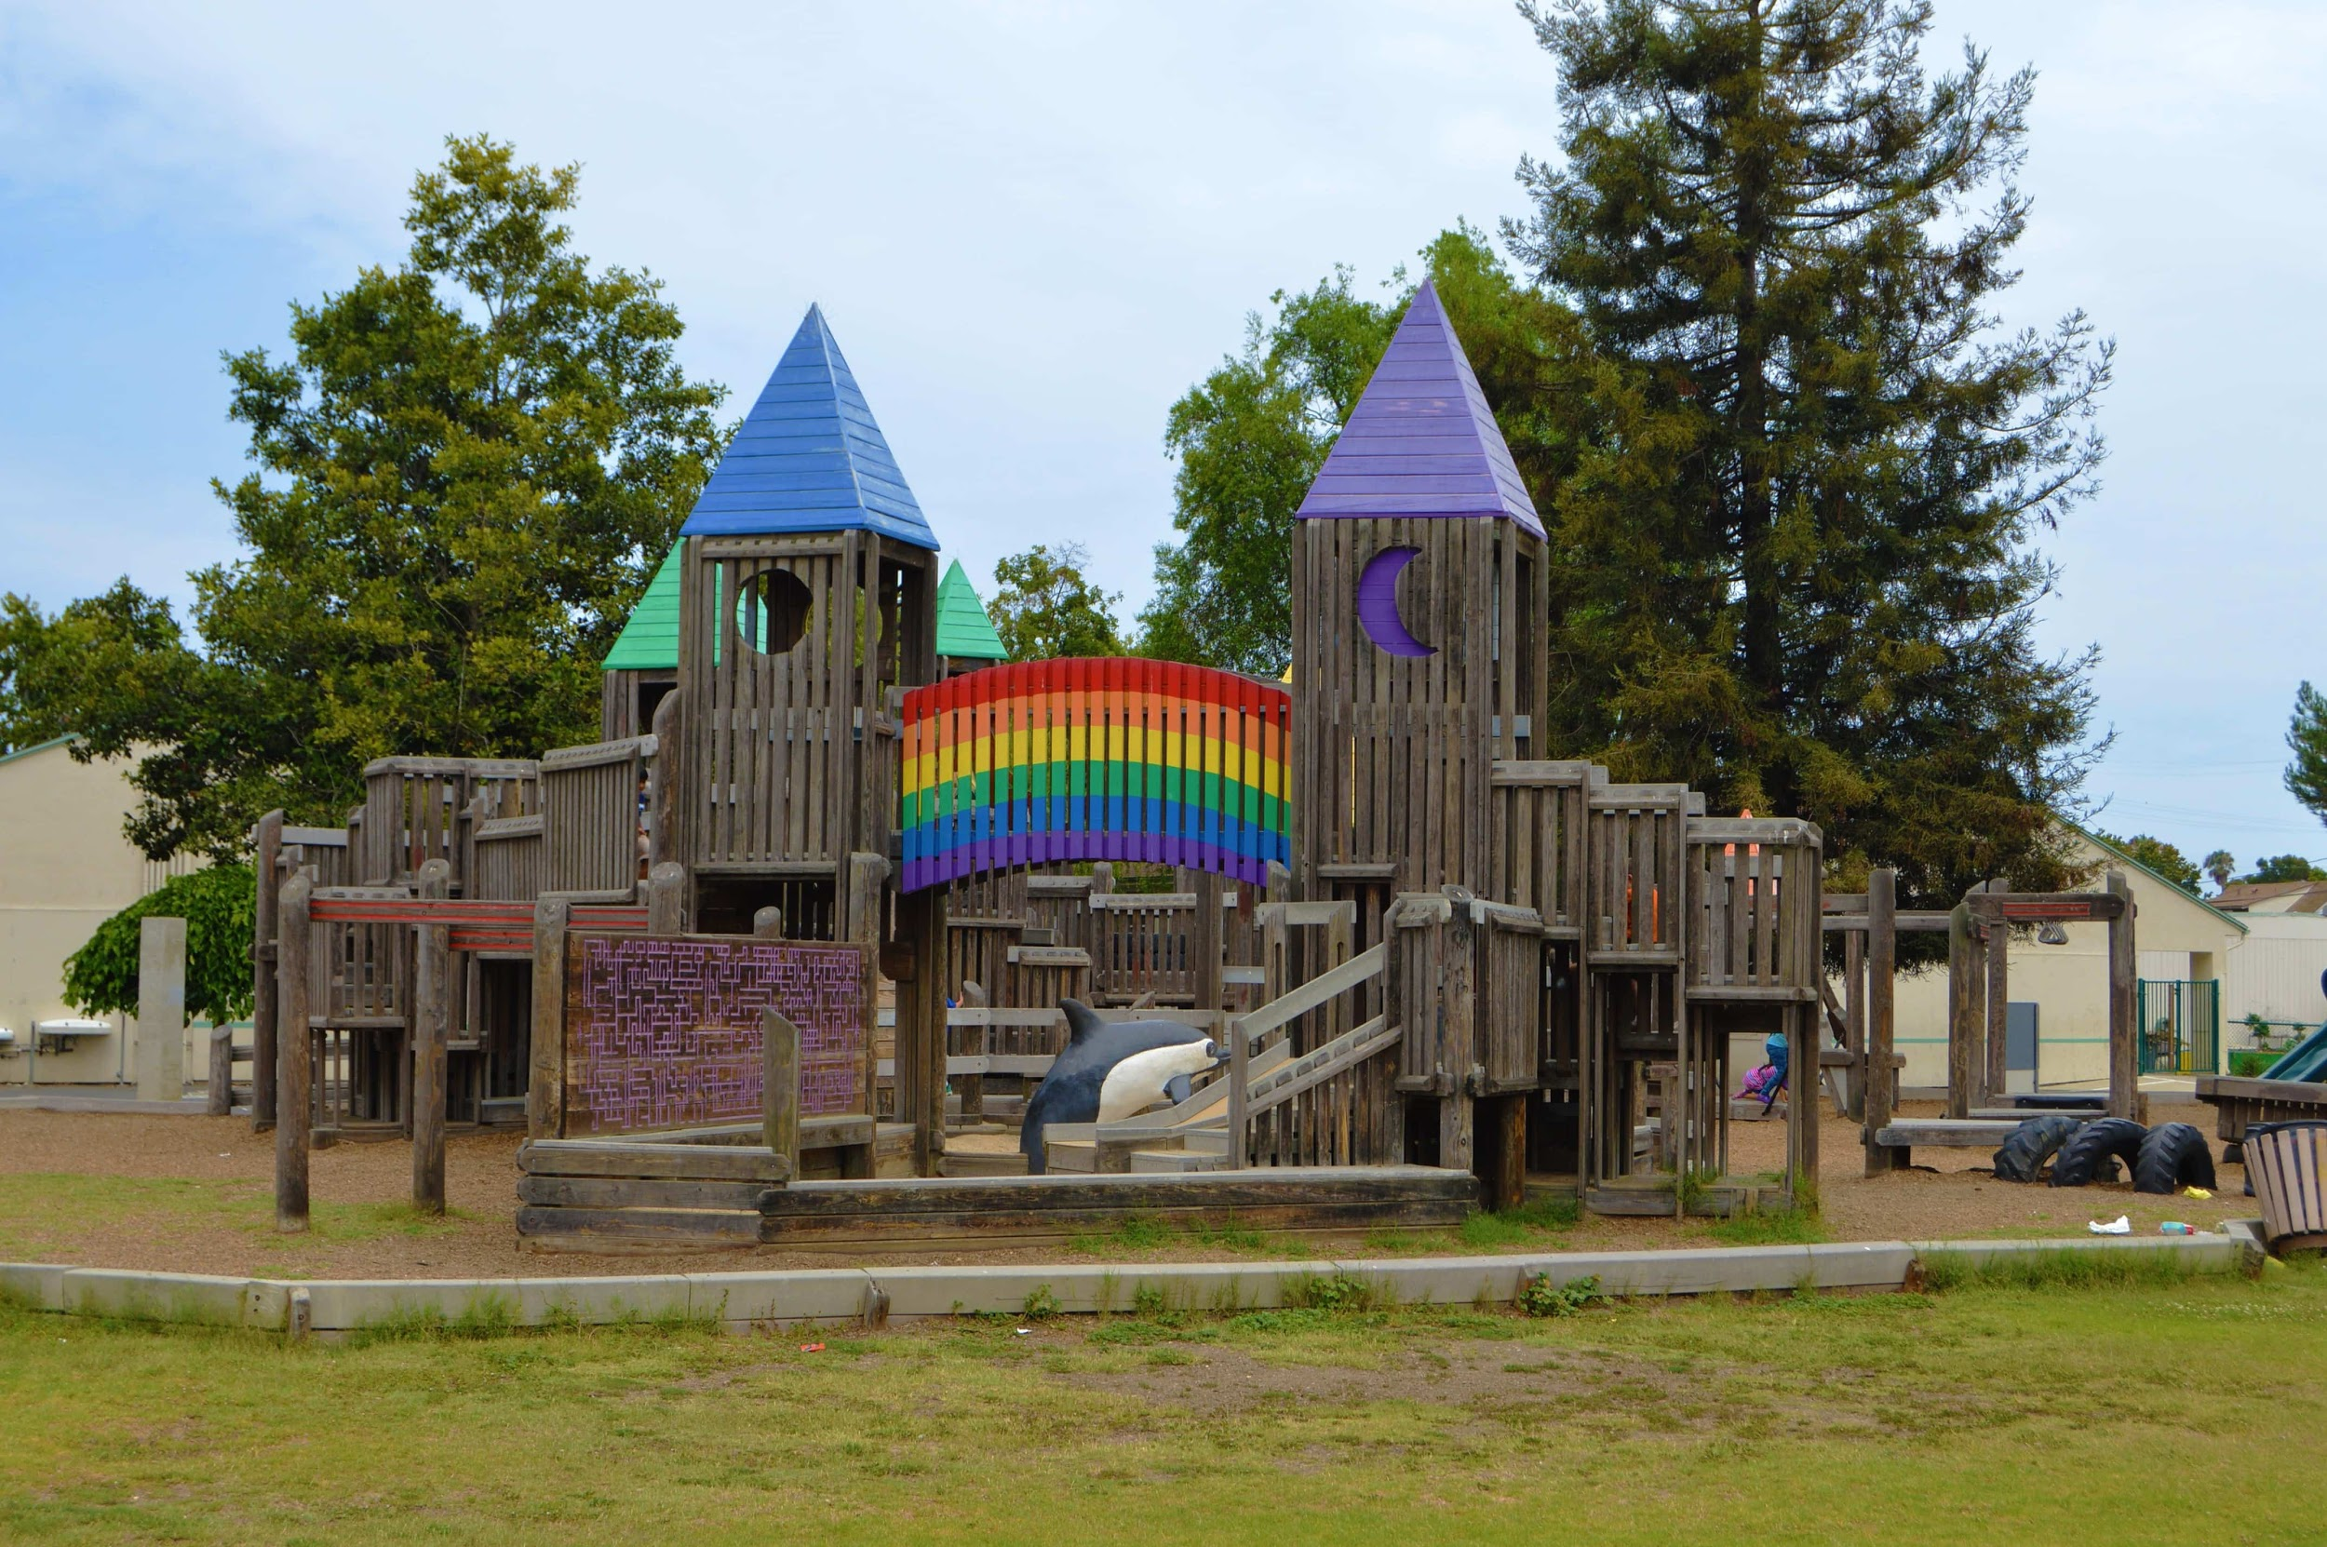
where do you play
in parks
in the payground
on the street
in the backyard
with your friends
at school

Slide 6
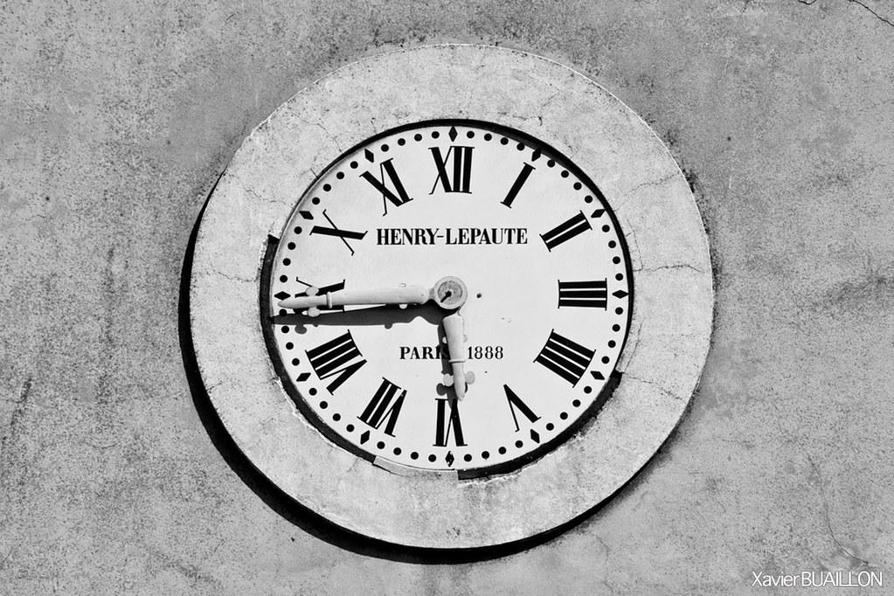
at whitch moment
in the afternoon
during the summer
wen thun sun shines

Slide 7

how long do you do that
in the summer you do it for 2 hours
in the spring an hour and a half
1 hour in the fall
in the winter 45 minutes
in total 5 hours and 15 minutes

Slide 8
