Slide 1
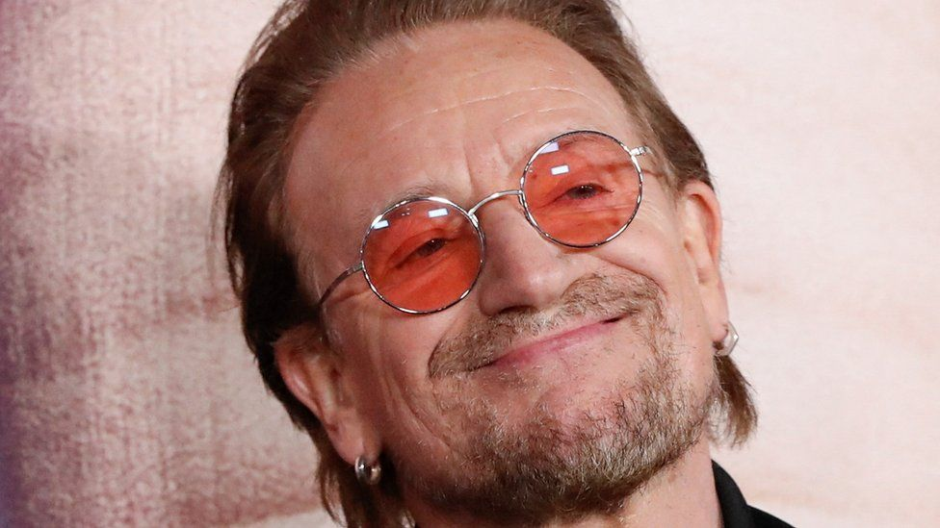
Bono of U2

Slide 2
BONO
Paul David Hewson (born 10 May 1960), known by his stage name Bono, is an Irish singer-songwriter, activist, and philanthropist.
He is the lead vocalist and primary lyricist of the rock band U2.

Slide 3
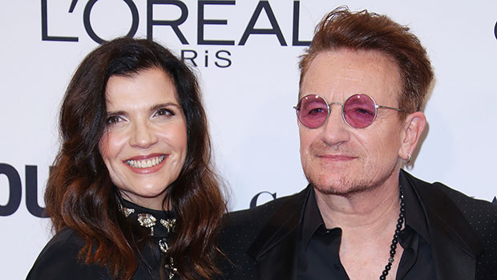
BONO
Born and raised in Dublin, he attended Mount Temple Comprehensive School where he met his future wife, Alison Stewart, as well as schoolmates with whom he formed U2 in 1976.

Slide 4
BONO
Bono soon established himself as a passionate frontman for the band through his expressive vocal style and grandiose gestures and song writing. His lyrics frequently include social and political themes, and religious imagery inspired by his Christian beliefs.

Slide 5
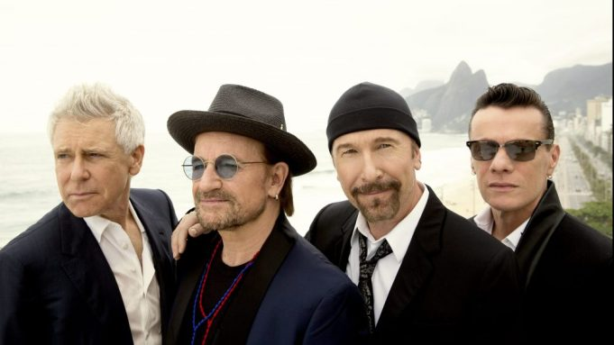
BONO
During U2's early years, Bono's lyrics contributed to the group's rebellious and spiritual tone. As the band matured, his lyrics became inspired more by personal experiences shared with the other members.

Slide 6

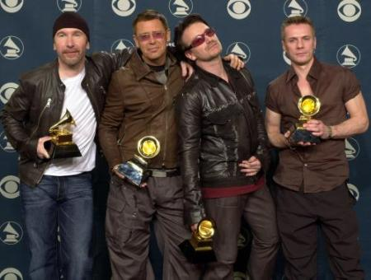
BONO
As a member of U2, Bono has received 22 Grammy Awards and has been inducted into the Rock and Roll Hall of Fame.

Slide 7


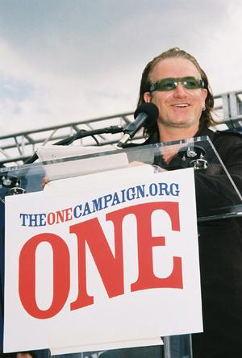
BONO
Aside from his music, Bono is an activist for social justice causes, both through U2 and as an individual. He is particularly active in campaigning for Africa, for which he co-founded DATA, EDUN, the ONE Campaign, and Product Red.

Slide 8
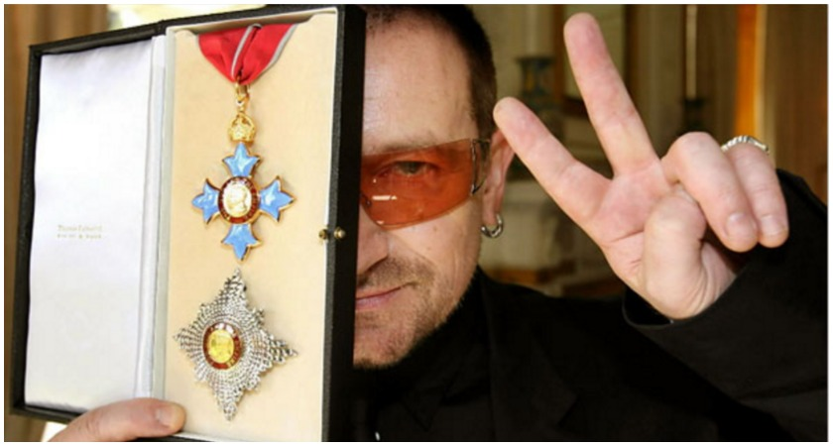
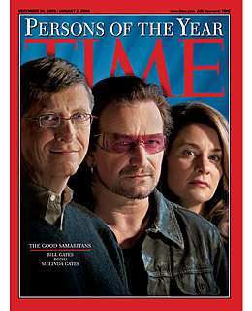

Bono
In 2005, Bono was named one of the Time Persons of the Year.
He was granted an honorary knighthood by Elizabeth II of the United Kingdom in 2007 for "his services to the music industry and for his humanitarian work",
He was made a Commandeur of the French Ordre des Arts et des Lettres (Order of Arts and Letters) in 2013.

