Slide 1

Scoil Iosef Naofa,
Corville,
Roscrea,
Co Tipperary,
IRELAND

Slide 2
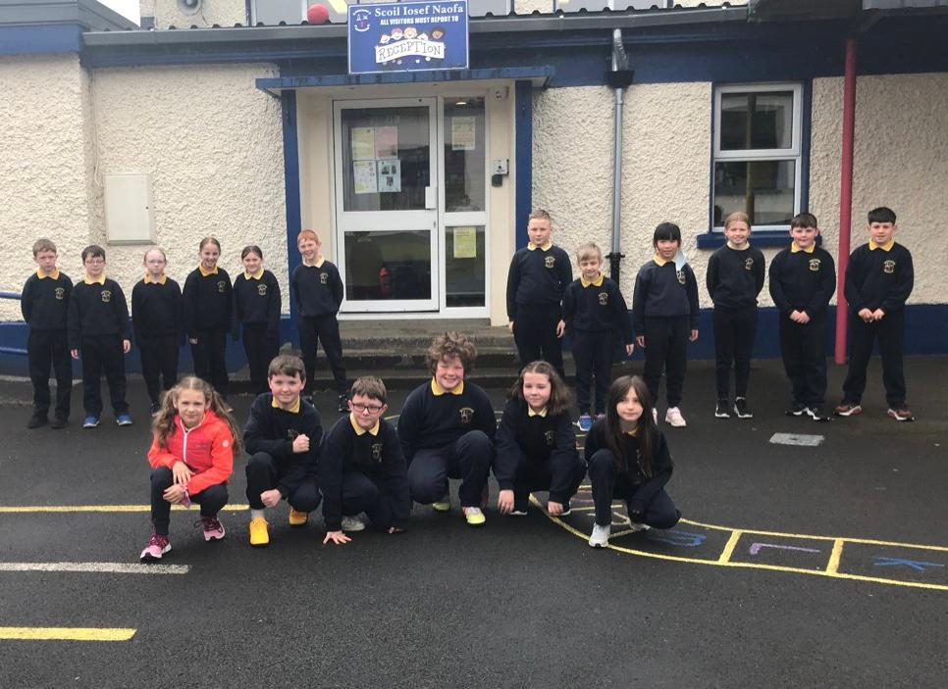
Clothes And Fashion In Corville

Slide 3
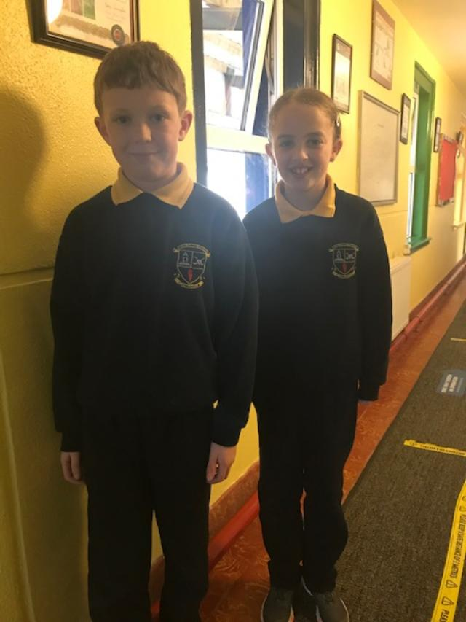
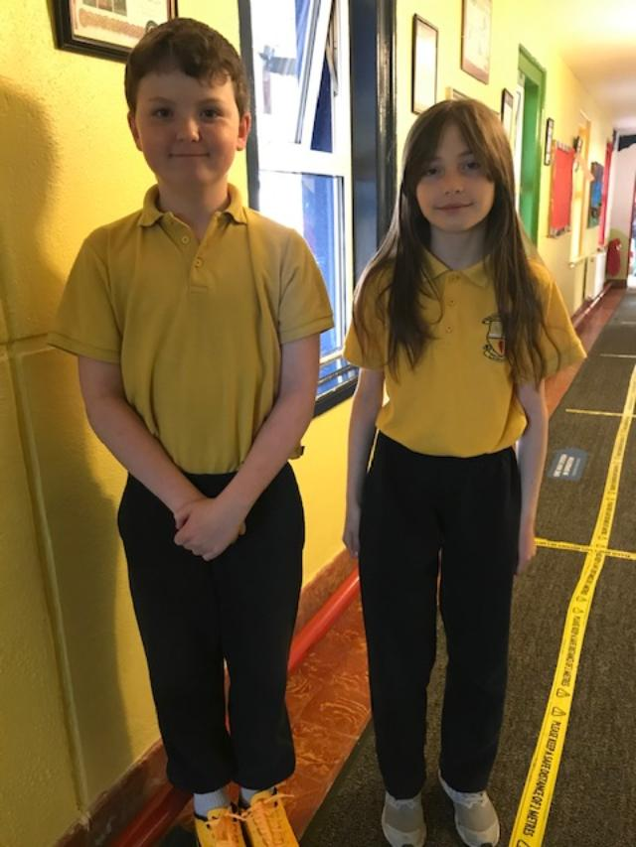
School Uniform
In school we wear our uniform every day.
We wear a navy jumper, navy trousers and a yellow polo shirt.
We have our school crest on the jumper.

Slide 4
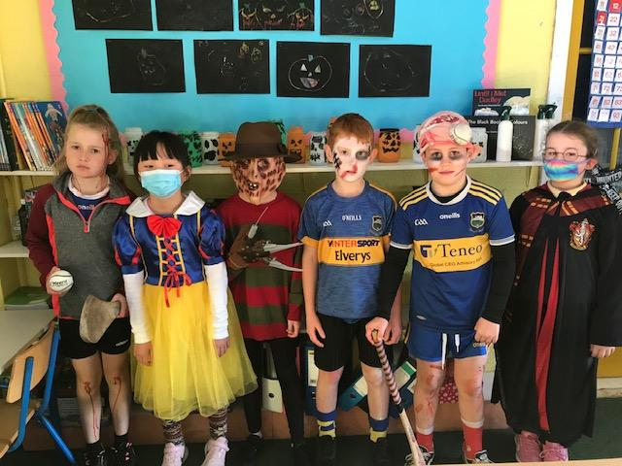
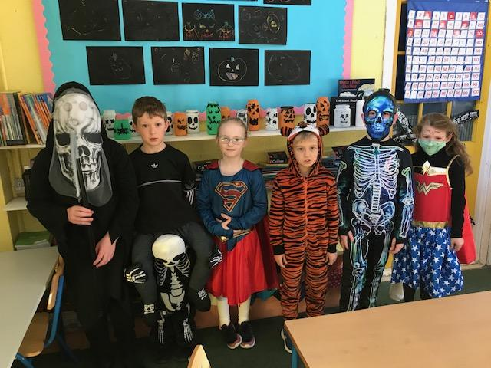
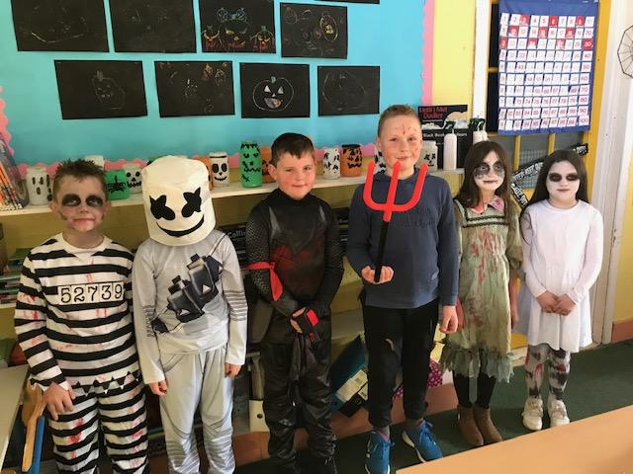
Special Occasions -Halloween
We dress up in costume for Halloween.
On our last day before the holidays we can wear our costumes to school.

Slide 5
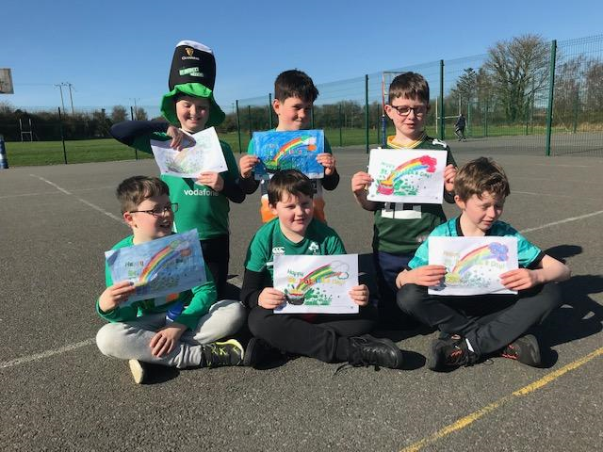
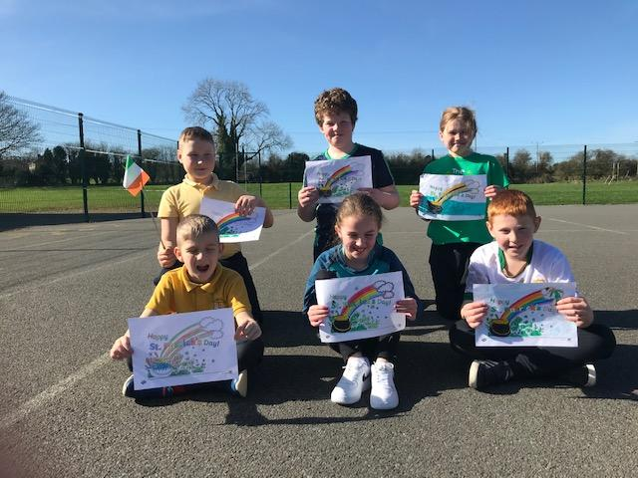
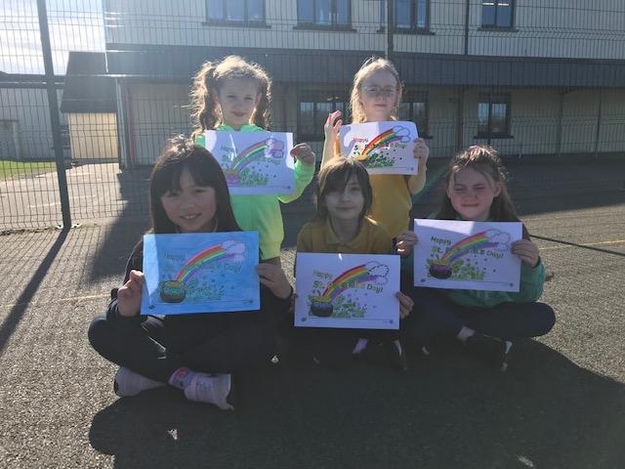
Special Occasions –St. Patricks Day
St Patrick is our patron Saint.
We dress in green and have parades to celebrate his day-March 17th.
In school we have ‘lá glas’ which means ‘green day’

Slide 6
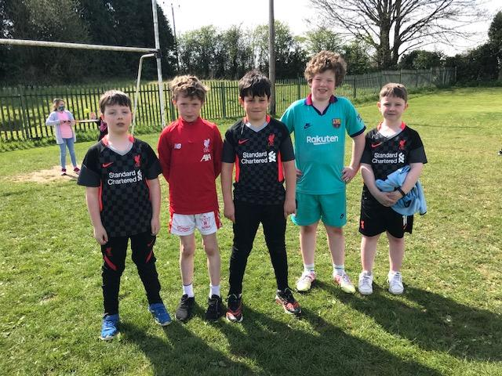
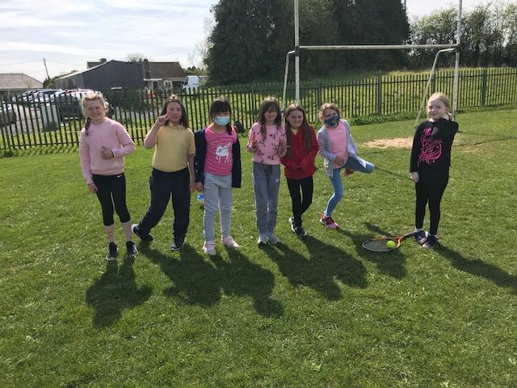
Parties!
We loooove parties!
When we go to parties we love being comfortable so we can play and have fun.

Slide 7
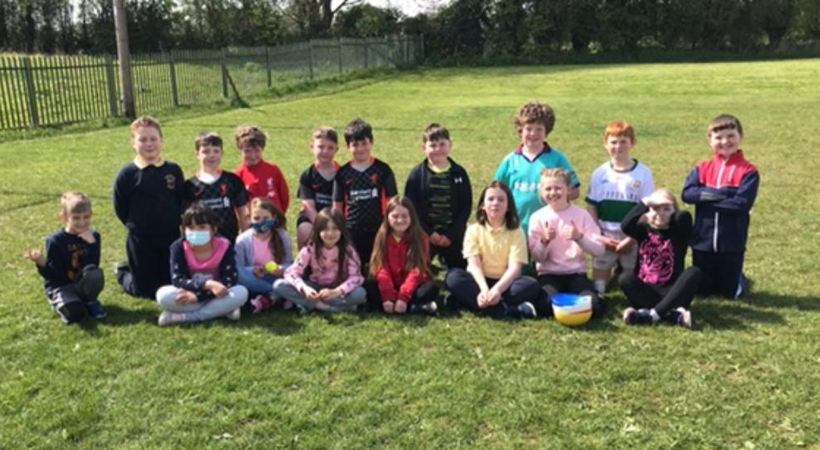
Parties!
We all love a good party!

Slide 8
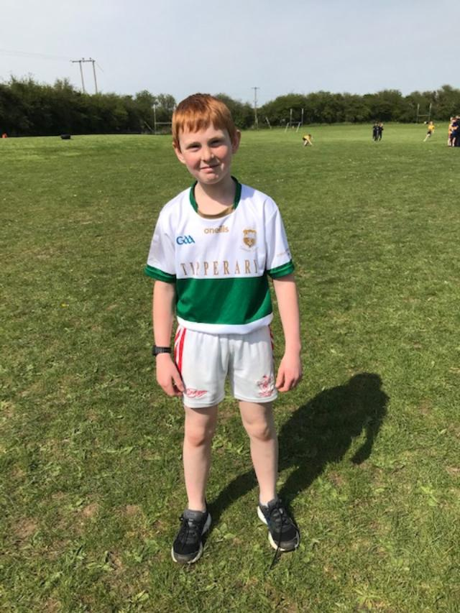
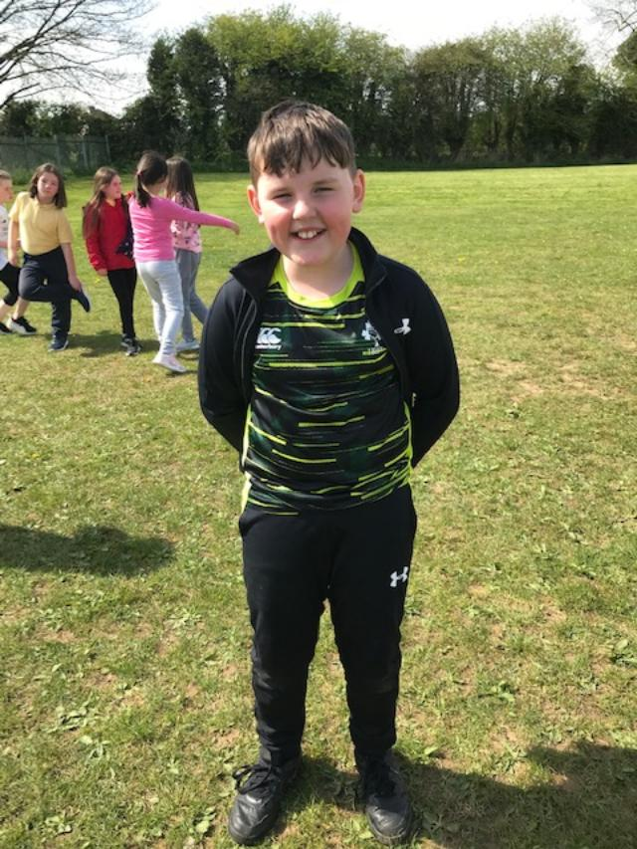
Sport
In Ireland we love playing sport. We play soccer, gaelic, hurling and rugby.
We wear jerseys and shorts or bottoms.

Slide 9
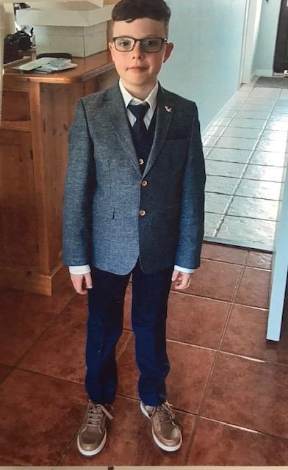
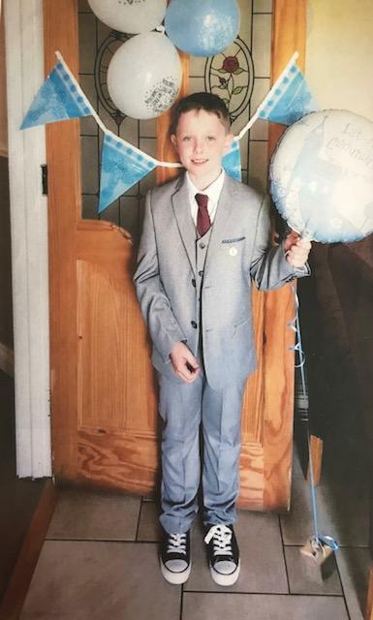
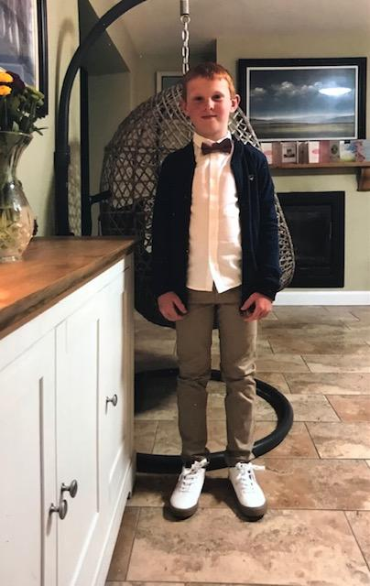
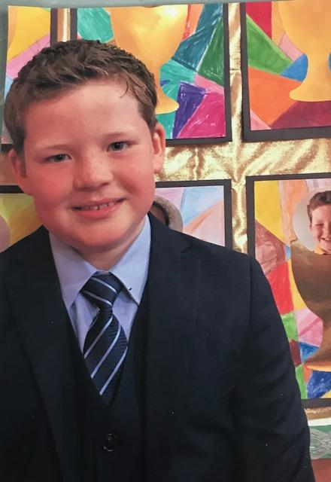
Communion
We celebrate the sacrament of communion in 2nd class ( 8 /9 years old)
We have mass and then celebrate with our families.
The boys wear suits and the girls wear white dresses.

Slide 10
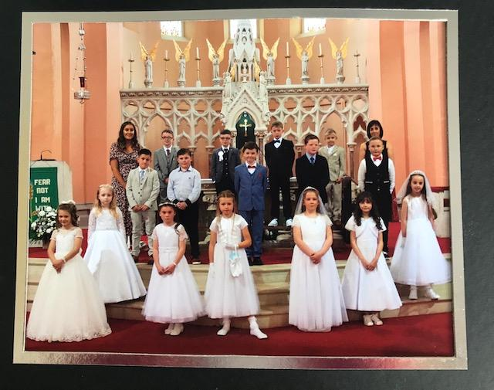
We all had a really special day!

Slide 11
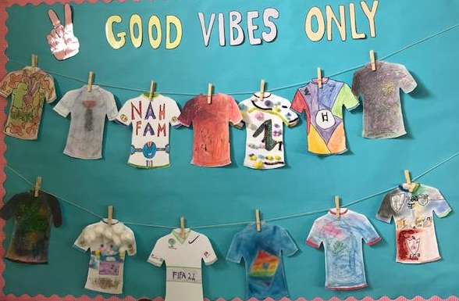
We hope you enjoyed our project! We love dressing up for all occasions!
3rd Class –
Roscrea ,
IRELAND

