Slide 1
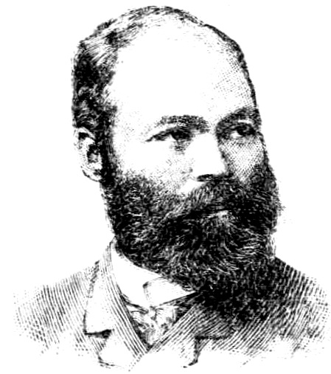
Georgios Jakobides
Georgios Jakobides (Γεώργιος Ιακωβίδης; 11 January 1853 – 13 December 1932) was a painter and one of the main representatives of the Greek artistic movement of the Munich School. He founded and was the first director of the National Gallery of Greece in Athens.

Slide 2
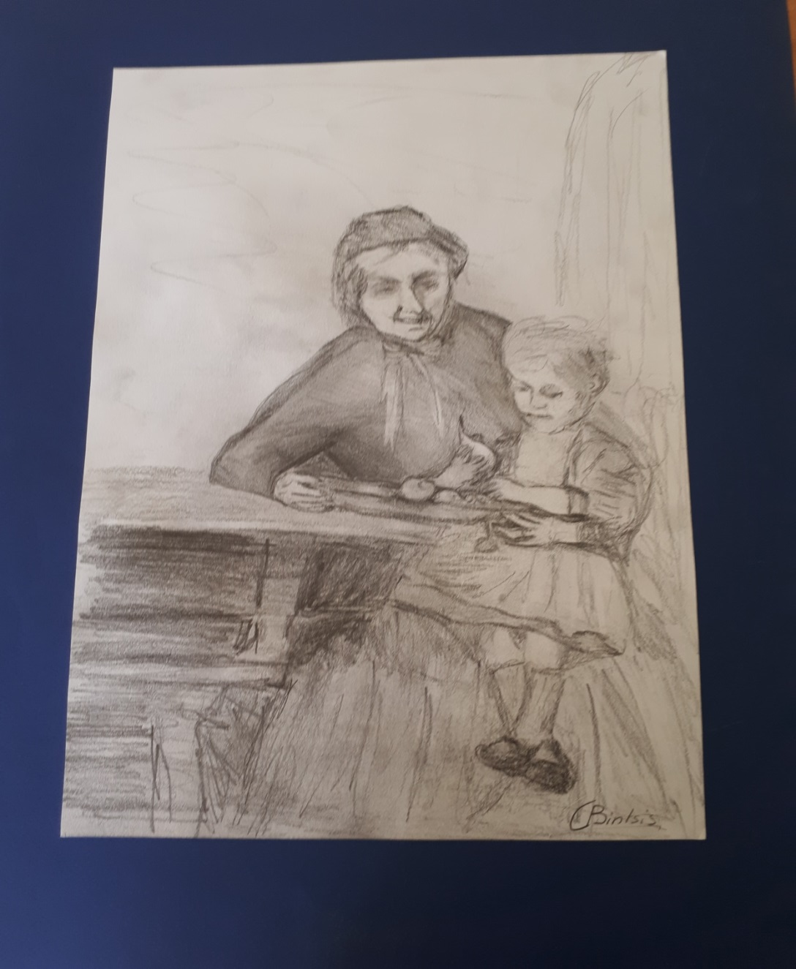
Our 6th Graders made some beautiful copies of his famous paintings!

Slide 3
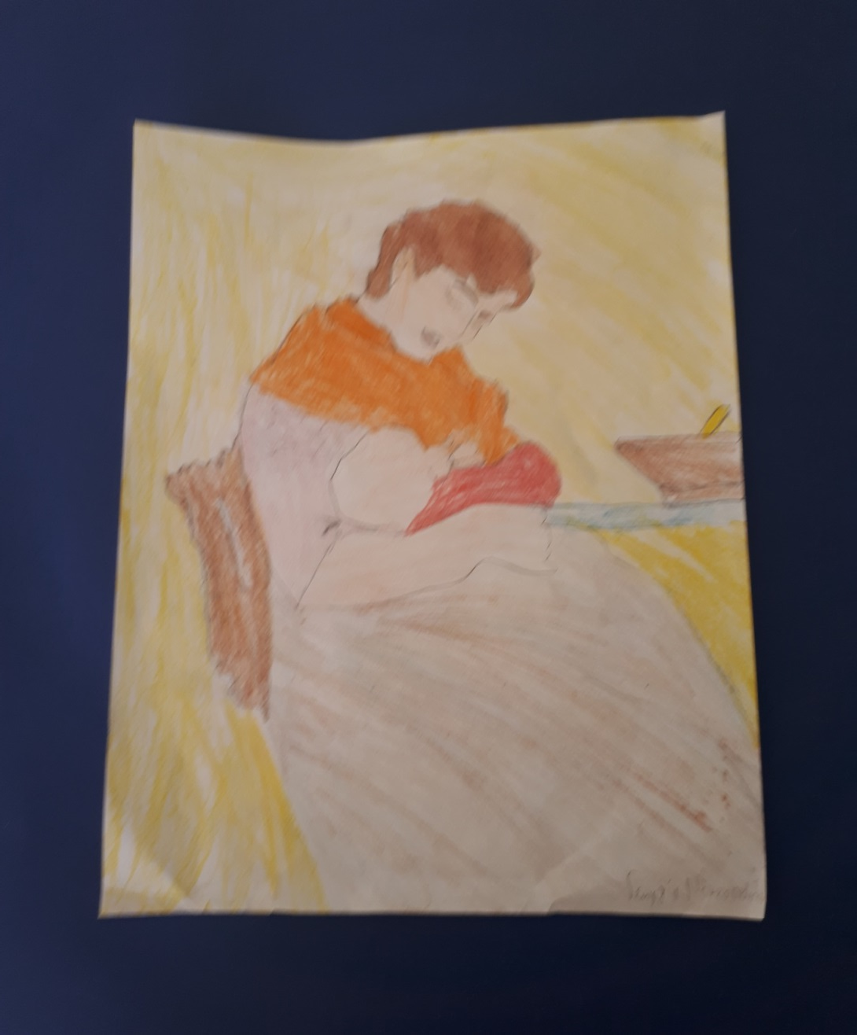

Slide 4
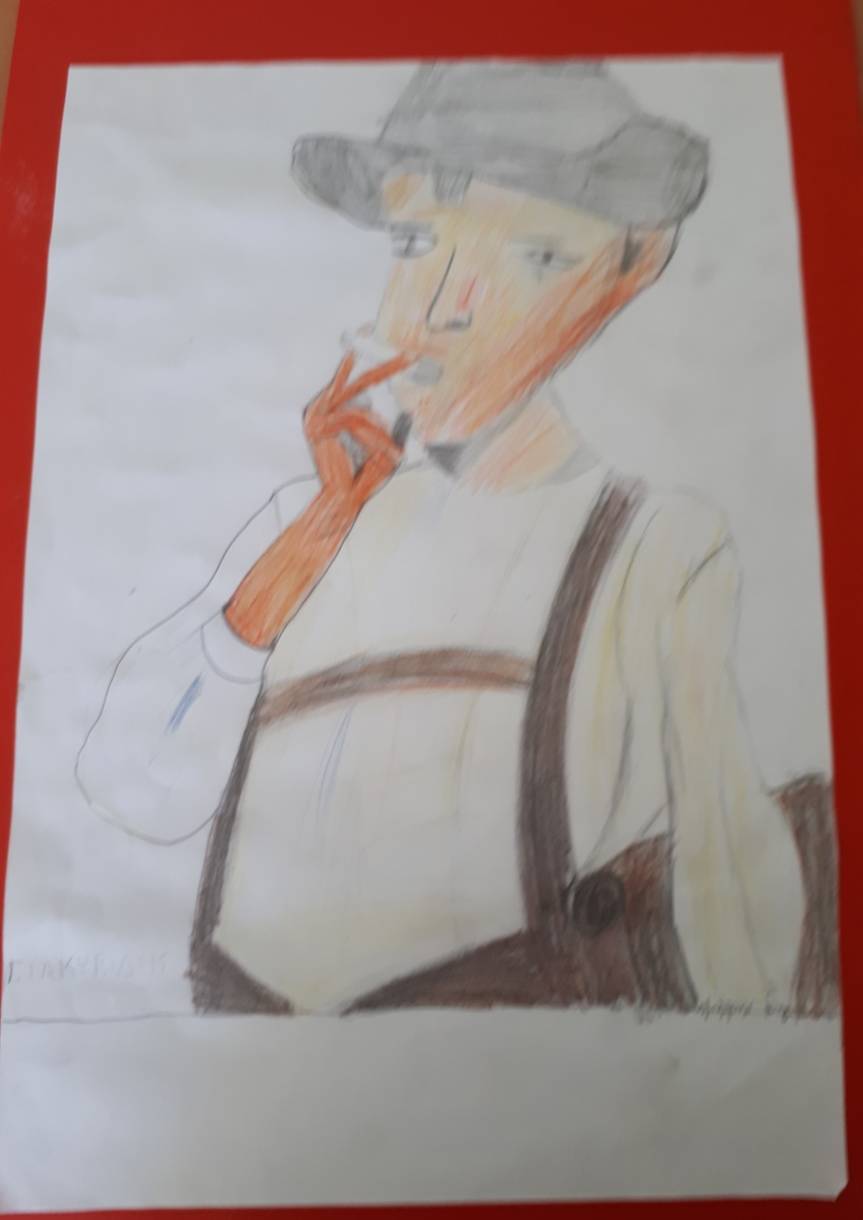

Slide 5
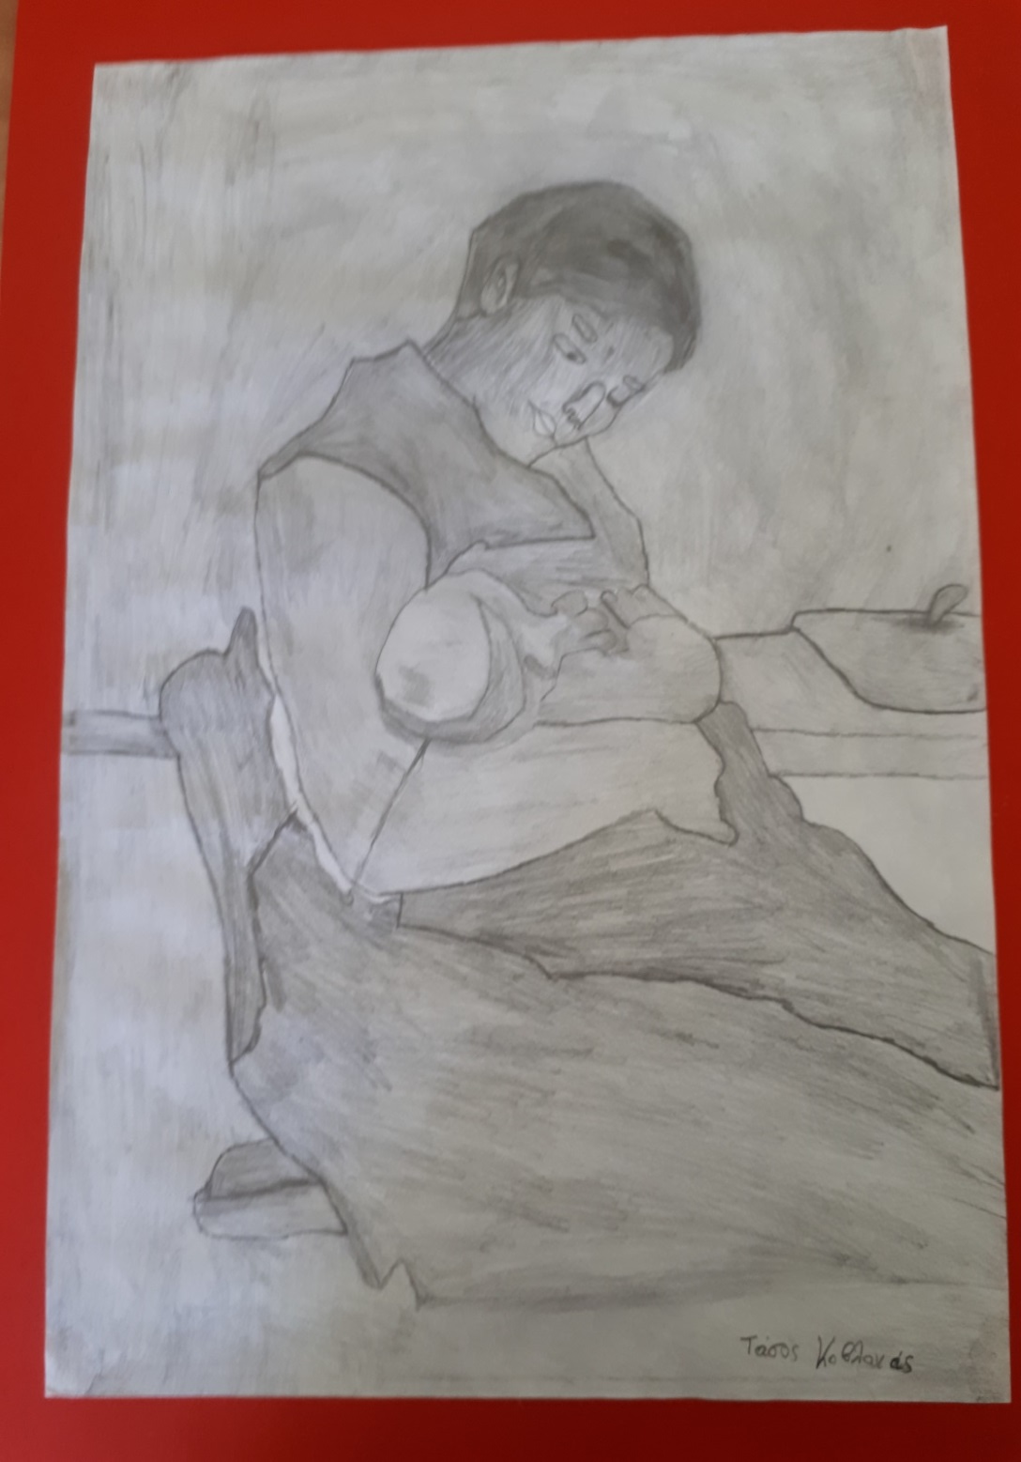

Slide 6
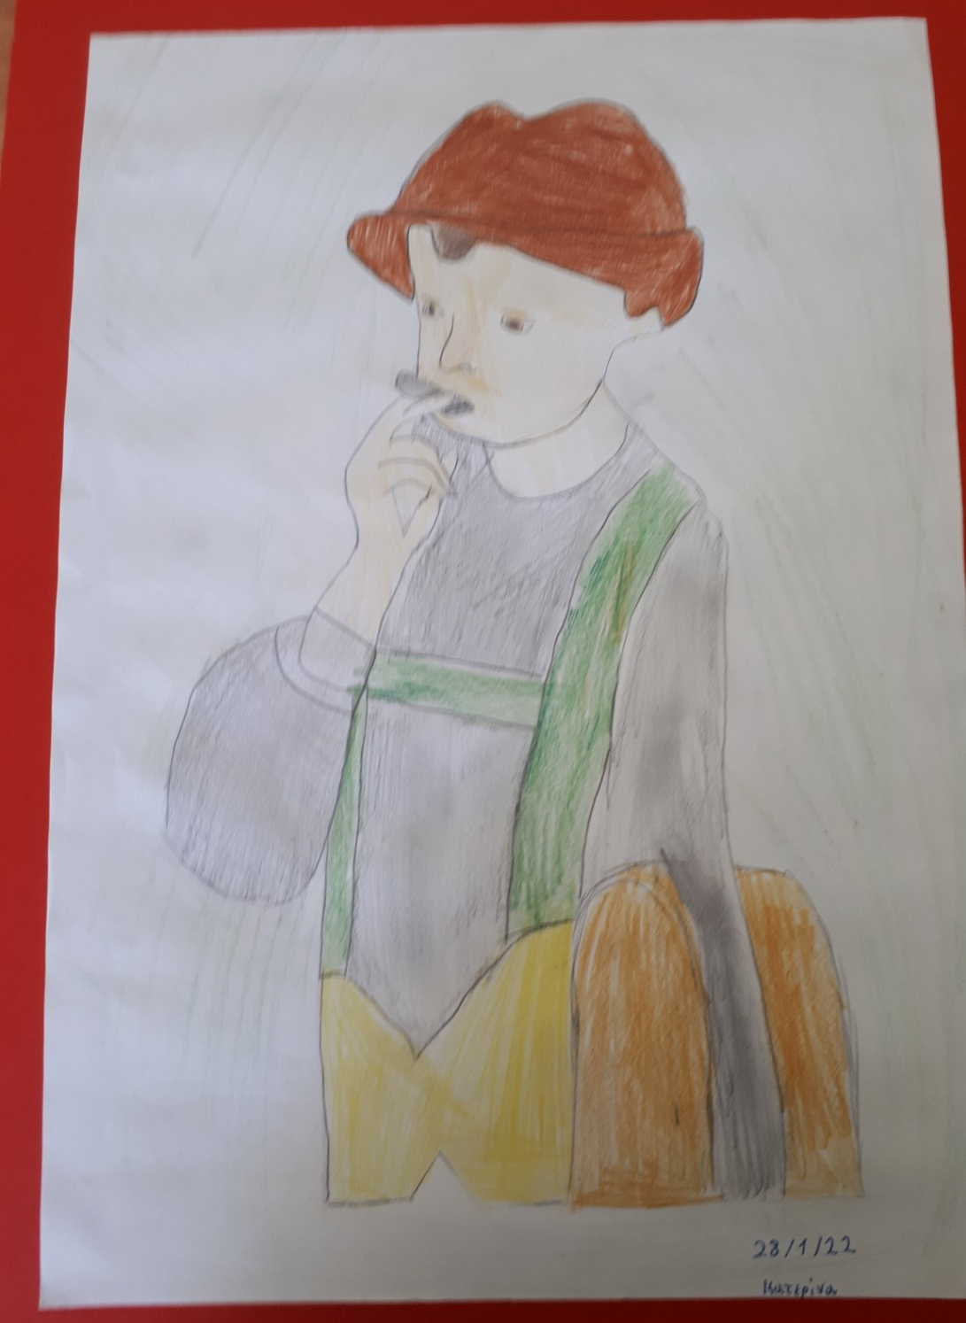

Slide 7
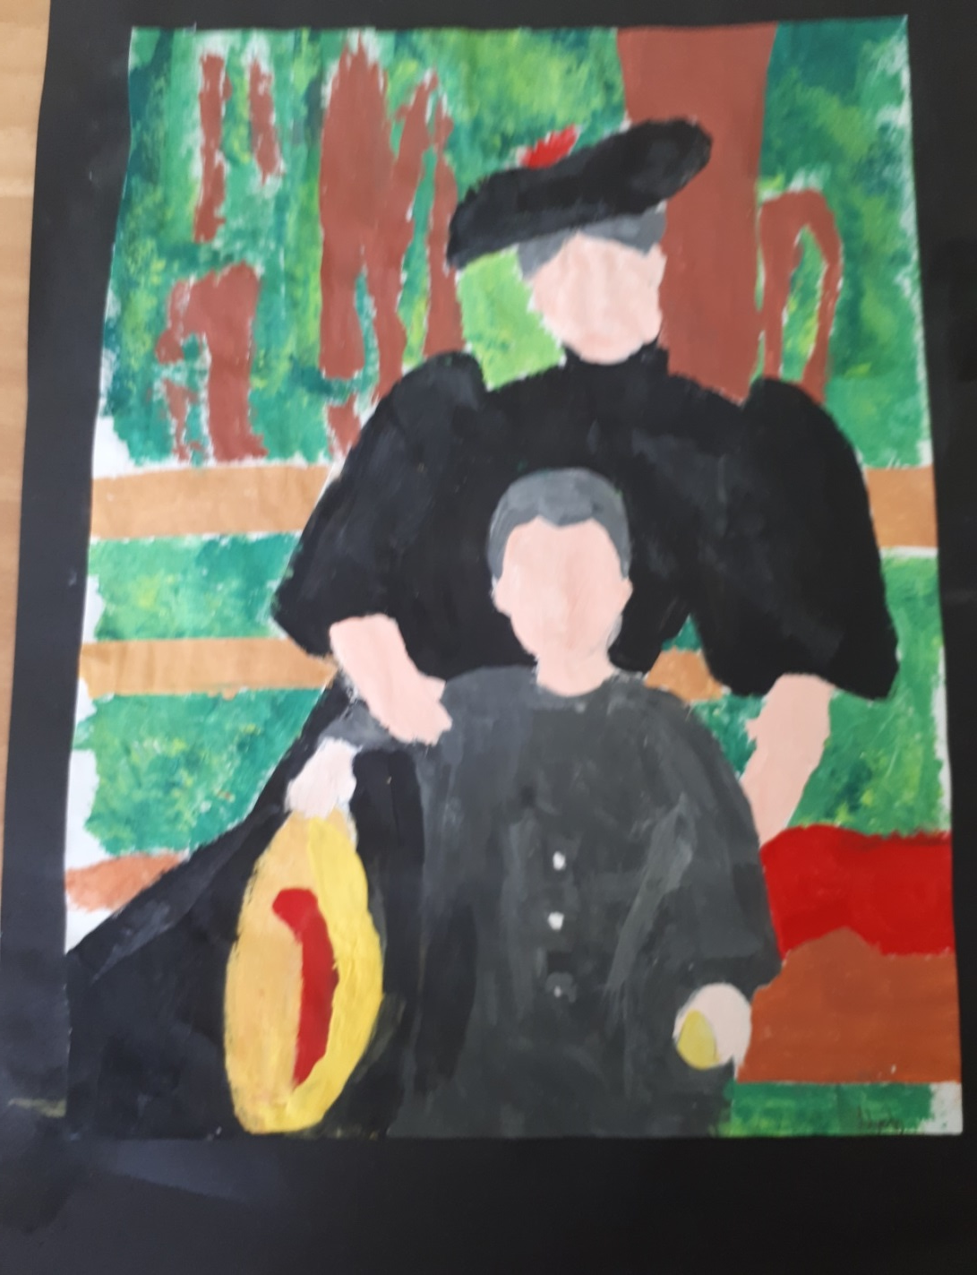

Slide 8
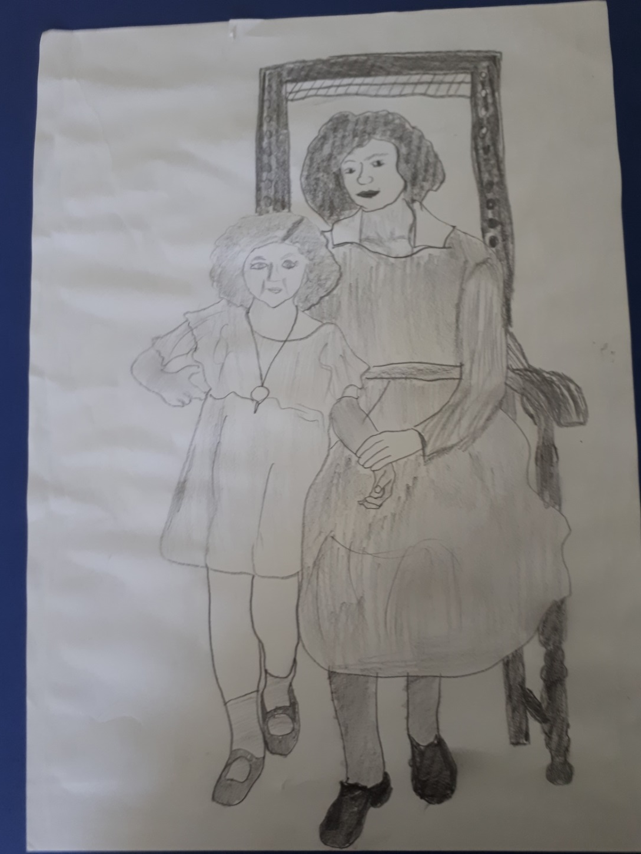

Slide 9
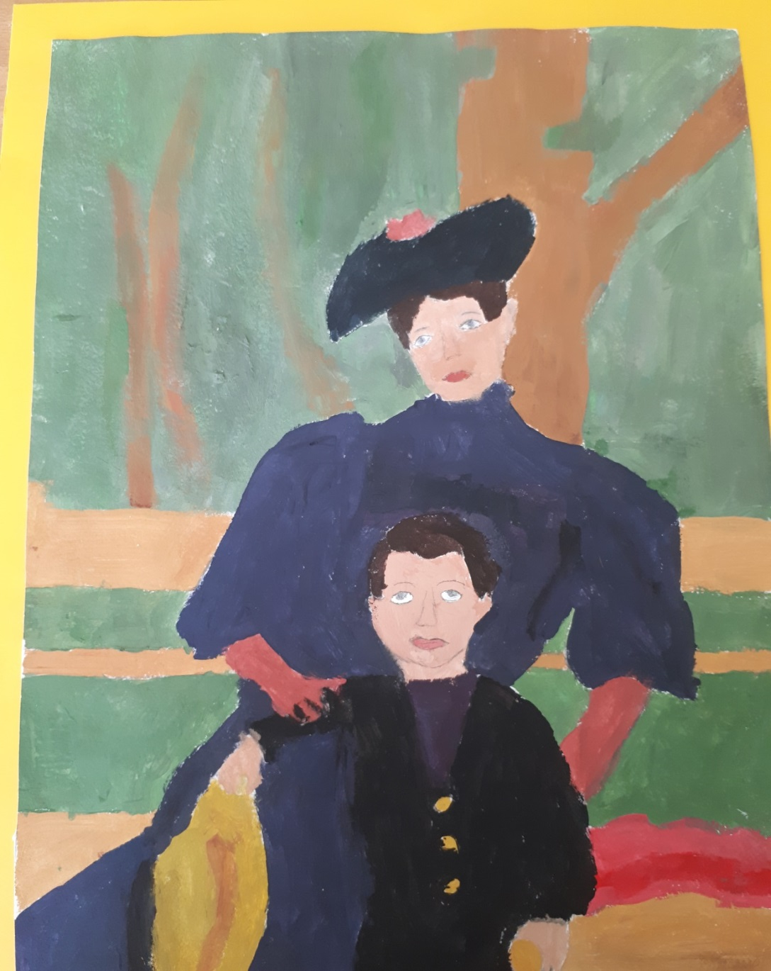

Slide 10
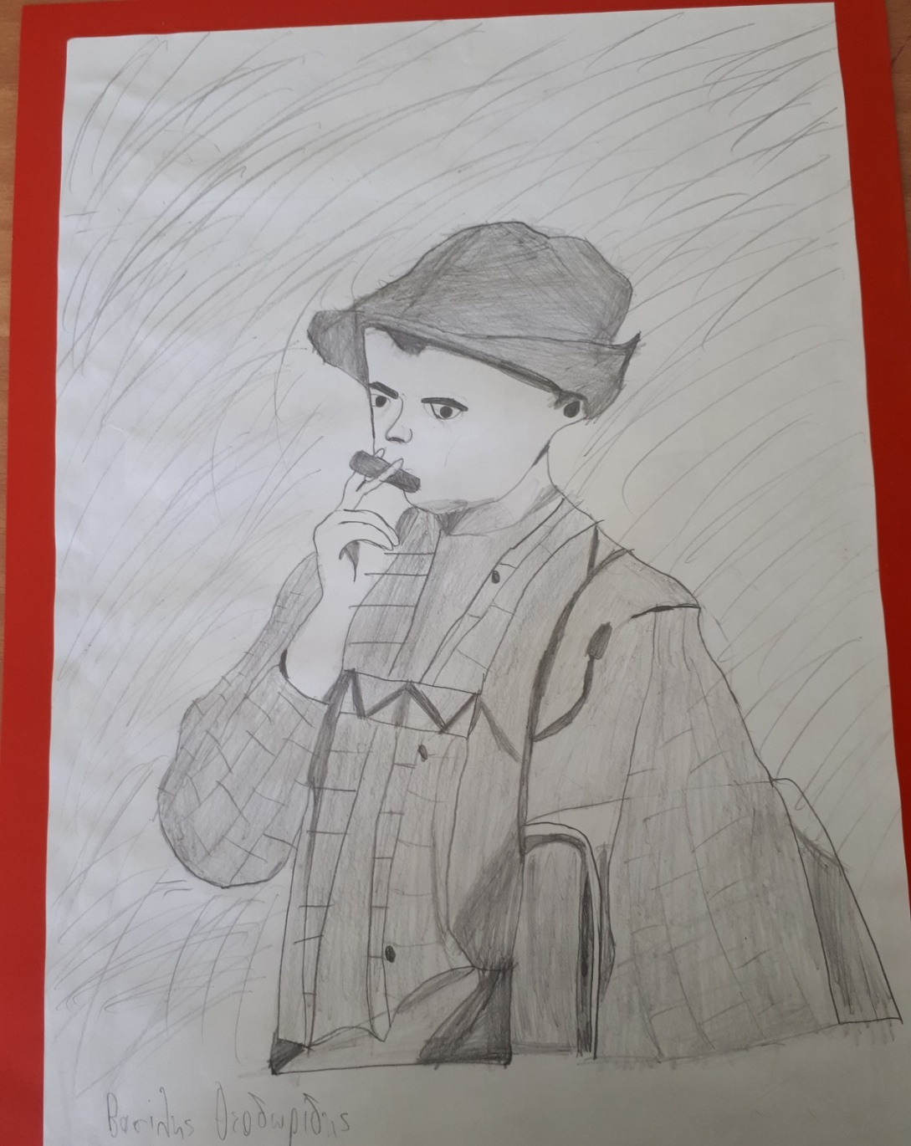

Slide 11
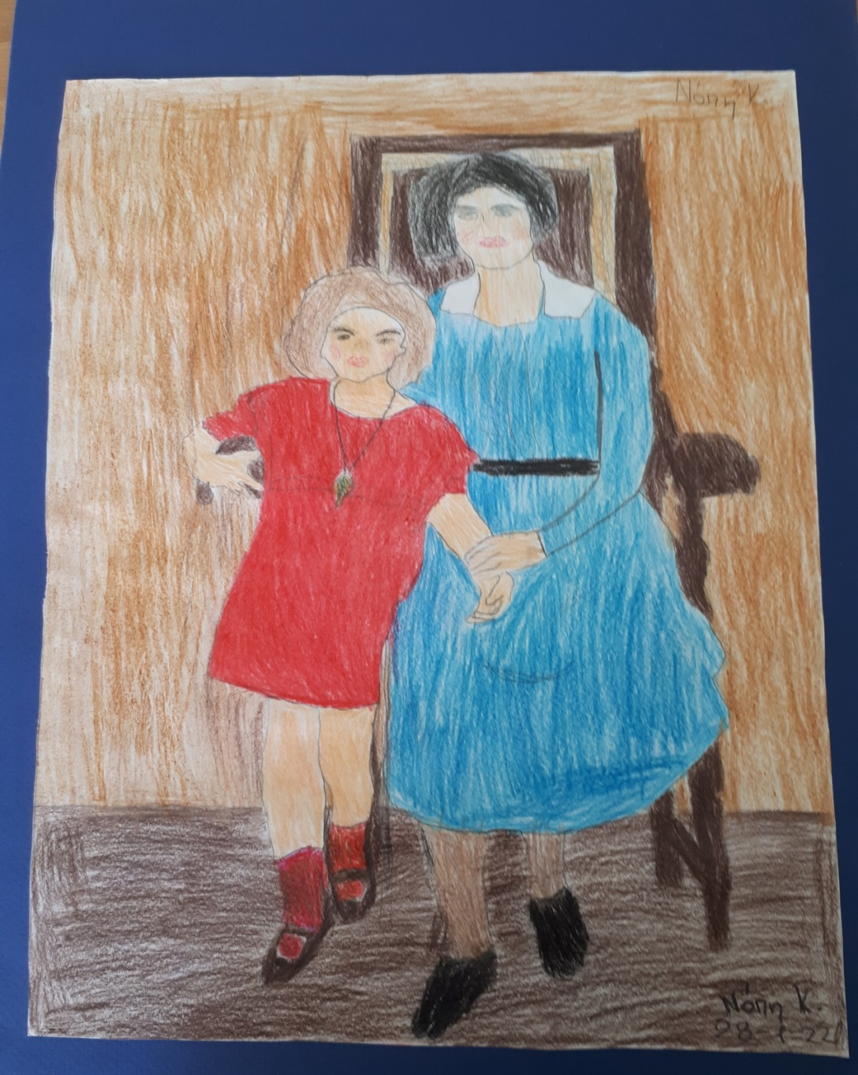

Slide 12
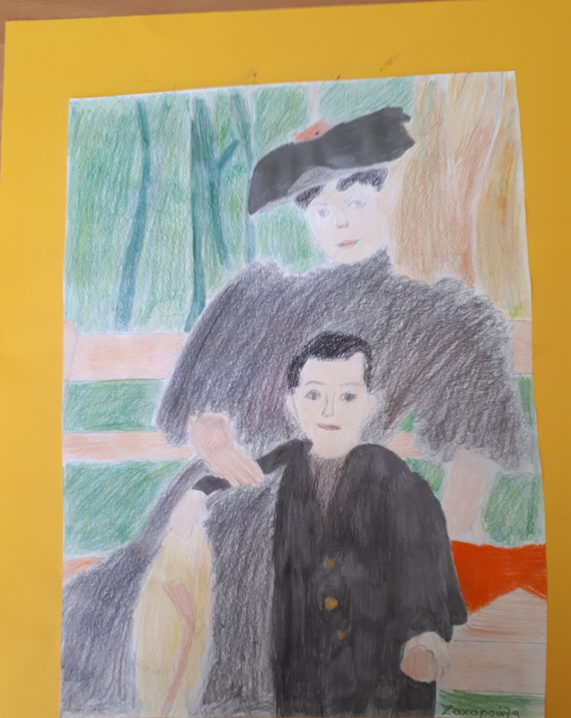

Slide 13
