Slide 1
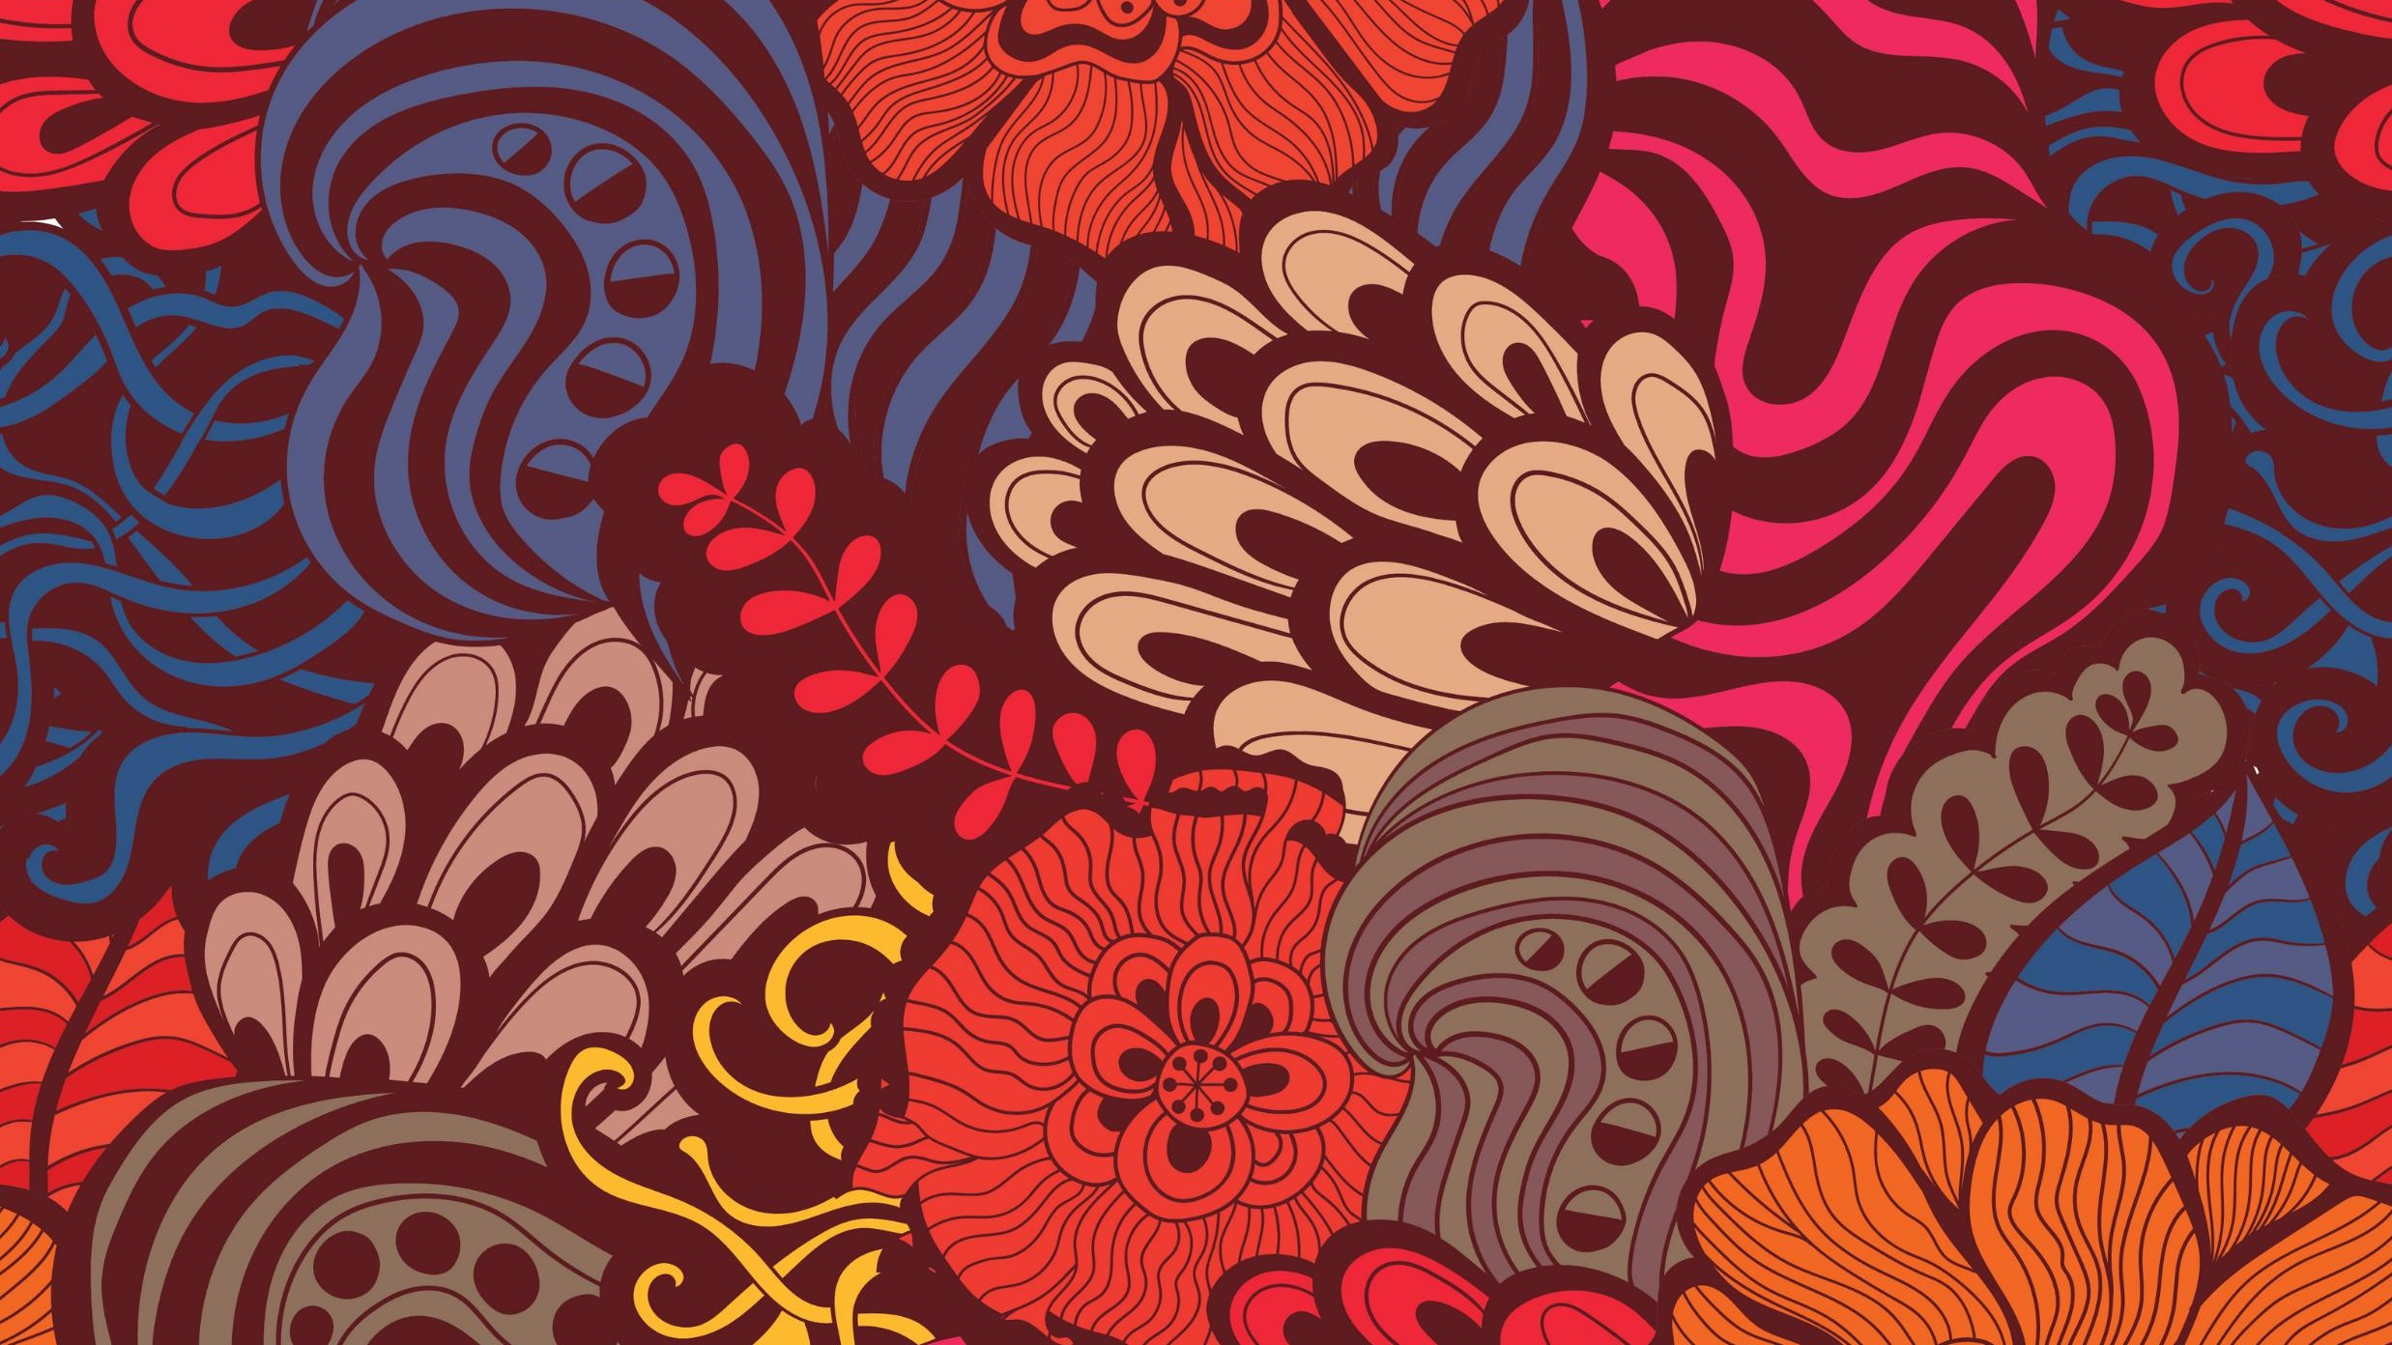
Jack butler yeats
Ala Hamill Kolodziejczyk

Slide 2
Family and Life
Jack Butler Yeats was born on August 23rd 1871 at 23 Fitzroy Road, London. He was the youngest child of artist John Butler Yeats and Susan Yeats. Jack was the brother of poet William Butler Yeats, Elizabeth Corbet Yeats and Susan Mary Yeats. Jack’s upbringing took place in London and Sligo. His wife was Mary Cottenham, they married in Surrey in 1894.
He died on March 28th 1957.

Slide 3
Education and Exhibitions
Jack Butler Yeats studied art in South Kensington School of Art, Chiswick School of Art and Westminster school of art.
In 1897 he focused on watercolours and held his first watercolour exhibition at Clifford Gallery, London that year.
After his death critics dismissed his work and called it irrelevant which damaged Jack’s reputation. Following a 1971 art exhibition Jack Butler Yeats’ reputation was revived and repaired.
Jack rose to fame following his portrayals of life in urban and rural Ireland.

Slide 4
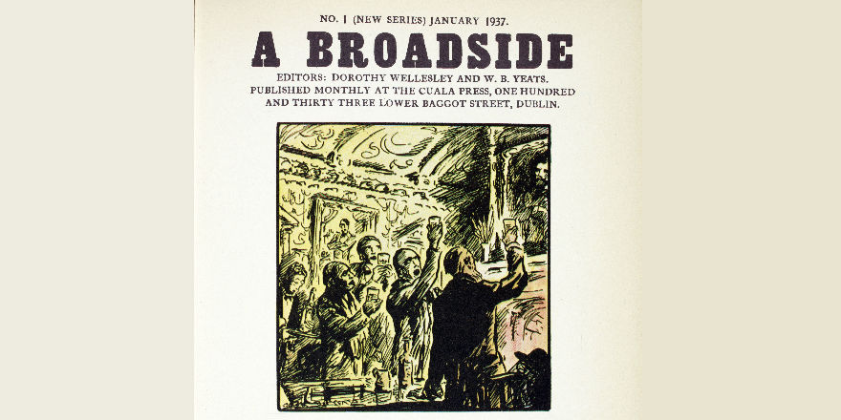
Phases of Jack Butler Yeats’ Work
In Yeats’ paintings there is always something “going on”. His first phase was the illustration phase, in the 1920s Yeats made drawings for newspapers

Slide 5
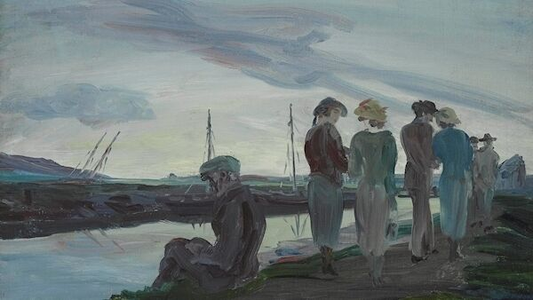
Phases of Jack Butler Yeats’ Work
In his second phase Jack had started to paint. During this phase the main focus of his painting were the drawings and lines rather than colours.

Slide 6
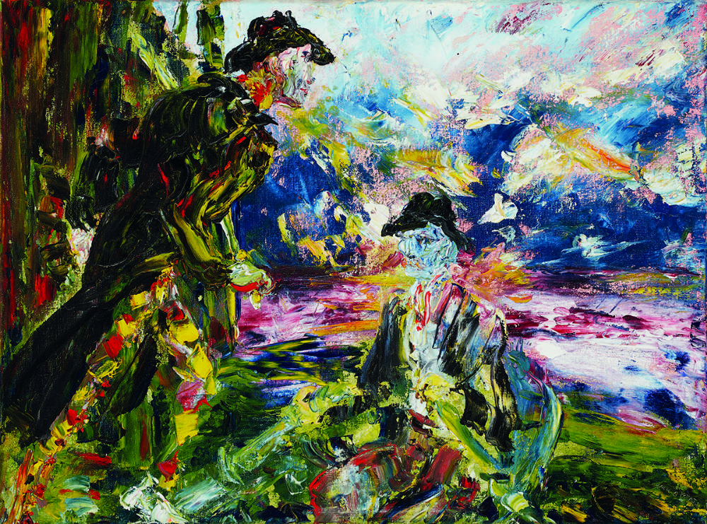
Phases of Jack Butler Yeats’ Work
In Jack’s third phase known as his optimistic phase the main focus of his art shifted greatly and was centred more around bright colours and loose, free lines.

Slide 7
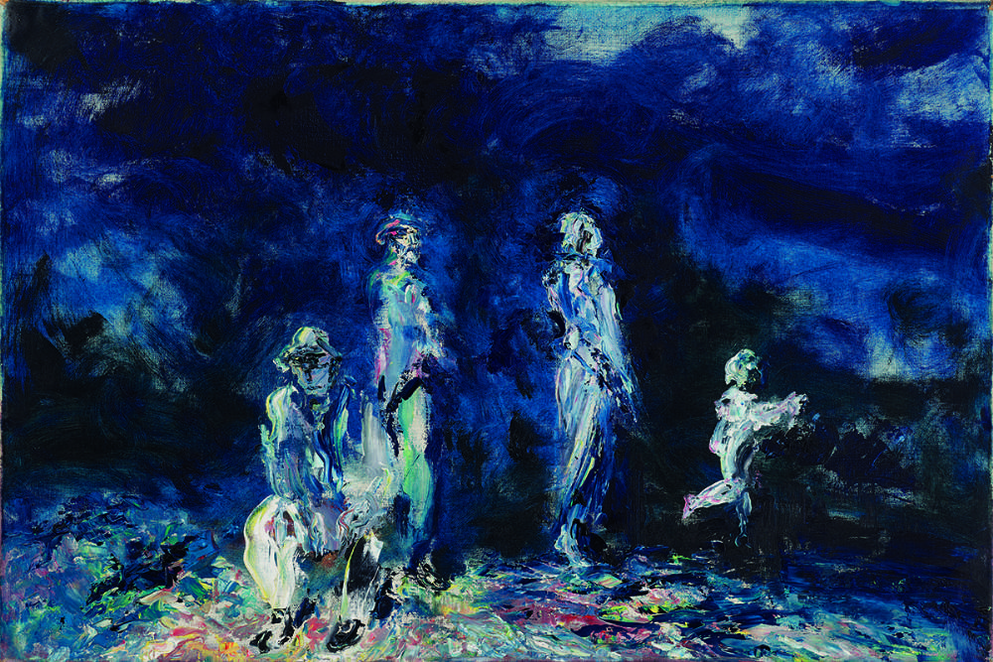
Phases of Jack Butler Yeats’ Work
Yeats’ fourth and final phase is known as his grief phase, in this phase Yeats’ art had a pessimistic tone, this phase took place before his death.

Slide 8
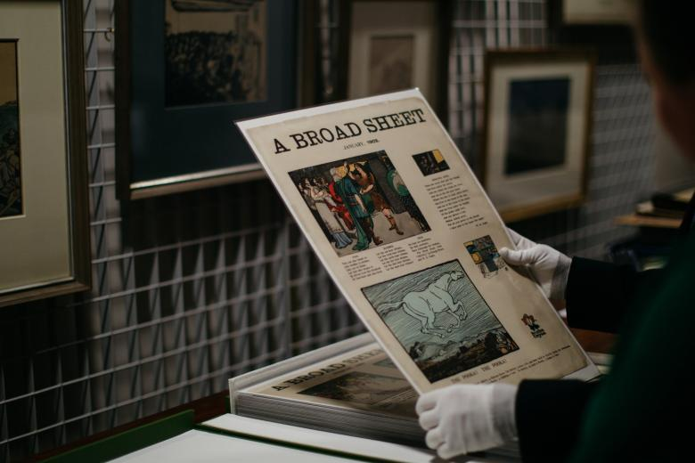
Jack Butler Yeats’ Archive
Yeats’ personal archive is on display in the National Gallery of Ireland. This includes his sketchbooks.

