Slide 1
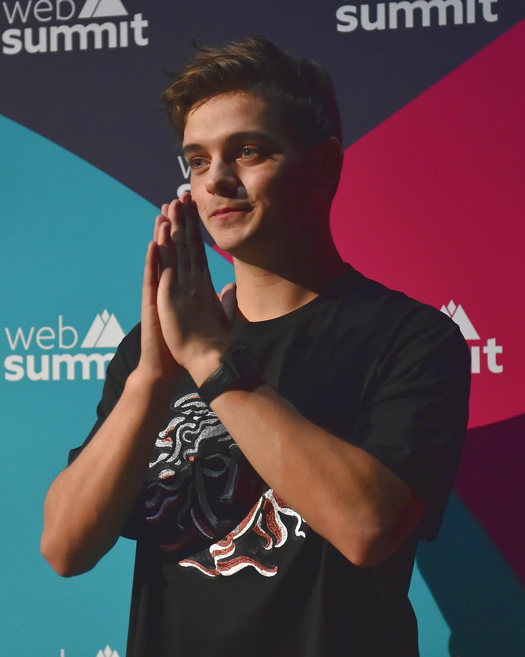
martin garrix
hi, i am martin garrix. i will lead you, click space to get to the next page 🙂
made by Thom and Ralf
From : The Weijerwereld Grade 8

Slide 2
Contents
Preface
Contents
Basic Information
Fun facts
Career
Family
Awards
Bekendste nummers
Final word
here are the subjects

Slide 3
Basic information
here is some information about me
Artist name : Martin Garrix
Real name : Martin Gerard Garritsen
Country : The Netherlands
Born : 14 mei 1996 Amstelveen
Age 26 years old

Slide 4
fun facts
-i had an interest in music from a early age, started playing the guitar at the age of 8
-my favorite meal is pizza with mushrooms, truffles, and cheese; i can’t resist it
-i can sleep anywhere and anytime, i am a boss at sleeping. Really convenient in my job
-i was just 17-years-old when i released “Animals”.
fun facts :-)

Slide 5
career
2012 : He start his career
2013-2014 : His talent is noticed by Tiësto.
One of his first songs is Animals. ever since he is famous
And he makes many songs, That are still known
About 5 Months ago, he performed at the triumph of Max Verstappen

Slide 6
Family
Dad : Gerard Garritsen
Mum : Karin Garritsen
Sister : Laura Garritsen
He does a lot with his family despite being so famous.
He still goes on holiday with family and friends very often

Slide 7
Awards
2012 : Slam!FM Dj Talent of the Year
2013 : First dutchman on 1 of the charts in Great Brittian
2014 : Platinum plate for the song : Animals
2015 : Best electronic act
2016 : Best global DJ
2017 : Single of the year
2018 : Best song
2019 : Best male artist
2020 : Best male artist

Slide 8
Most famous songs
Animals
In the name of love
Scared to be loney
No sleep
Tremor

Slide 9
Finish Word
I hope you learned something from this presentation.
At least we learned from it
i wish you the best

