Slide 1
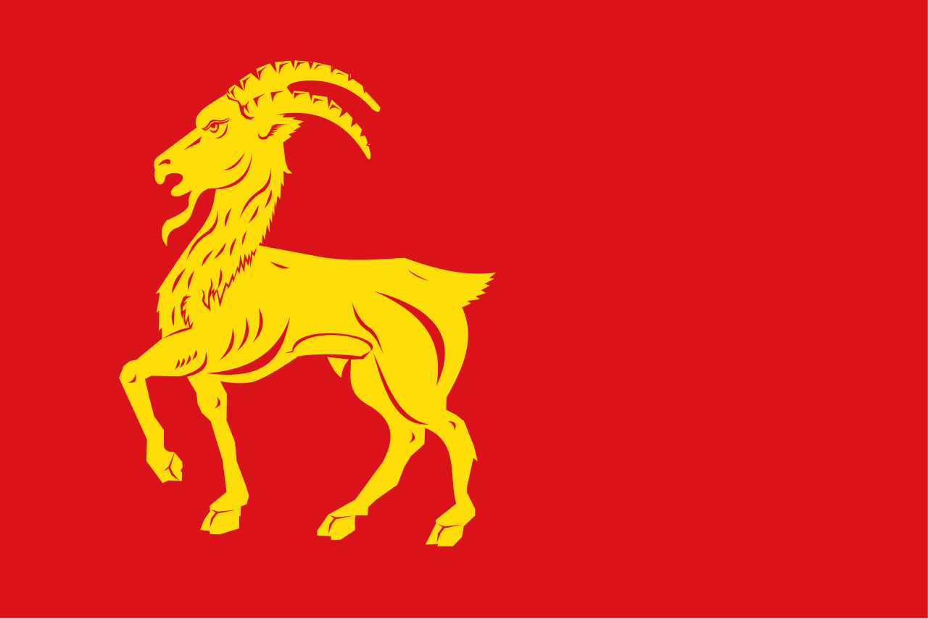
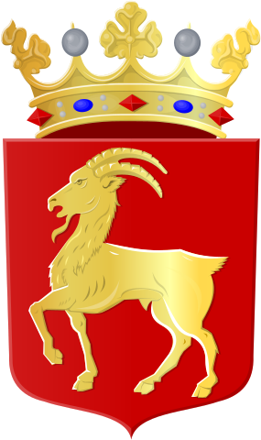
Boxmeer

Slide 2
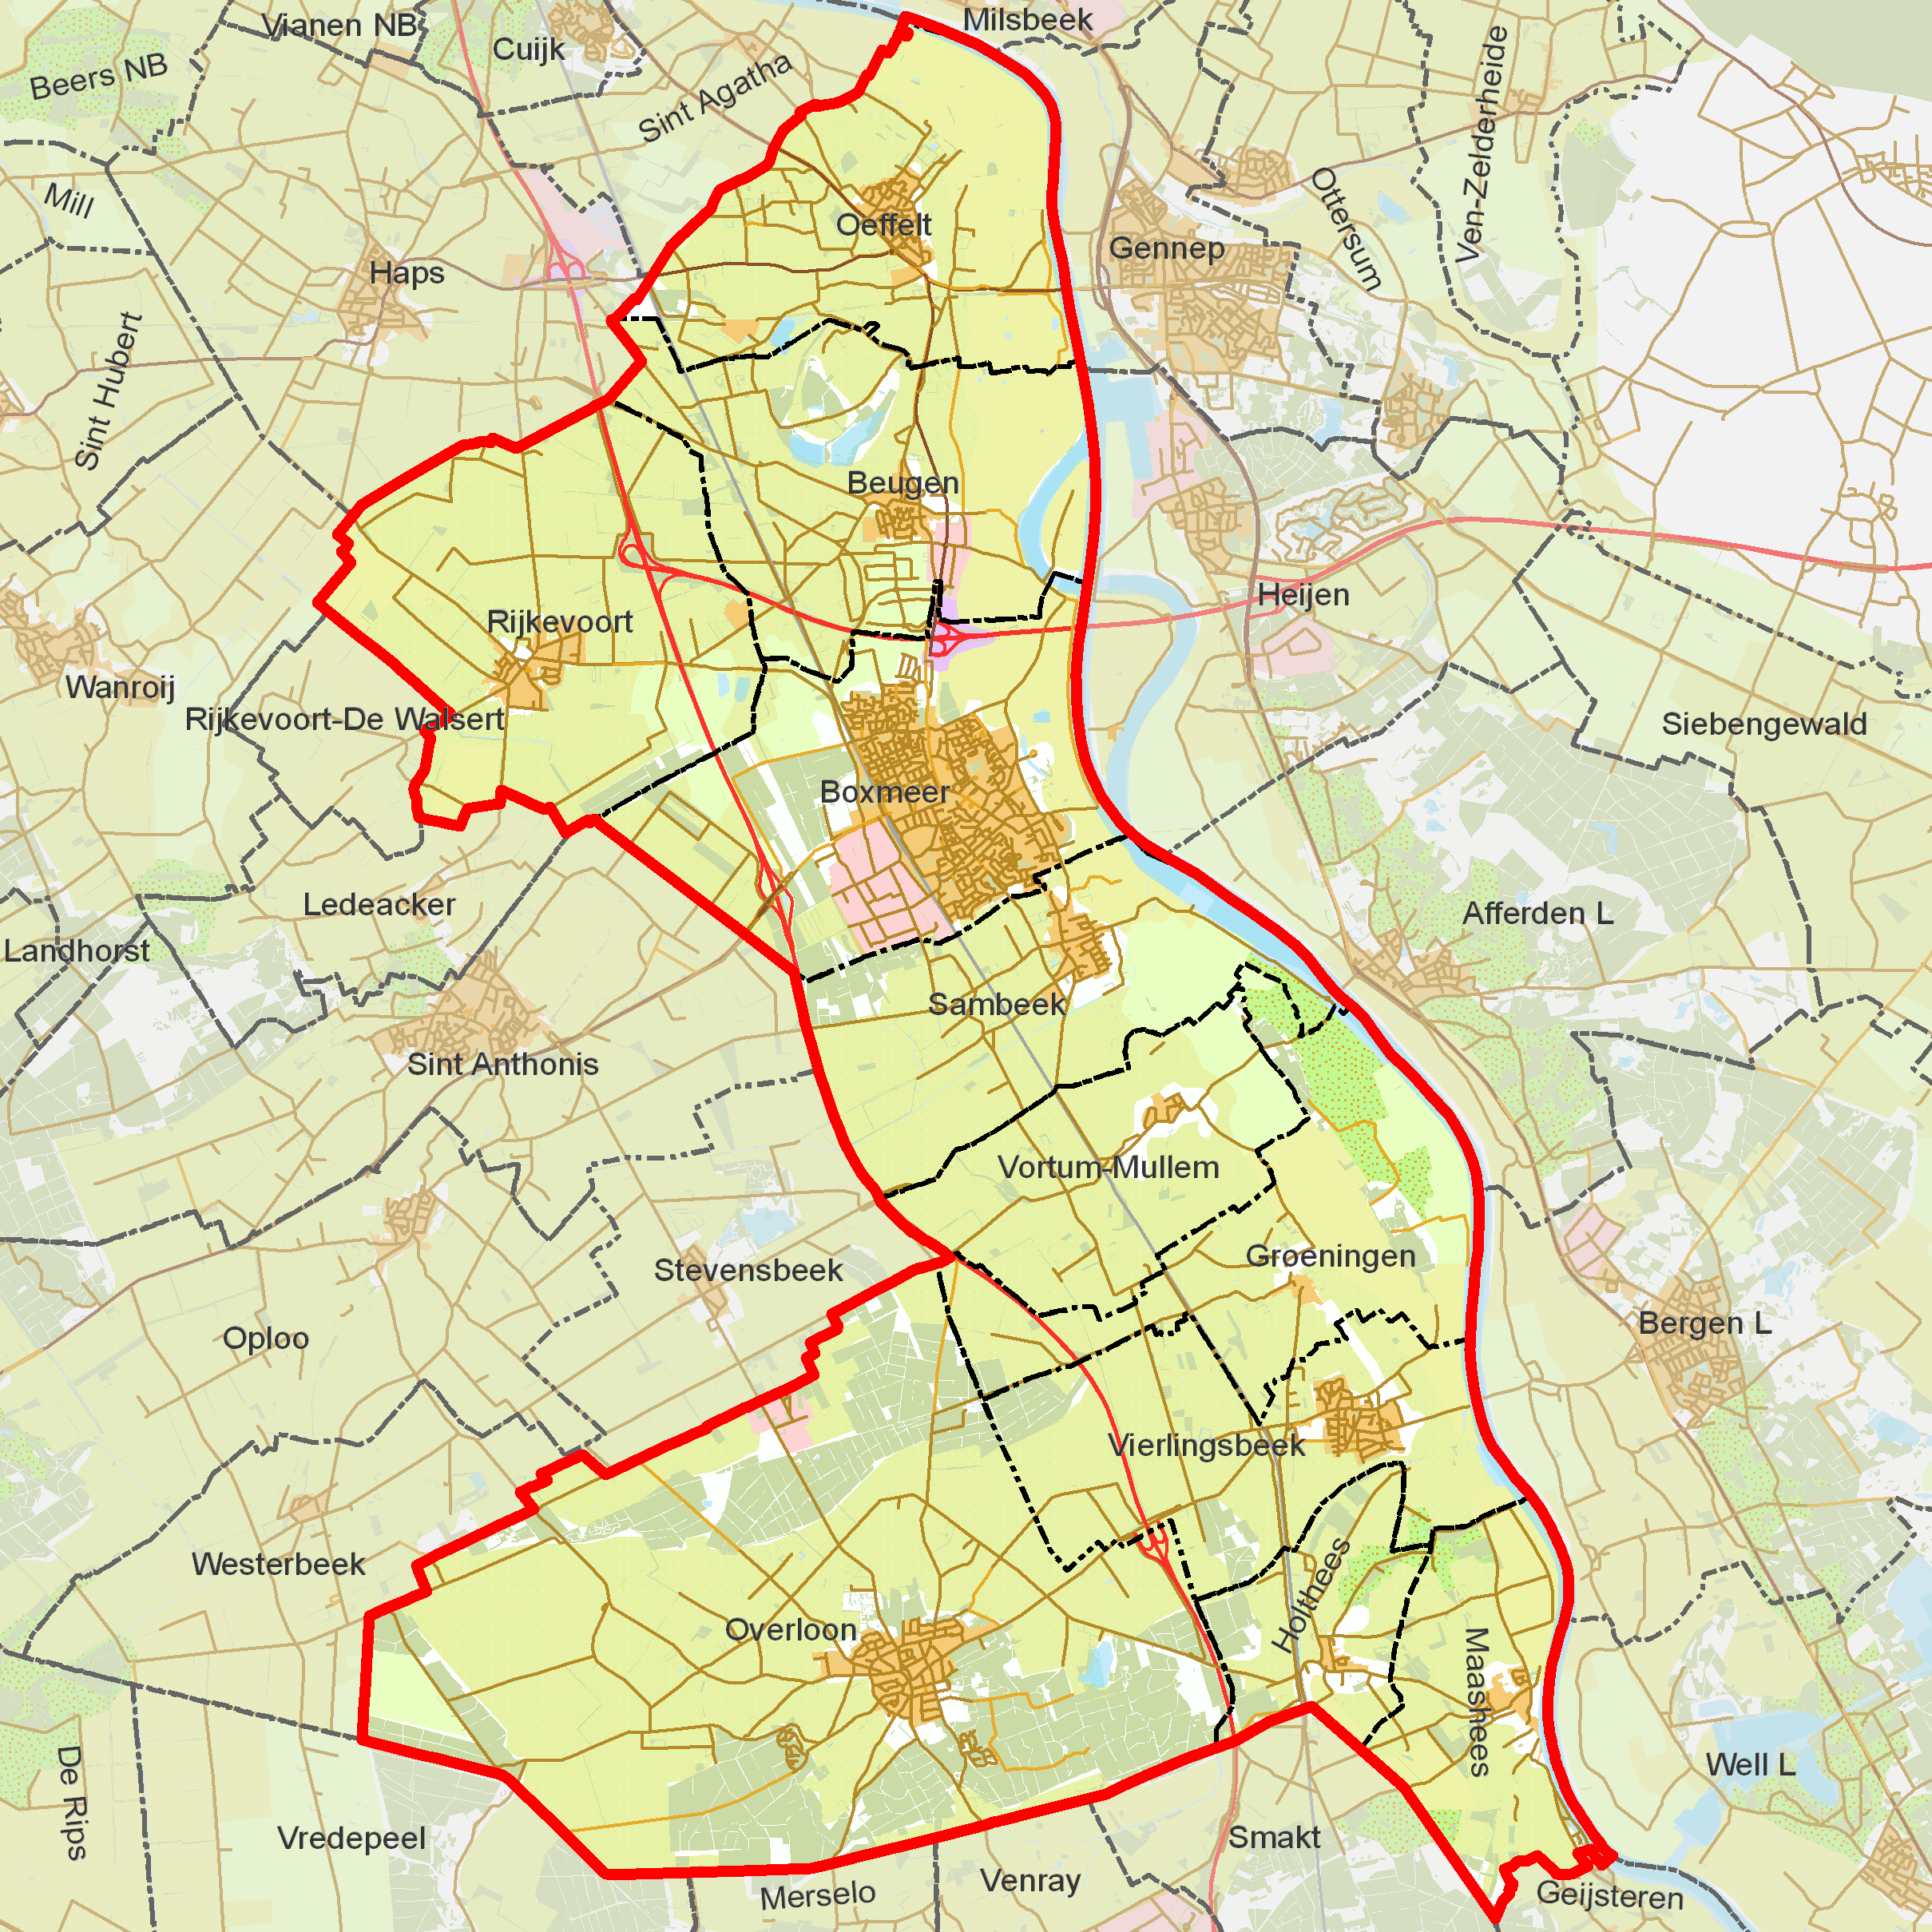

Slide 3
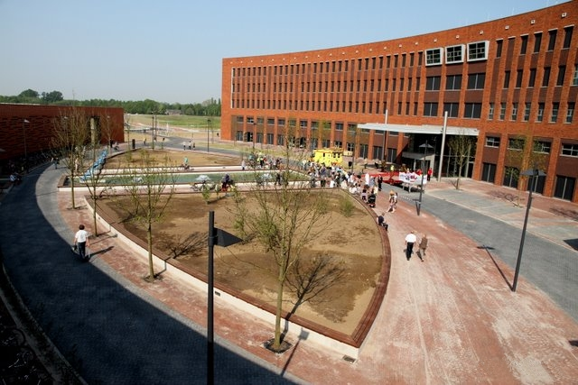
Hospital Boxmeer

Slide 4
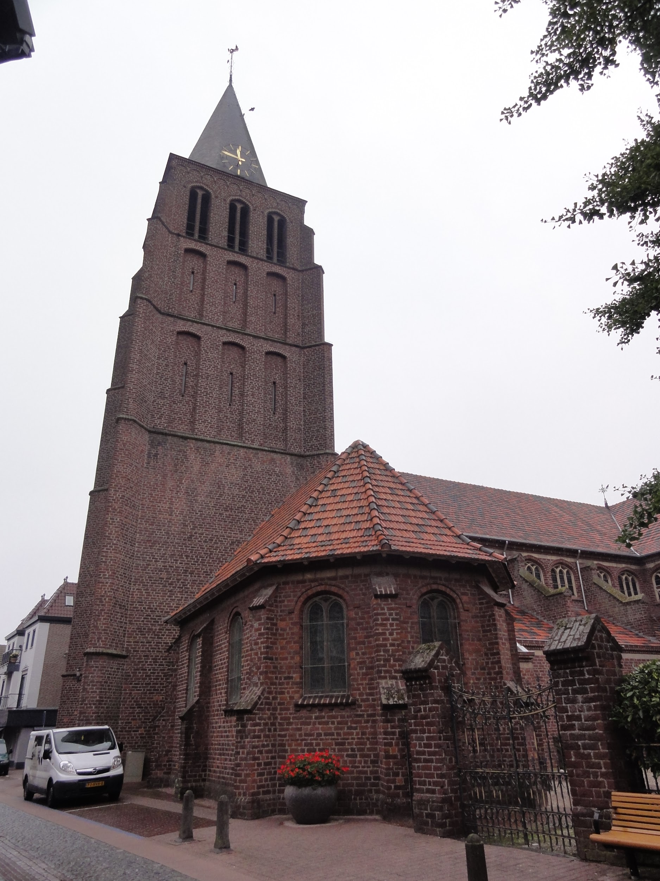
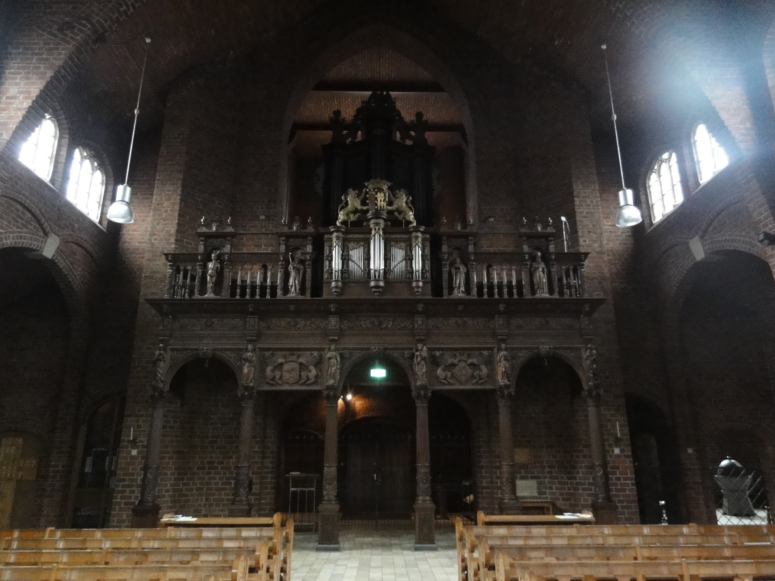
<Church Boxmeer Inside church Boxmeer^

Slide 5
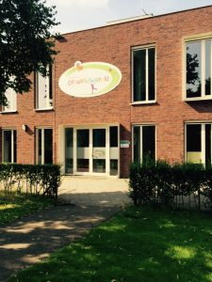

de Weijerwereld;)

Slide 6
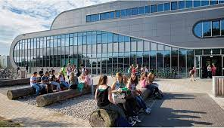
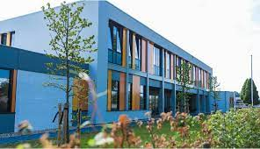

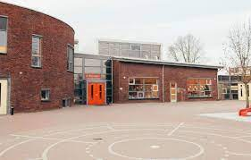
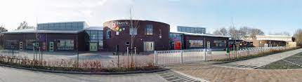
Other schools in Boxmeer
Metameer(secondary school) Elzendaal(secondary school) De Peppels/Canadas(elementary school) De Bonckert(elementary school) De Bakelgeert(elementary school)

Slide 7
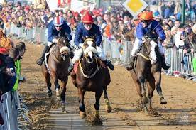
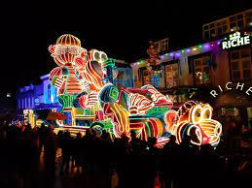
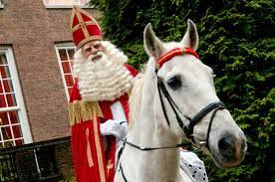
Traditions
Metworst
Carnival
Siant Nicholas

Slide 8
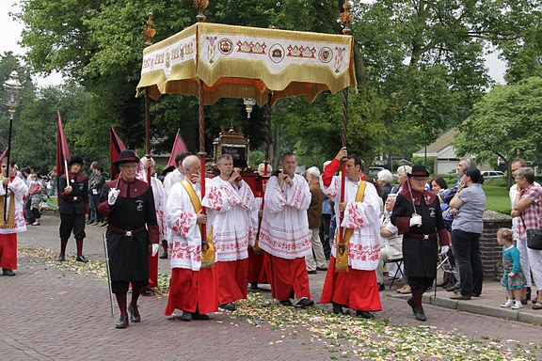
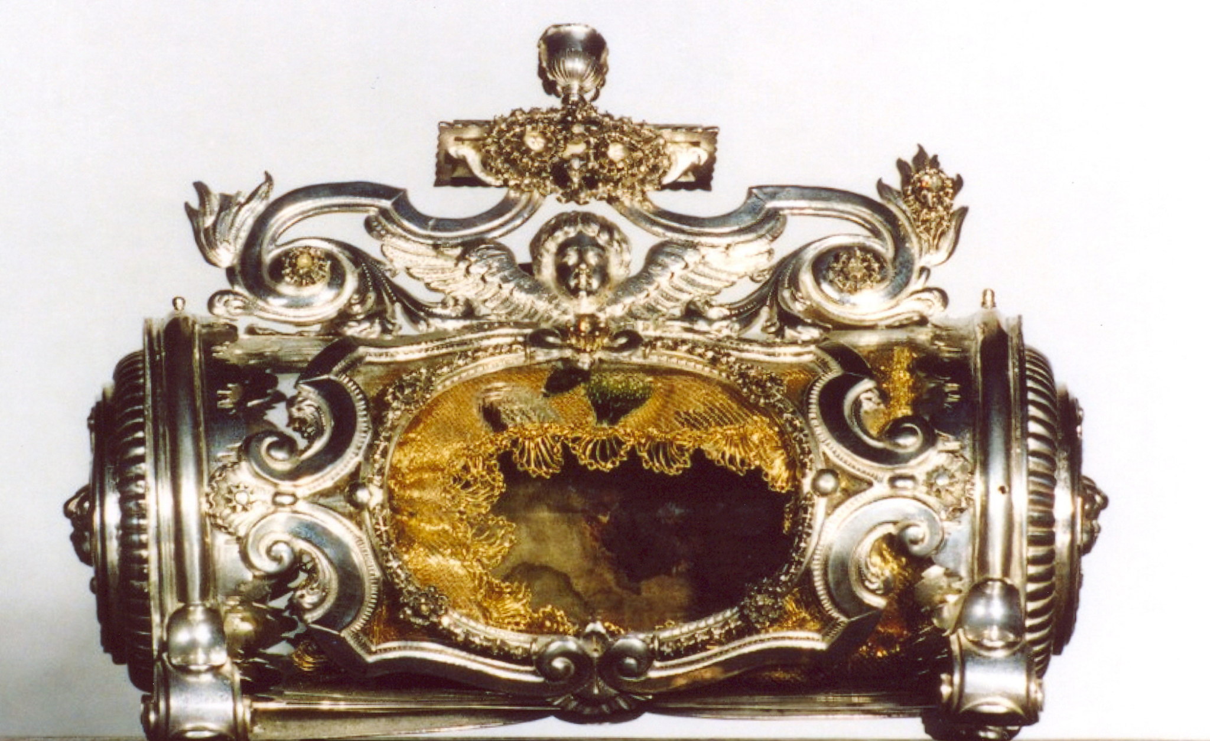
De Vaart
De Vaart is a journey for the Holy Blood. It has to do with Jesus. It used to be and still is very sacred to many people.
The tour goes through all of Boxmeer.
It has been around for about 600 years. It started around 1400.
The Origin of the Holy Blood: It happened when the priest thought that Jesus today was the form of bread and wine. Then the wine bubbled up and overflowed and turned to blood. That's very sacred to some people.
Holy Blood The Vaart

Slide 9
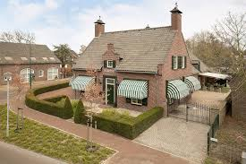
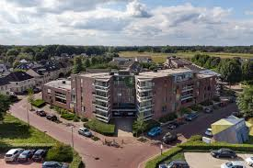
Houses Boxmeer

Slide 10
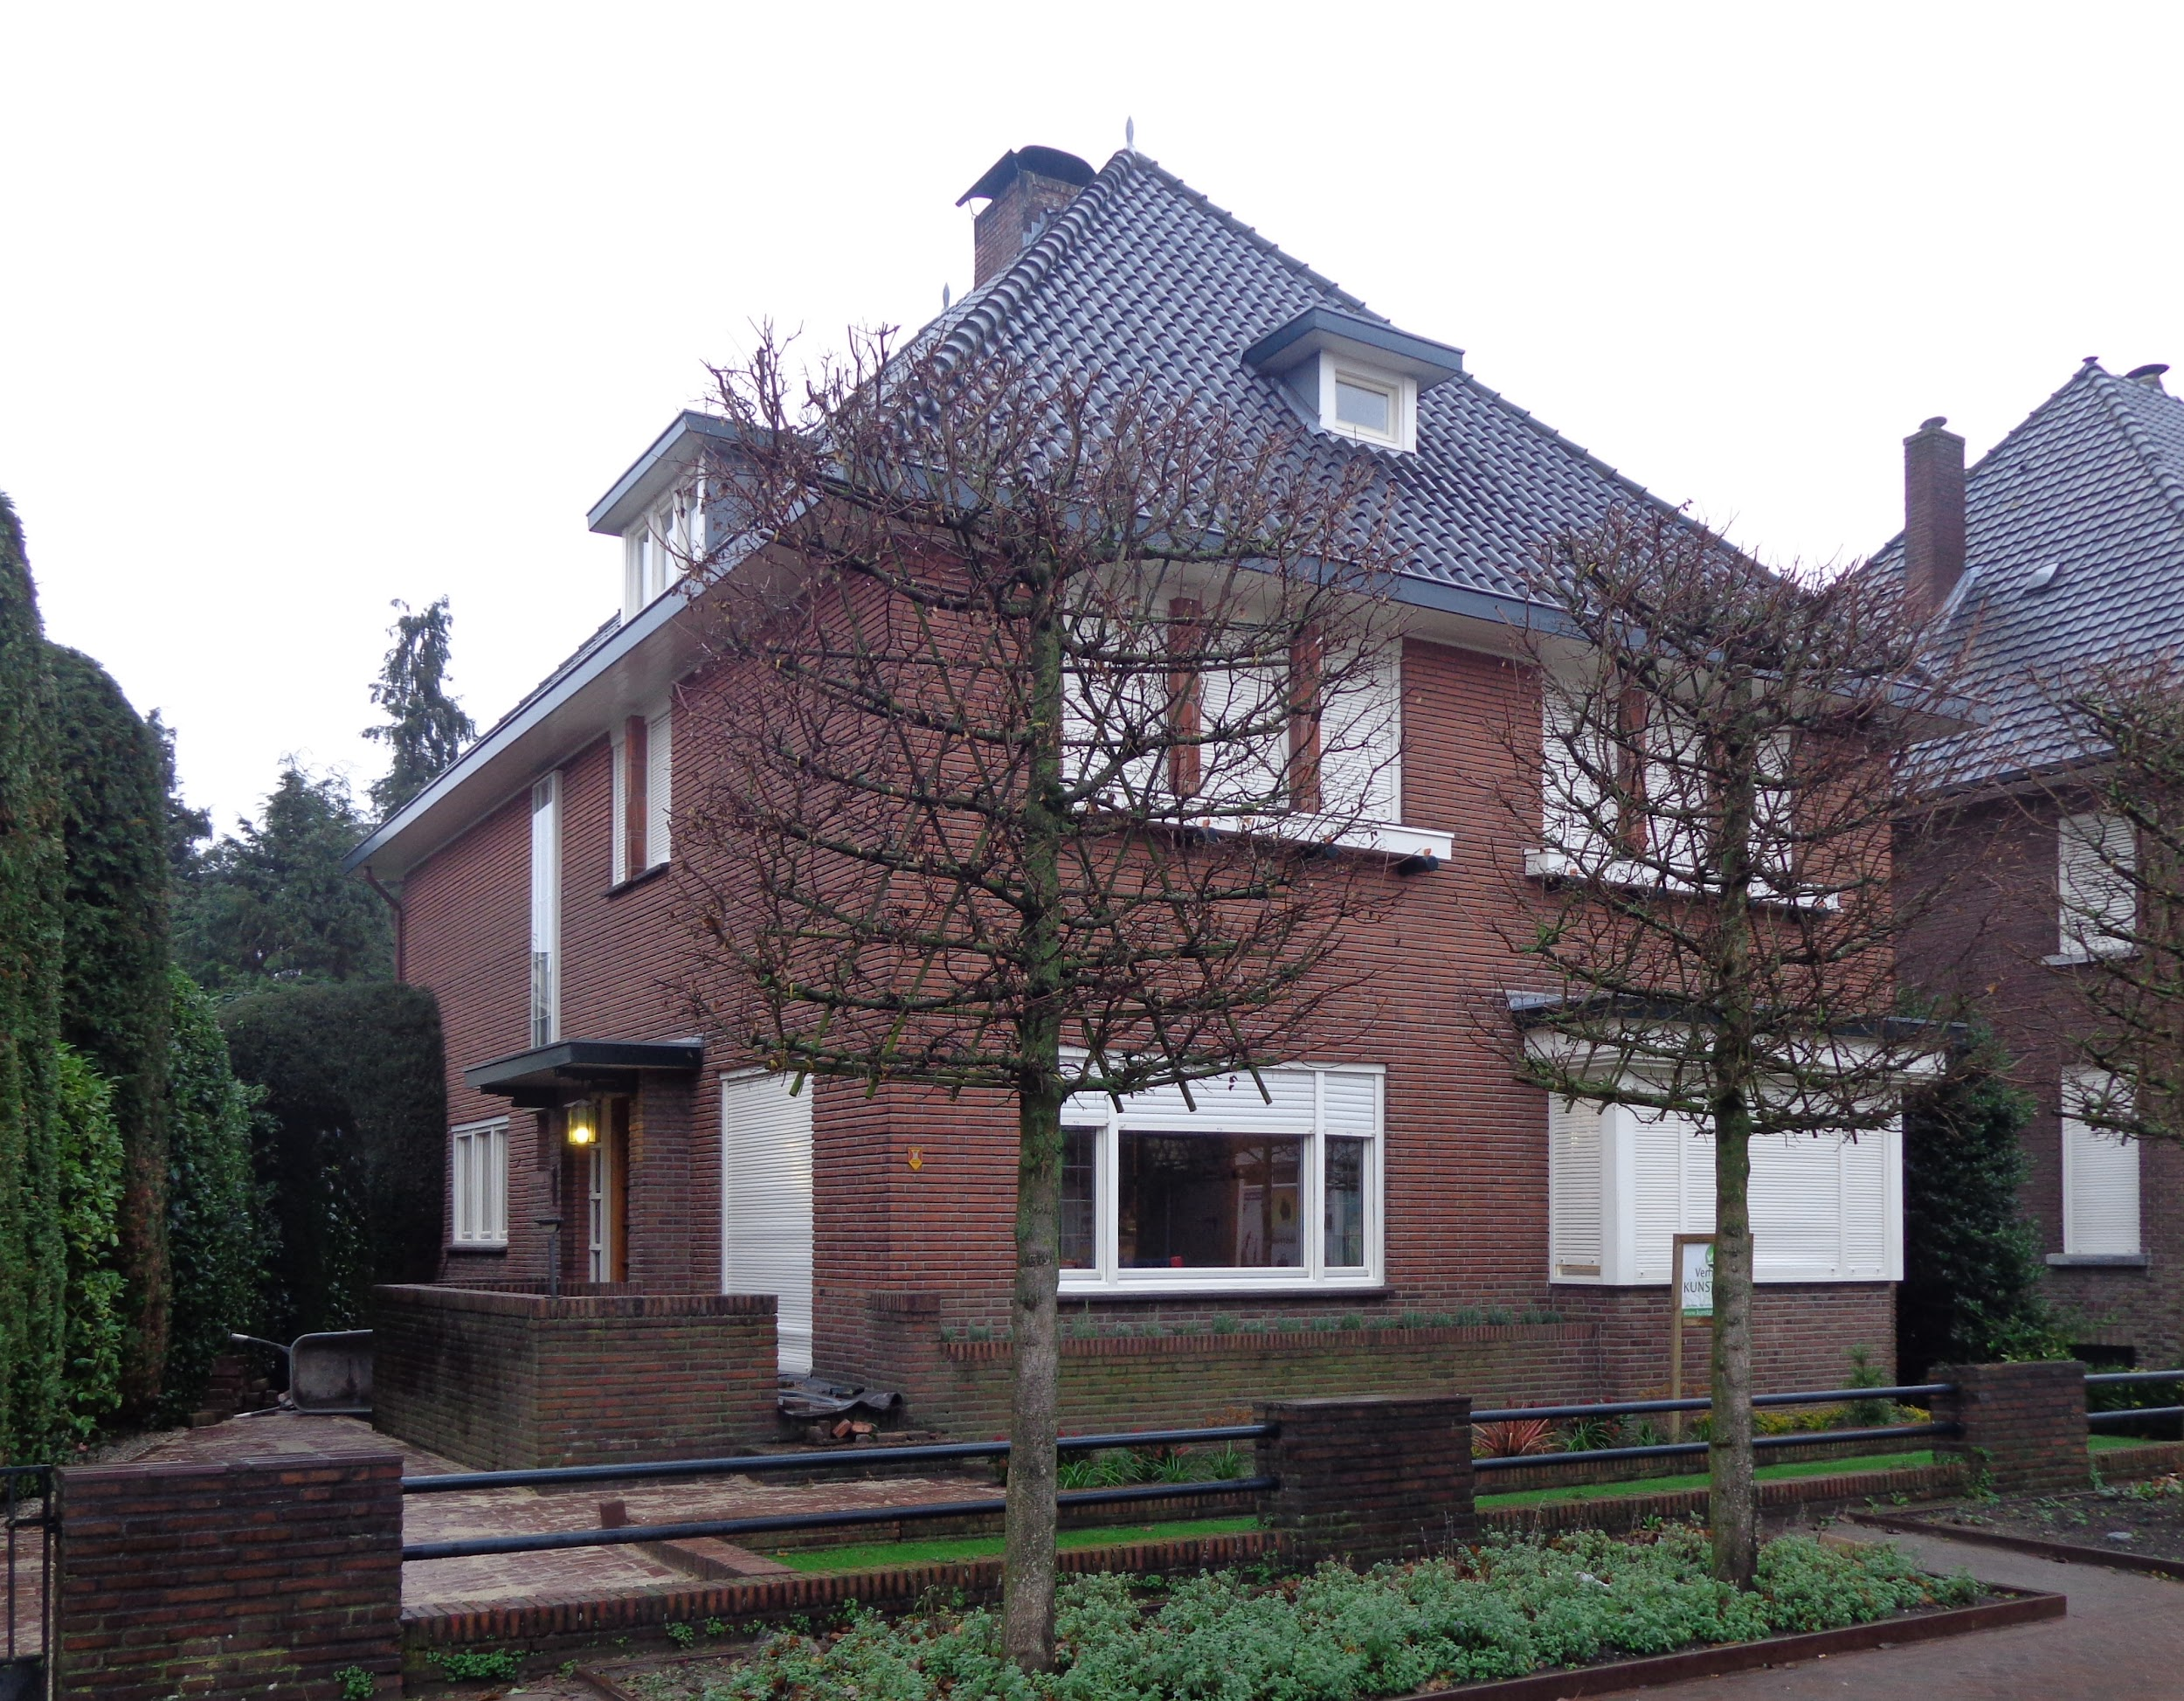
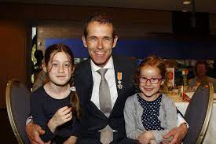
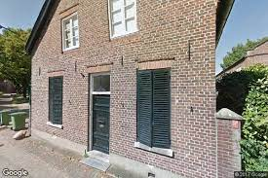
Houses Boxmeer (Part 2)

Slide 11
The End

