Slide 1
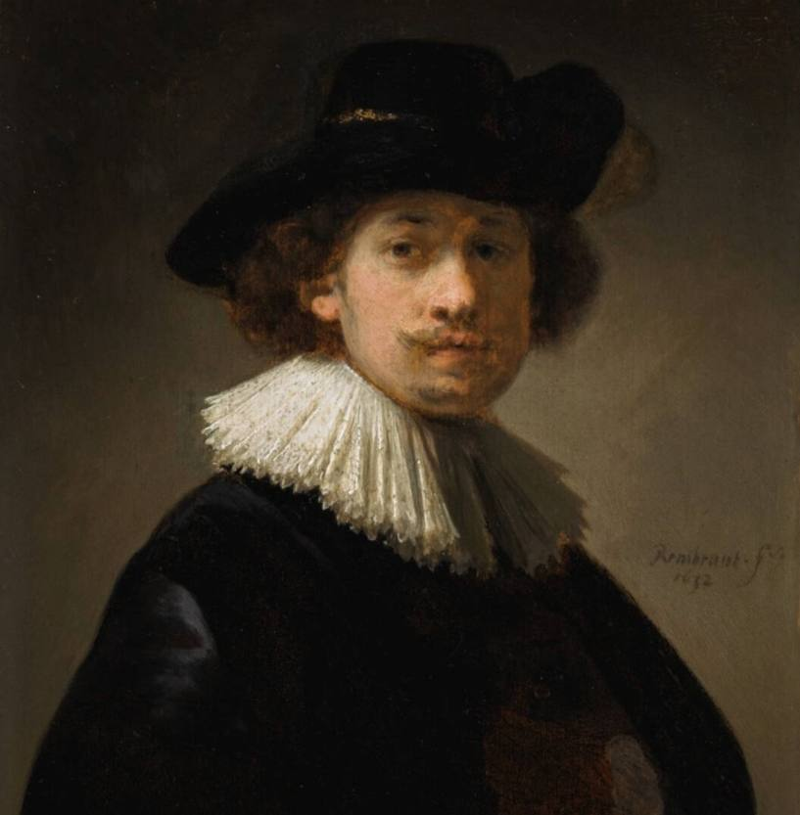
Rembrandt
van
Rijn
Made by: Mohammed and Julia

Slide 2
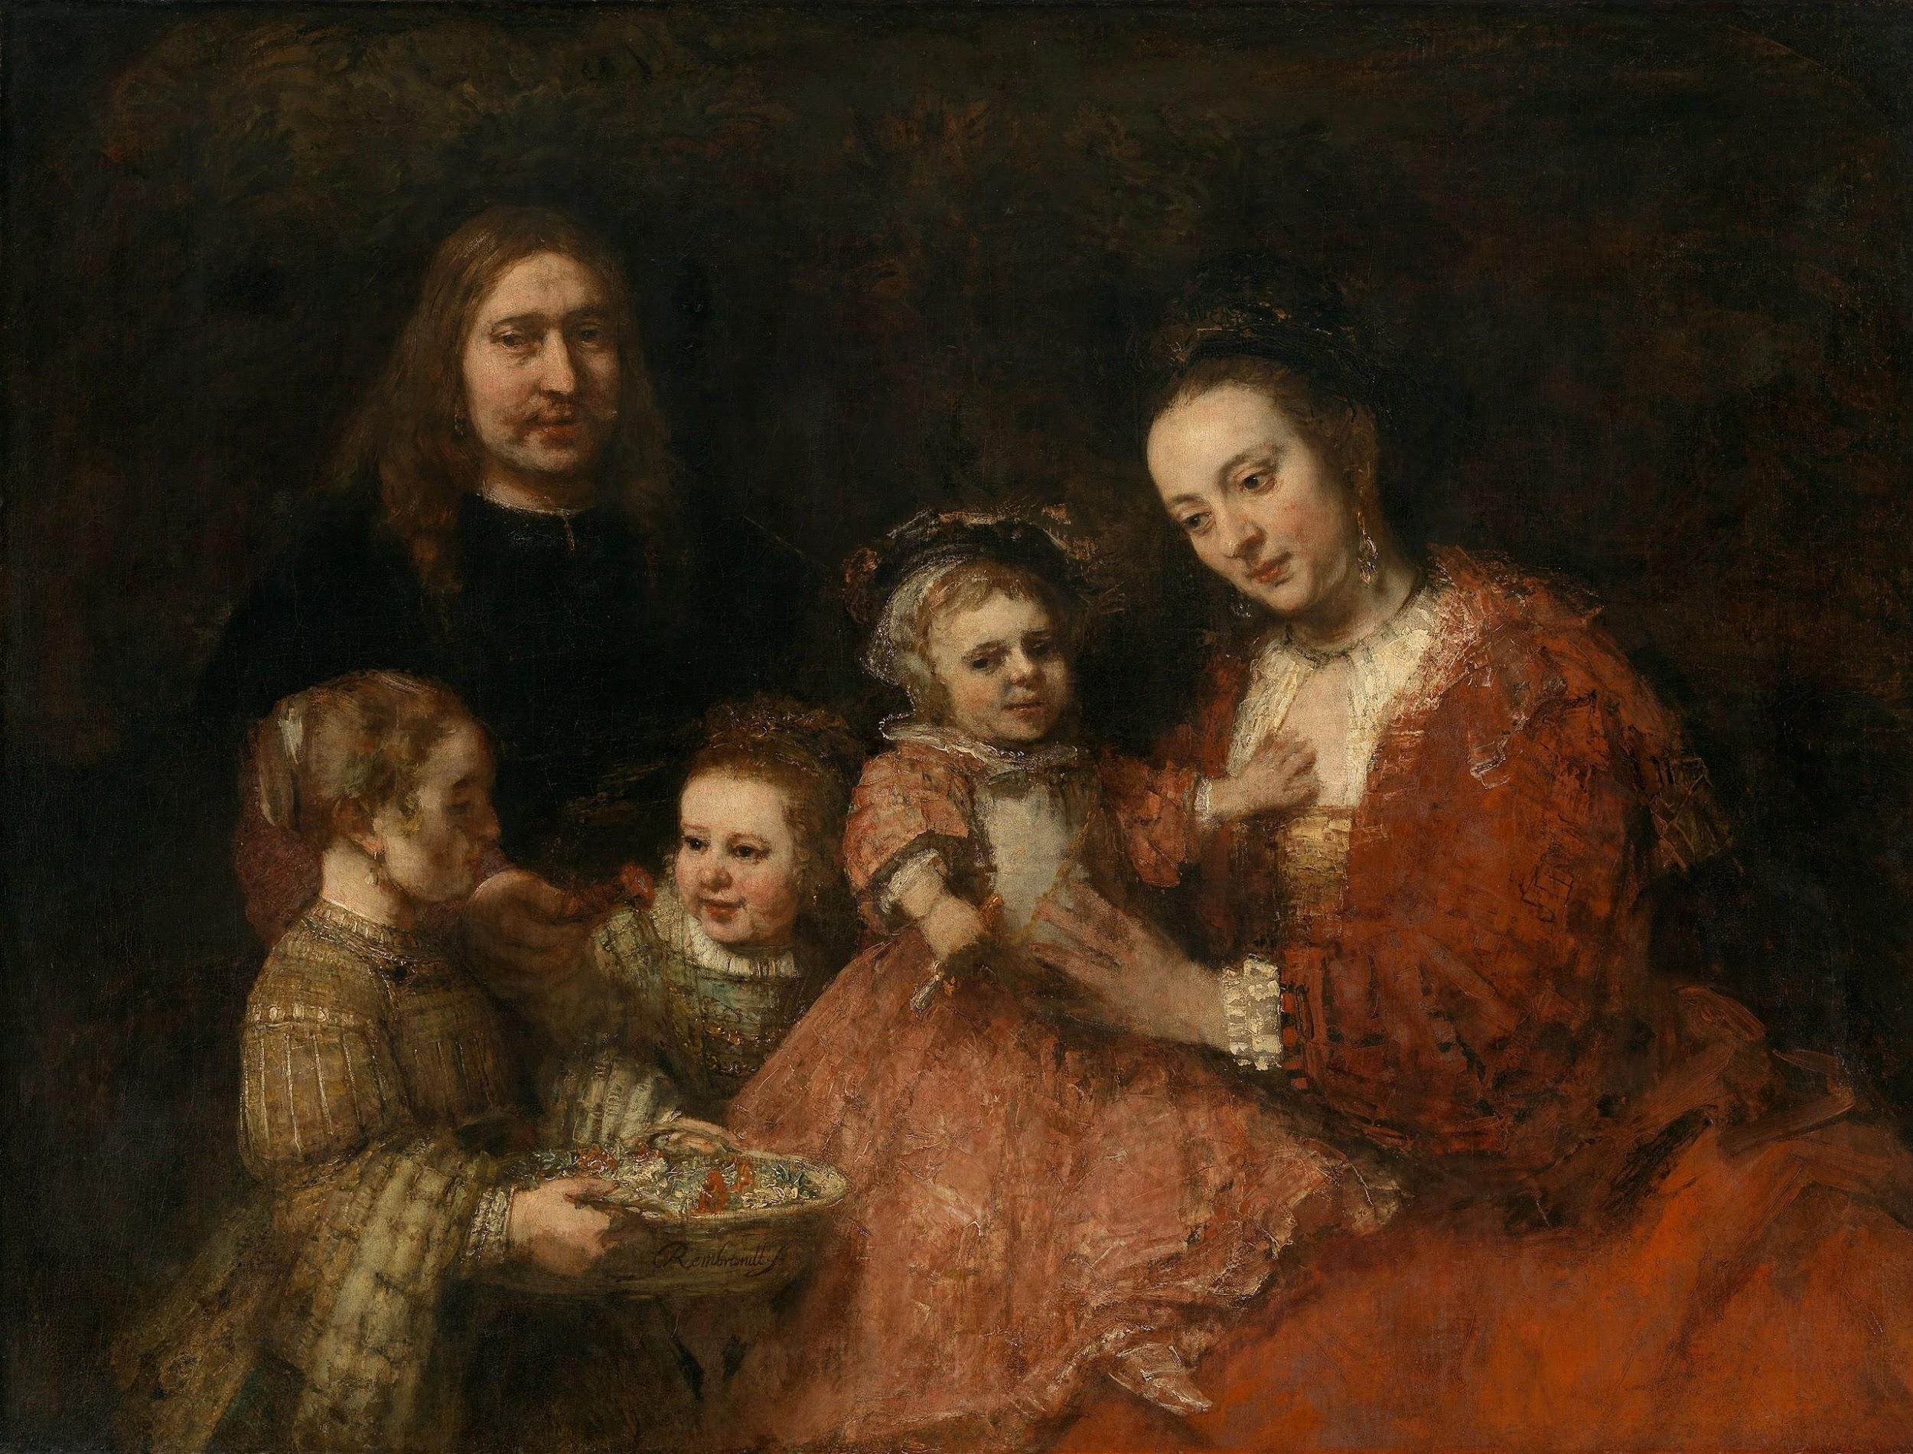
Facts about Rembrandt Van Rijn
Rembrandt lived in the 17th century
He`s wife was
Saskia Uylenburgh
Click the site
He made 300 paintings
Rembrandt van Rijn had 3 children
The family of Rembrandt van Rijn
He was born on 15 july 1606
It took him 2 years to end the Nightwatchman
He died in 4 October 1669
His first painting was the four senses 1642
On of his most popular paintings is The Nightwatchman
The children of Rembrandt are: Titus - Cornelia - Rumbartus

Slide 3
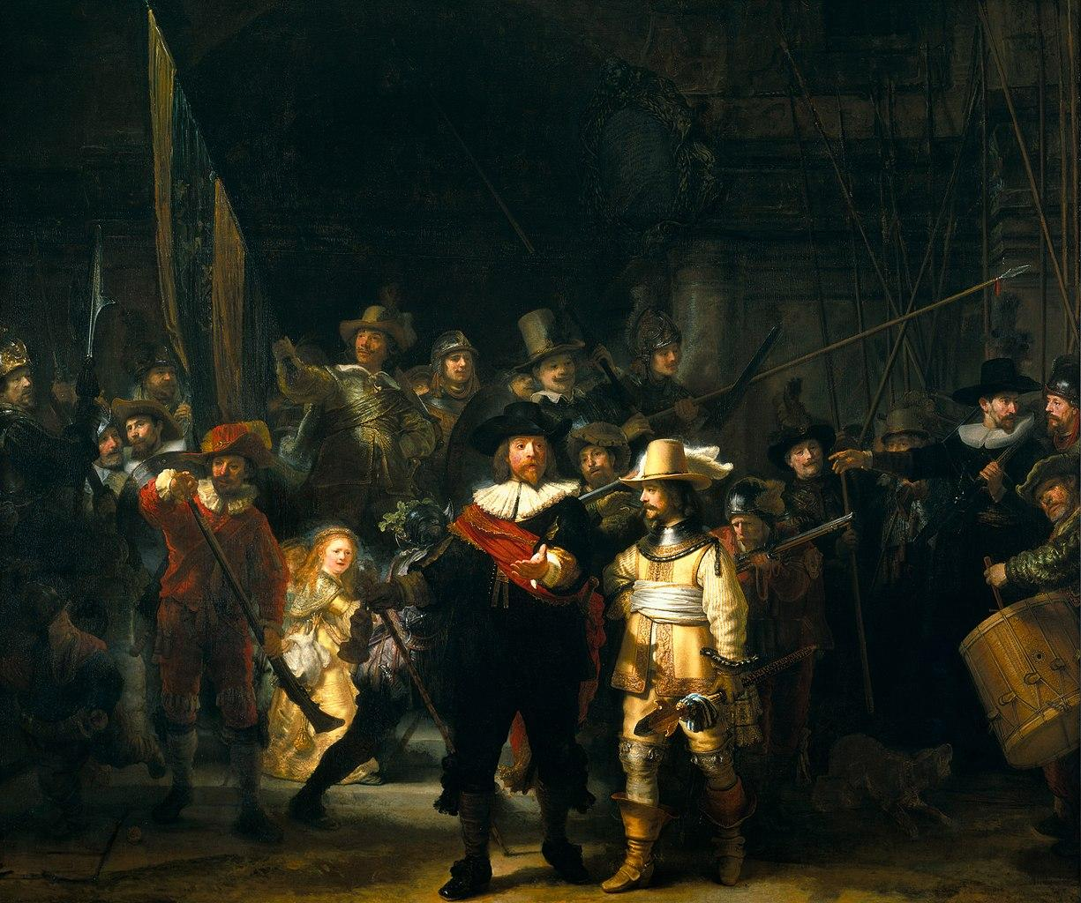
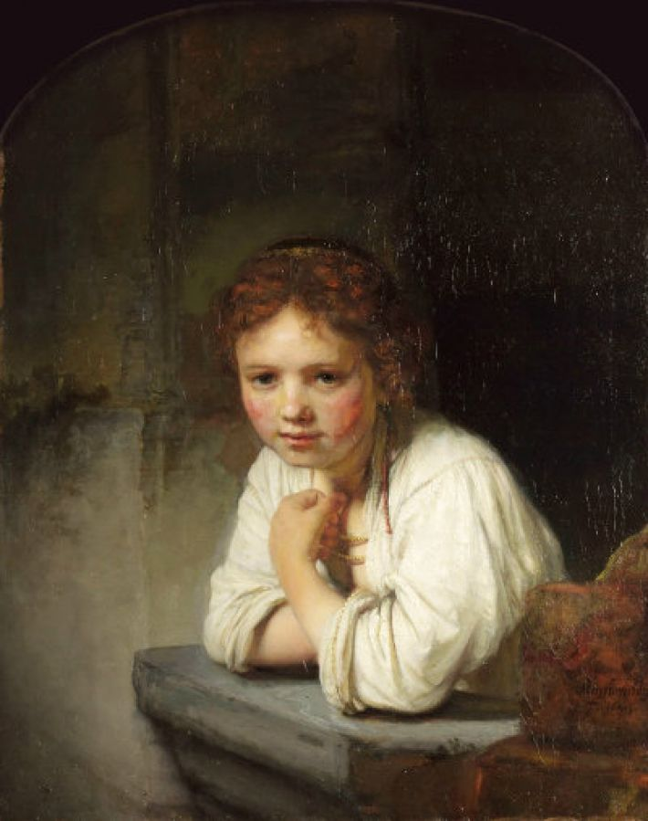
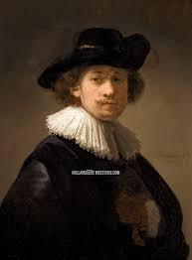
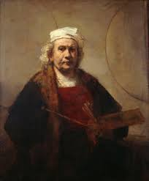
Young girl at the window
The nightwatchman
Jong meisje bij het raam
De Nachtwacht
Most famous paintings
Rembrandt van Rijn’s last painting
Self-portrait
with collar and black had
Zelfportret met kraag en zwarte hoed
Rembrandt van Rijn
laatste schilderij

Slide 4


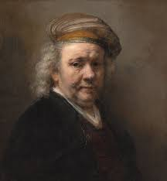
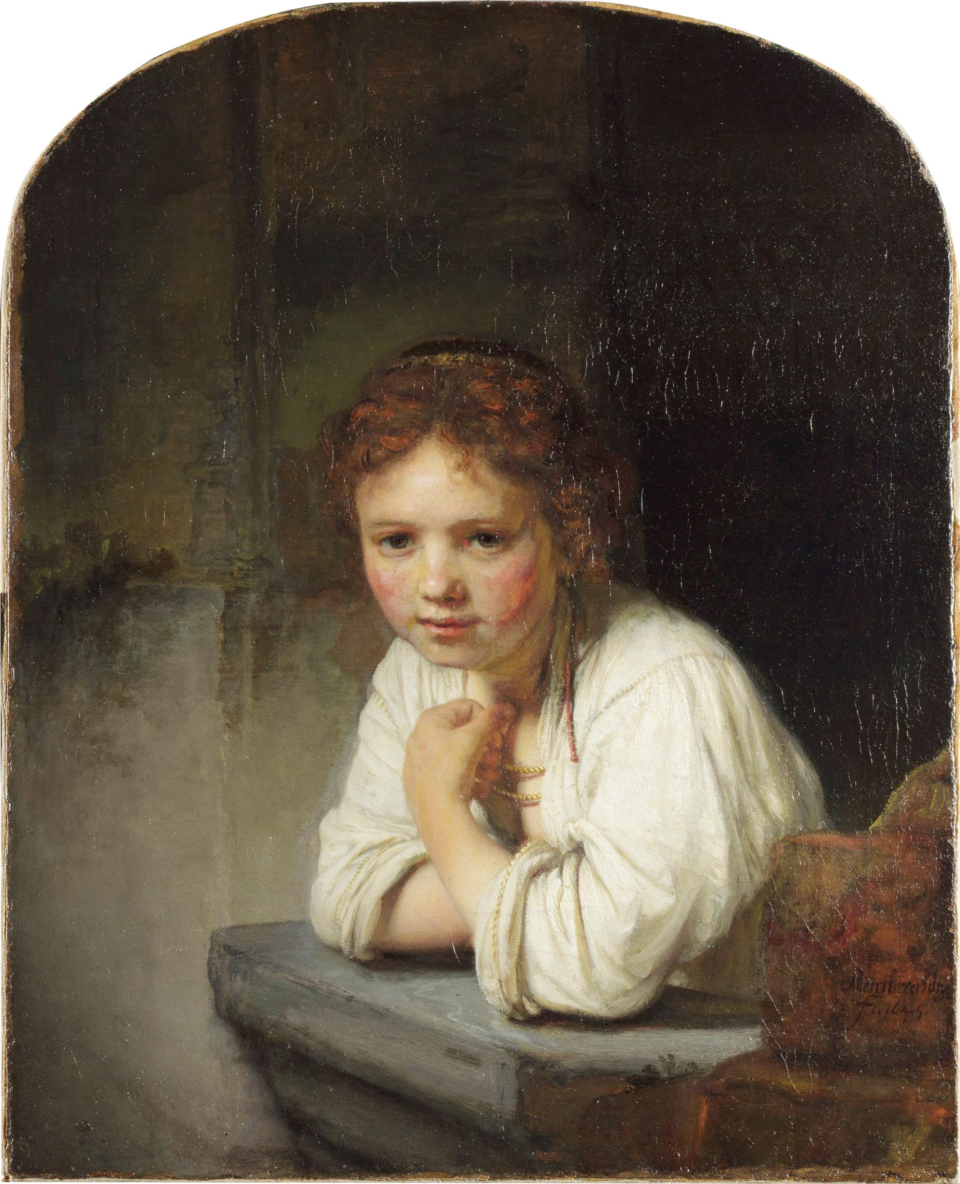
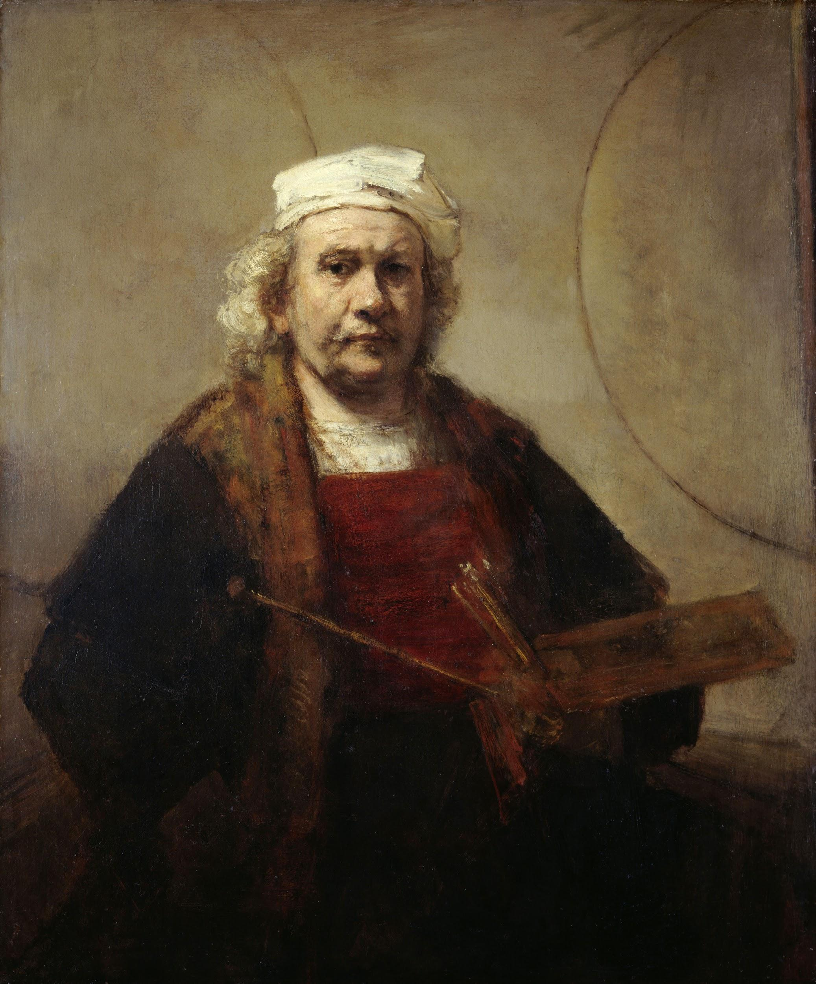
The end

