Slide 1
Women’s day
08 March 2021

Slide 2


That day men give women a little presents or flowers.

Slide 3
That day is only once in the year !!!
Don’t forget about women !!!
It is their day !!!

Slide 4
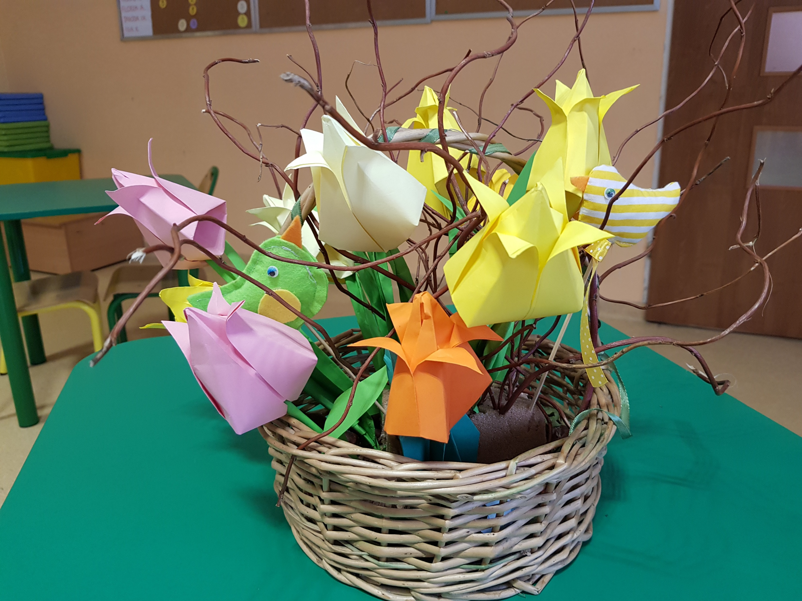
In school we make paper flowers for women.

Slide 5
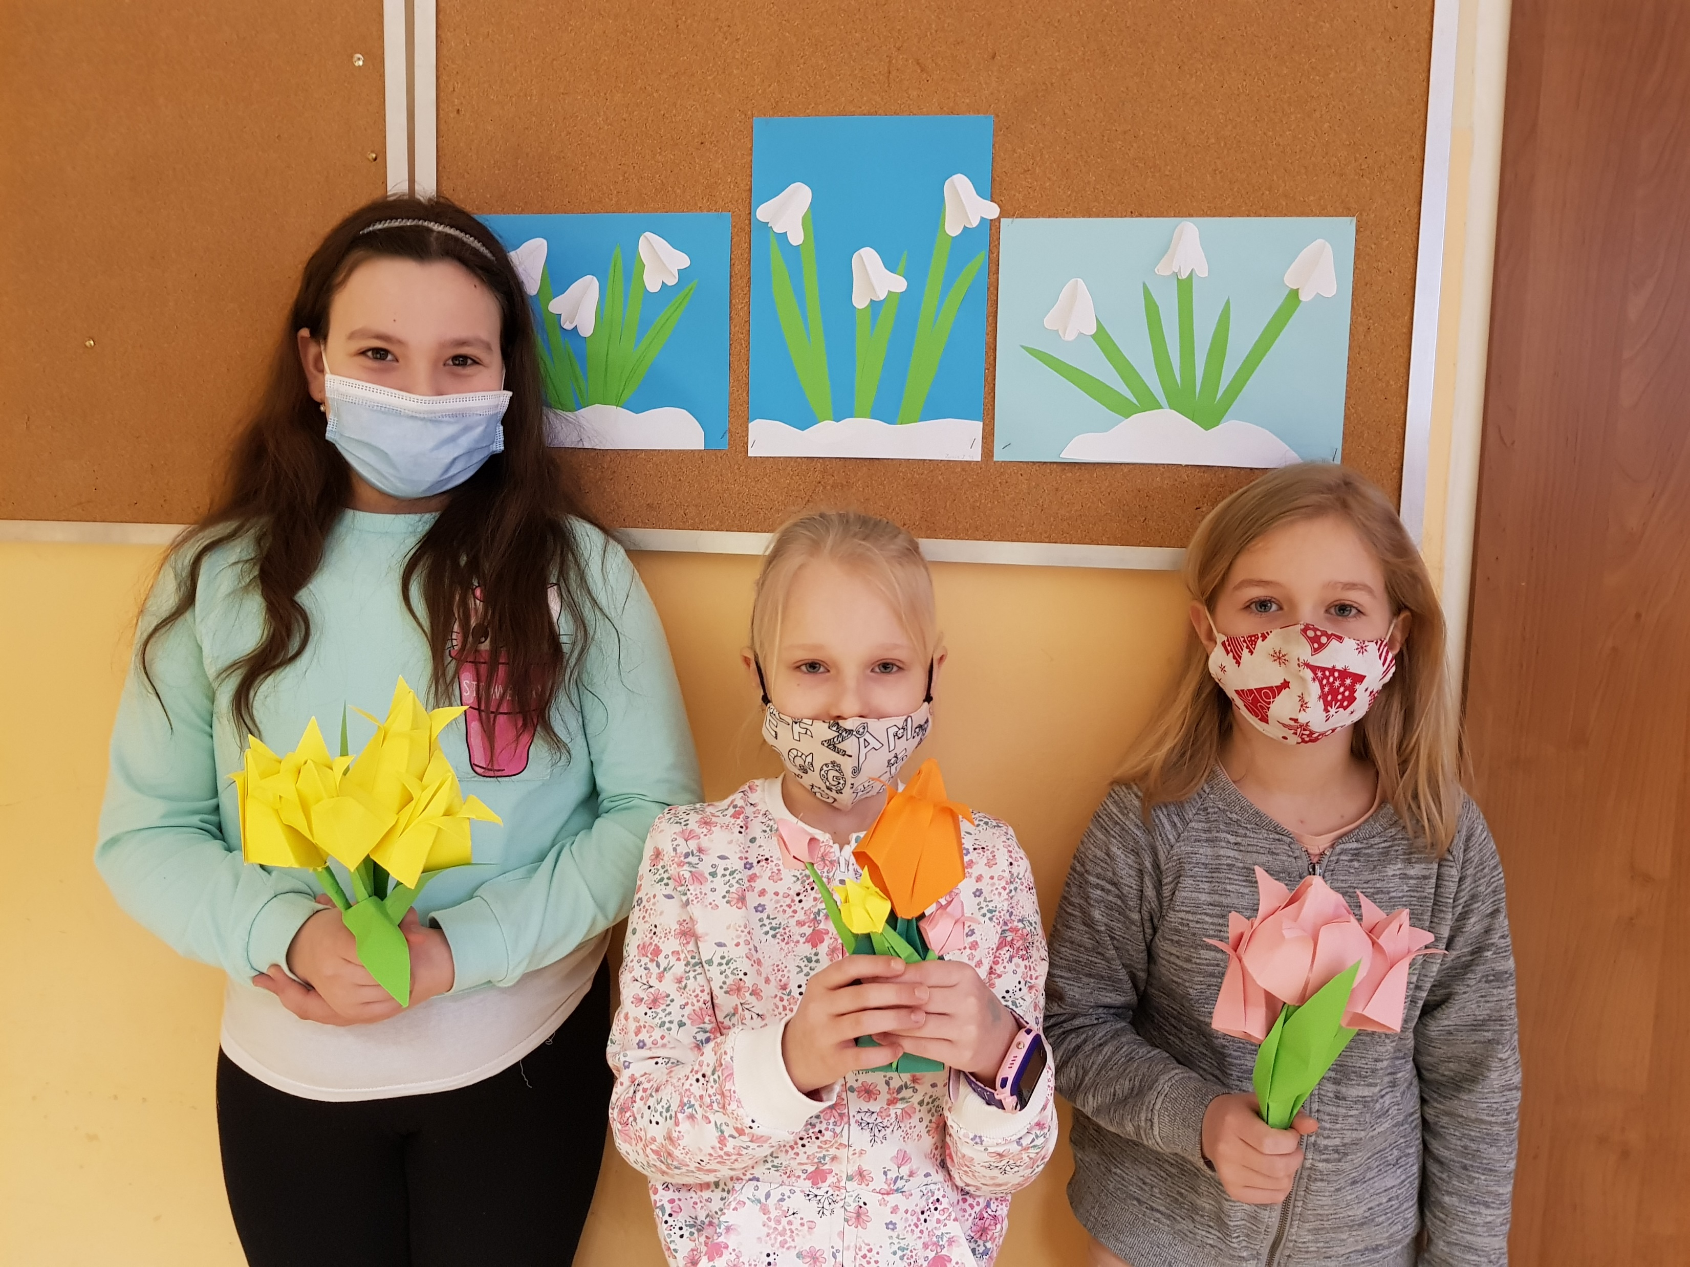

Slide 6
Women love that day!

